Slide 1

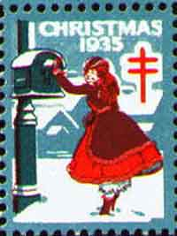

Seal Mail
or Seals that Carried the Mail and Shouldn’t Have.
By Florence Wright
Updated 2026

Slide 2

Several years ago, the Christmas Seal and Charity Stamp Society published an article in its journal, Seal News, which described mail legitimately carried by seals. I thought, what about mail not legally carried by seals? I approached several other members of the Seal Society and a few shared their examples of “seal mail" with me. Those combined with the examples I owned seemed good enough to share – so here we are!
If I have shown this here before and you remember it, you may take a nap – just don’t snore, please!

Slide 3
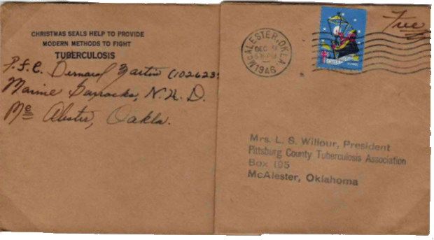
First, some examples of the legal use of seals…
Active military (shown) and members of Congress who had free franking
privileges.

Slide 4
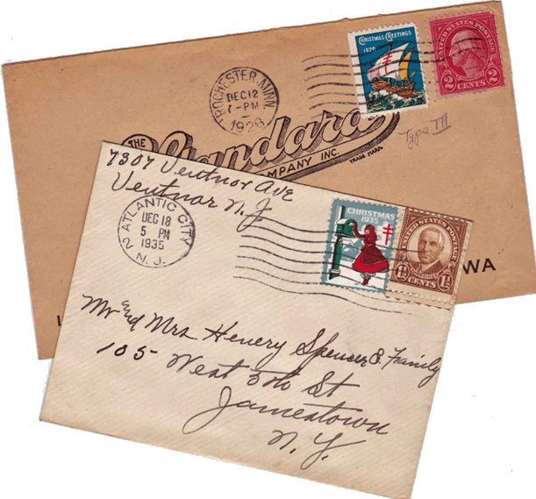

Also legal, bearing stamps…
Emily Bissell created the first U.S. Christmas seal in 1907. She prevailed on the local post office in Wilmington, Delaware to allow her and her helpers to sell them inside the lobby of the post office. She said, “These little seals will not carry any mail, but any mail will carry them.”
Type 2
The fact that these seals were sold in post offices for a penny – the same as the going rate for postcards – and were called at first ‘Christmas stamps,’ probably created some confusion. Often mail was posted only with a seal. Being the Christmas season, postal employees were either too busy to notice, or tolerant enough of this new idea to let them slide through.

Slide 5

The earliest example we’ve seen of a post card going through the mail with only a seal is this one. Here a Type I 1907 seal (often called a local seal) serves as the ‘stamp’ with a Dec. 24, 1907 postmark. The fact that it was a local Philadelphia mailing, and posted Christmas eve, probably helped it along.
Type 1

Slide 6
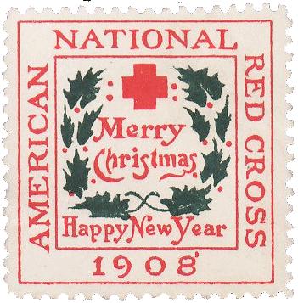
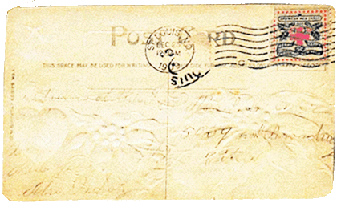
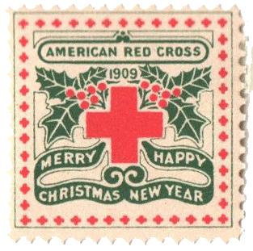
A 1908 seal carried a post card from Baltimore, Maryland. Among early seals that carried the mail is this lower card, a holiday greeting as evidenced by the embossing, posted with a 1909 seal mailed from St. Louis, Missouri.

Slide 7
Here is questionable cover with a postmark date of April 16, 1908 cancelling a 1908 seal not issued until November, seven months later. Clearly the postmark contains an error.

Slide 8
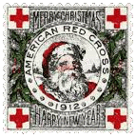
Here’s a 1912 seal used on a post card. The smudged cancel’s date reads "Jan. 1, 1912.“ The year is wrong, as its wasn’t available until 11 months later. The postal clerk cancelling it probably wasn’t fully awake at 9 AM on January 1, 1913, maybe from celebrating too much on New Year’s Eve.

Slide 9
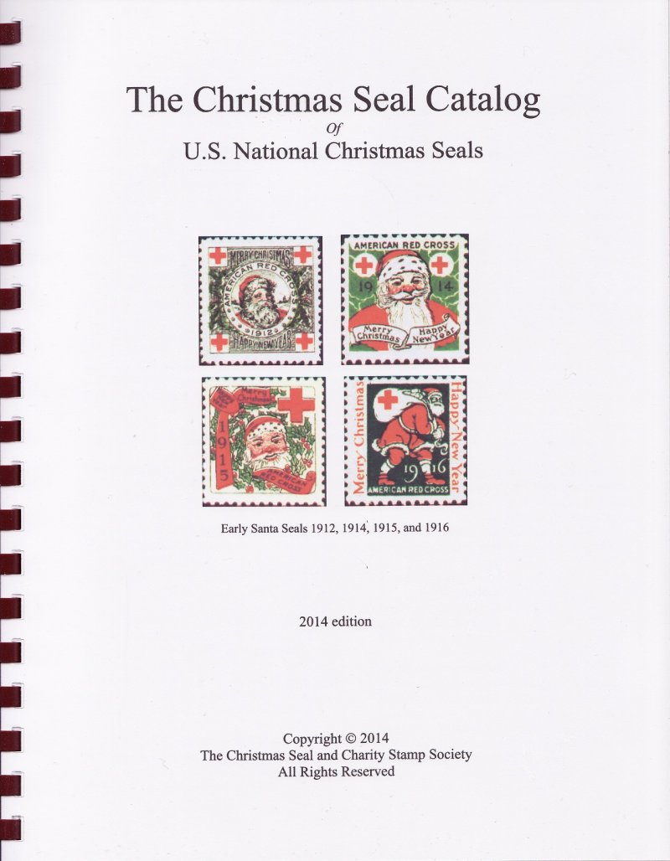
I organized all the seal mail covers sent to me into categories. In doing so, I found the post cards and covers revealed plenty of information. This specialty of philately is called "postal history.“ I call it a lot of fun!
1. Contests
2. Ordinary Mail
3. Business Mail
4. On Purpose?
5. Seals Other Than Christmas
6. Caught
The first grouping I termed "Contests." Maybe they were meant to test the postal clerks' alertness, but a number of covers sent with just seals instead of postage were sent to a surprising number of contests around the country.

Slide 10
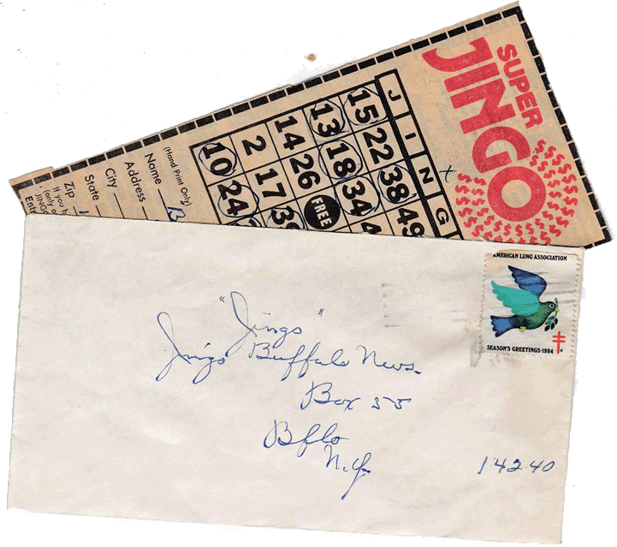
1- CONTESTS The ‘Super Jingo’ contest ran in the Buffalo (NY) News in the mid-1980s. The contest board looked like a bingo card, with entrants circling lucky numbers on the card in hopes of winning a prize. The local contest ran through December. Both of these seal-stamped envelopes had their entries still in them!

Slide 11
Boodle & Dine sweepstakes entries were mailed to St. Paul, Minnesota in 1983. Here’s one mailed from Tampa, Florida postmarked April 20. The seal used was one of 1982’s set of six different designs and labels featuring dogs and Santa.

Slide 12
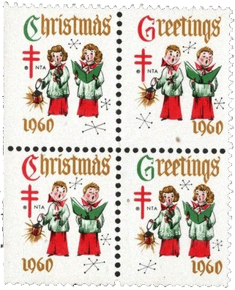
Here’s another, sent to ‘Perky Panda Playtime’ at the Post and Times Star of Cincinnati. Mailed December 1960 from Amelia, Ohio, a small town east of the city, the envelope still had a child’s penciled handwritten note inside: “Here is my entry to the Perky Panda Contes[t] to see who wins with the best card.” Written on a sheet of his mother’s pink stationery is: “To a small boy on a big day. Merry Christmas and a happy New Year.”
Several of these contest entries had never been opened. Were they jinxed by the improper postage? Or, perhaps, they arrived too late to make the entry deadline.

Slide 13
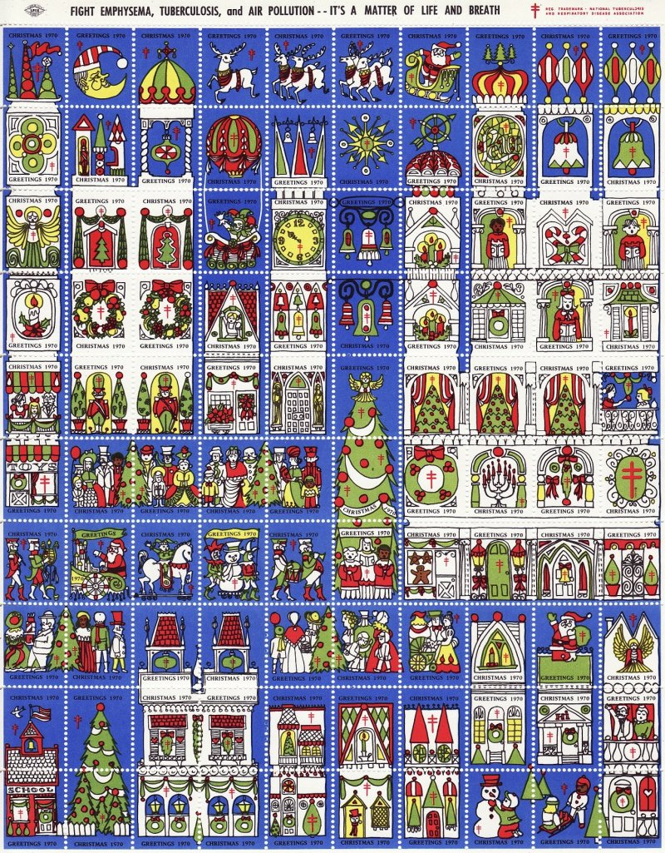
This was addressed to the ‘Strikes, Spares’ and Misses‘ contest by TV station WBEN Buffalo (lacking address). It was mailed from Manitoba, Canada with using three strikes of a special Christmas cancel and took a side-trip to New York City before reaching its destination, all for 2 1970 Christmas seals. This was the first year with 100 different designs in a seal sheet.

Slide 14
2. ORDINARY MAIL
This small category of mine contains post cards and envelopes using seals mailed from 1921 into the 1960’s during the December holiday season, when mail volumes were typically at their peak.
By 1920 Christmas seals were known to just about everyone, unlike their introduction to the public nearly two decades earlier. There is no excuse for this mail to have passed successfully through the mail stream without proper postage.
Blame it on just too much mail, temporary/substitute mail clerks, increased processing automation and mailmen not paying attention to the mail leaving their hands.

Slide 15
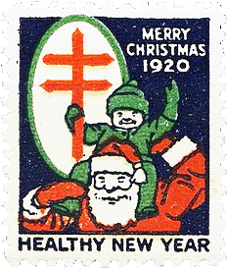
Ordinary they may be, yet each one has its own interesting story. Why was a pair of 1920 seals on this local San Francisco letter postmarked on Jan. 14 needed when only one could have worked?

Slide 16

A December 20, 1930 letter Chicago local letter had a 1930 seal used as a stamp on the front and backflap seal on the reverse.

Slide 17
The lamplighter 1946 seal carried this letter or holiday card from New Hampshire.
A card from Niagara Falls, New York to Ohio went by way of a 1952 seal with the double-barred cross on the left, nicely cancelled with the TB slogan cancel: “Fight TB, Support your TB Association.”

Slide 18
Two covers carried seals in the lower left corners - neither had a stamp. The 1957 piece shows a machine cancel in the usual place, over empty space. The two 1966 seals on the lower cover were thought to be stamps by the automatic canceller that triggered the cancellation over them.

Slide 19
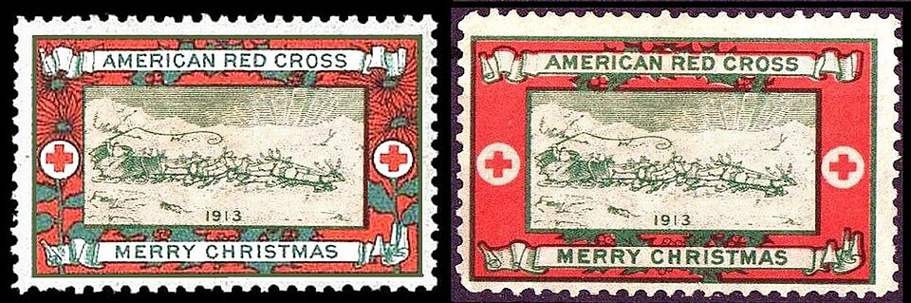
Here’s a wonderful post card bearing a 1915 Pacific Panama Expo promotional flag cancel over a 1913 seal as postage..
Types I and II

Slide 20
3. BUSINESS MAIL to/from businesses using seals for stamps
1963 Mail to Hobby House in 1954 with a cancelled seal of that year. An upside-down 1962 seal sends a probable bill payment to Standard Oil in Cleveland from Cincinnati Ohio

Slide 21
These three covers mailed in December or January to Bankers Trust were all carried by the seals of those years. One cover shows a receiving mark applied by the bank. There was no return address on them and no attempt to collect postage due.

Slide 22
Miss Feeley of American Bank and Trust’s personnel office received a letter with a vertical pair of 1974 seals with the bank's receiving stamp as well. Did the sender get the job?

Slide 23
Young Rowena Sunico of Knoxville, Tennessee got a really cool gift for Christmas, and then she filled out the product card to return to the company. Not sure from an unclear cancel when she mailed it, but it carried a 1983 Christmas seal for postage. So, what did Rowena get?

Slide 24
4. ON PURPOSE?
Letters to Santa Claus often were accepted and processed because they seldom went any further than the local post office in most cities. Not sure if Joe’s buddy or buddies stuck the 1965 se-tenant pair of seals on purpose.

Slide 25
Jerry Greene received several unaddressed covers now in my and a fellow seal collector’s collection. We began to suspect that Jerry was perhaps someone who was ‘baiting the system,’ sending these covers to himself, or had seal collectors mail them to him. Otherwise, how would he happen to have a pair of 1932 Christmas seals on envelopes dating from in 1955!

Slide 26
Wouldn’t it seem logical to you to affix a current 1970 seal on the envelope being mailed to the local Tuberculosis Association? It seemed so to a lady in Valley Center, Kansas; and apparently to the postal workers who let the ragged 1970 lower right corner seal carry the donation envelope

Slide 27
Probably an insurance bill payment, this letter sent from a Columbus suburban resident to Hartford, Connecticut (zip 06152) was mailed on Dec. 13, 1977 with a 1975 seal. Oddly, this envelope went to Butler, PA (zip160xx) first, possibly due to some dyslexic postal clerk or malfunctioning mail reading equipment per the backstamp cancel.

Slide 28
A “Thrifty Markets” business envelope was used by someone who applied a pair of 1971 seals with shifted perforations to mail a letter to a Minneapolis doctor.
Just how thrifty can one get?

Slide 29
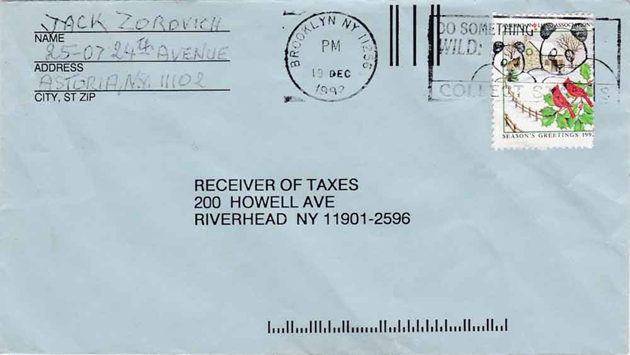
Two possibly disgruntled taxpayers obviously decided “not to spend one more cent!” when paying tax collectors of Virginia Beach, VA and Riverhead, NY with the 1990 doves and poinsettia seal (top) and 1992 cardinal and snow seal (bottom).

Slide 30
A phonetic joke. The recipient was F. Burton Sellers, a noted philatelist and president of the American Philatelic Society from 1991-1993. But who was the sender?
on the reverse

Slide 31
5. SEALS OTHER THAN CHRISTMAS
The Society for Crippled Children was started in 1919 in Elyria, Ohio, and became The Society for Crippled Children two years later. Because the seals were produced around Easter time, the society renamed themselves the Easter Seals Society. The white lily is its trademark. Here a 1960 Easter seal helped transport a phone bill for Palumbo’s Plumbing to Rochester Telephone.

Slide 32
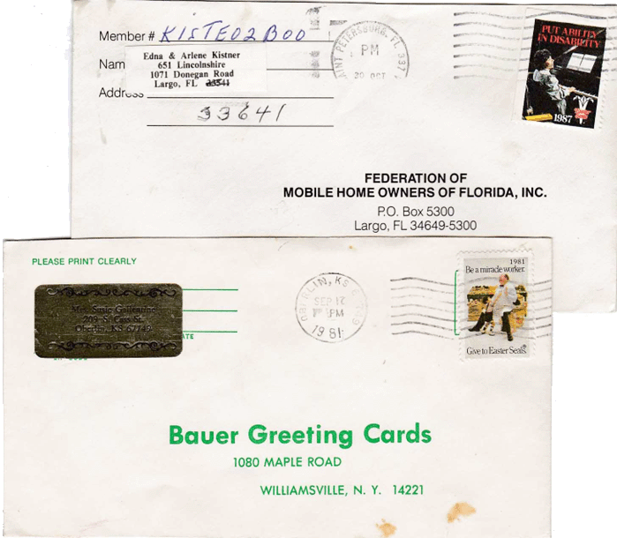
Next, an Easter seal from 1987 franked a local letter from Largo, Florida. Its message emphasizes the rehabilitation focus of Easter Seals – “Put Ability in Disability.” The white lily is seen at the bottom. On the bottom cover, a 1981 Easter Seal took this business reply envelope from Kansas to NY.

Slide 33
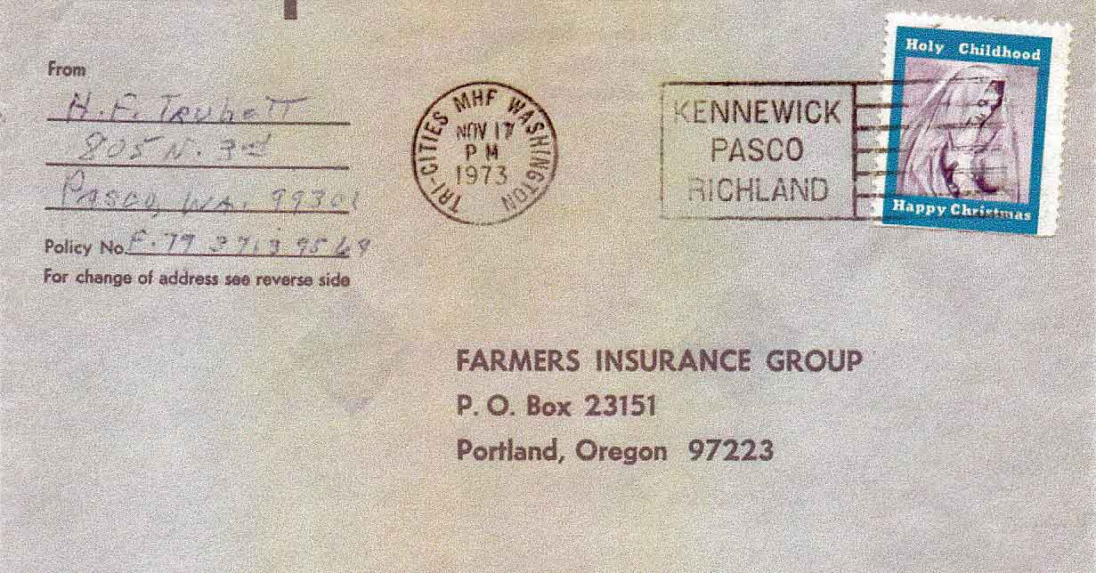
A cover sent from Washington state to Oregon is neatly cancelled over a Holy Childhood seal, dated Nov. 17, 1973. Holy Childhood is a non-denominational, non-profit agency that has enriched the lives of people with intellectual and developmental disabilities for over 70 years.

Slide 34
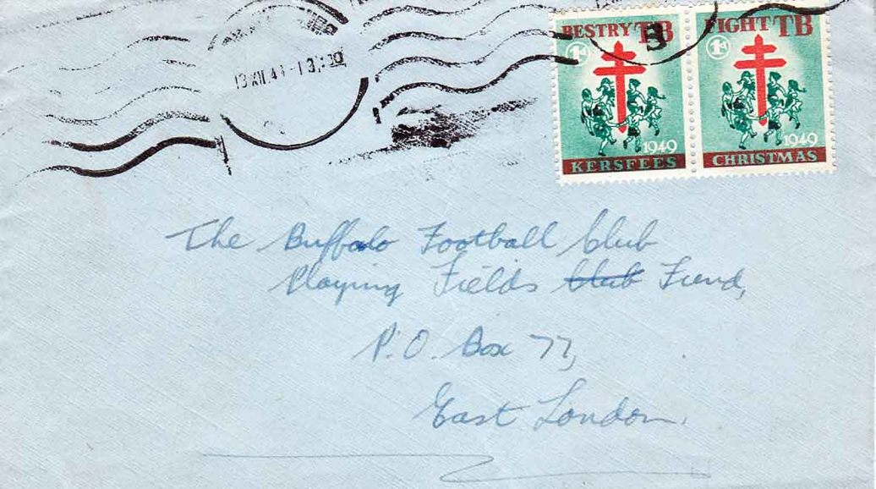
Even Overseas – These are Christmas seals, but not from the United States. A setenent pair of bi-lingual South Africa English/ Afrikaans Christmas seals, cancelled Dec. 13, 1949, carried this domestic letter to its destination in East London.

Slide 35
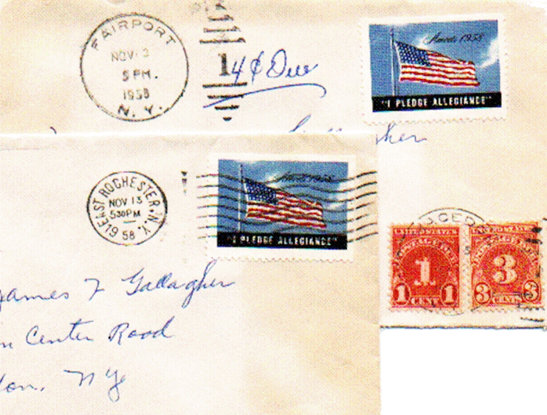
Two envelopes mailed to Mrs. J. Gallagher in November 1958 in Macedon, NY were posted with Amvets “I PLEDGE ALLEGIANCE” seals. The top one was caught by the P.O.in nearby Fairport, date stamped Nov. 3 and assessed 4¢ postage due by the Macedon P.O., paid the by the recipient. The one below mailed from East Rochester, NY successfully made it through.

Slide 36
6. CAUGHT
This brings us to some examples of “seal mail” that were caught for their postal infractions. Not all 1908 seals-as-stamps made it through the mail system. From Joe Ward’s collection we see a 1908 seal franking a letter in Philadelphia. A large black “DUE 2” appears in the lower right. Nearby is a two-cent precancelled postage due stamp, confirming that payment was collected.

Slide 37
A similar case with this post card that a sharp-eyed postal person caught with a 1911 Red Cross seal. Why Red Cross? After Emily Bissell got the seal project going, the National Tuberculosis Association wasn't yet able to assist her financially. She appealed to the Red Cross that took over issuing Christmas seals until 1920 when the TB group took over.

Slide 38
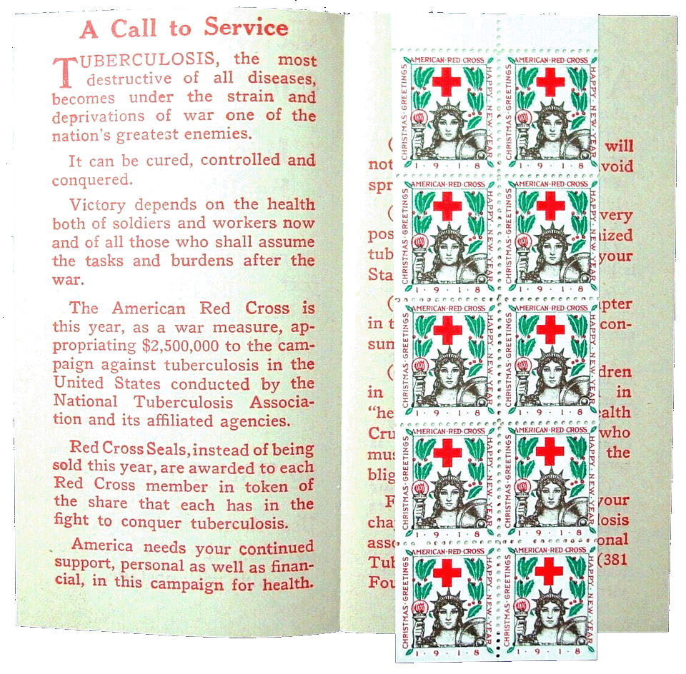
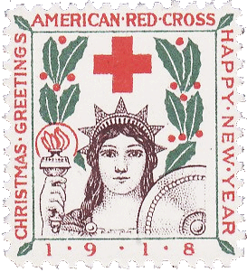
A later example is this cover with a 1918 seal postmarked Foxboro, Mass. The recipient in Connecticut paid the fee - 2 cents - as seen by the postage due stamp affixed. The member who loaned us this cover, said, “It’s a good example of what should happen.” A 1918 seal on cover is difficult to find as it was it the midst of WWI and seals were only sent to contributing Red Cross members in booklets of ten.

Slide 39
When it came to collecting postage, Bankers Trust finally had to pay up. Although marked “POSTAGE DUE 5 CENTS,” there is no postal indication that the 5 cents was collected on this 1963 envelope.

Slide 40
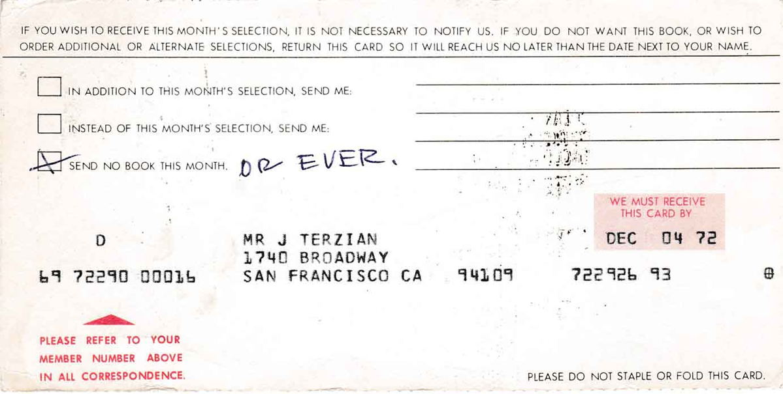
An amusing scenario showed up on a card mailed to a book club in New Jersey. John Terzian in San Francisco stuck a strip of three 1972 seals on his selection card, which was caught and assessed 8¢ postage due to the club.

Slide 41
A single S&H Green stamp, by chance the color of the 1¢ stamp of the day, and a 3-cent Liberty stamp does not equal 4¢, the letter rate in 1959. The post office noticed and rubber-stamped “Postage Due 1 Cent.” on the cover twice in purple ink.

Slide 42
When this stamp dealer couple moved, they sent out 500 change of address letters. Each one was to get a 1-cent stamp, a 32-cent stamp and an American Lung Association spring seal. They missed the 32-cent stamp on this one and it was returned.

Slide 43
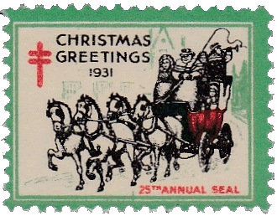
Of course, there's a brief miscellaneous category! The Christmas Seals and Charity Stamp Society was founded in 1931, so we have a hand-back cover with a 1931 seal cancelled from Santa Claus, Indiana on an official organization envelope.

Slide 44
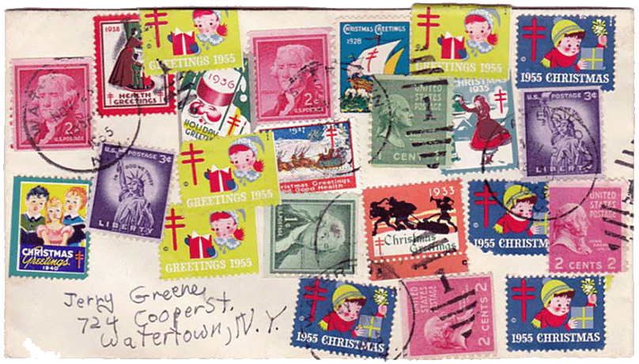
How about this multi-stamped envelope posted in 1965 with an assortment of seals and stamps to end the program? Seals dated 1928-1955 are here along with a combination of 16 cents postage, sent to our friend Jerry Greene. Remember him????

Slide 45
Thanks for watching!

