Slide 1

US Presidential Series of 1938
Interesting & Unusual Uses
by Stephen L. Suffet
APS No. 106103
RPA Member 1996-06-L
Presented on 05/11/23

Slide 2
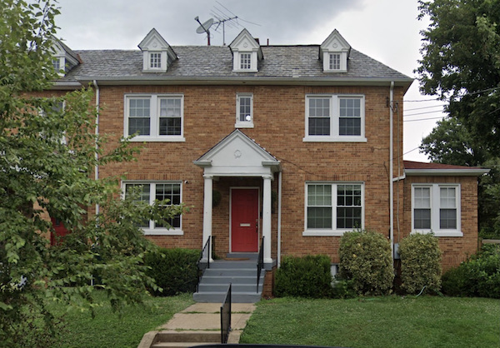
First day of issue: April 25, 1938. 2¢ local letter rate.
Returned to sender. Why? House existed, built 1931.

Slide 3
Last day of 2¢local letter rate:
March 25, 1944.

Slide 4
3¢ letter rate, addressed to German civilian internee on Ellis Island: 1942.

Slide 5
3¢ letter rate, absentee ballot cover: 1944.

Slide 6
3¢ letter rate, sent to undercover address for
Los Alamos nuclear weapons facility: 1945.

Slide 7
3¢ V-Mail letter sheet rate, used to APO 464 in Italy: 1945.

Slide 8
1¢ 2nd class transient rate: 1943 docketing.

Slide 9
1¢ 3rd class bulk rate, private precancellation: undated.

Slide 10
1½¢ 3rd class bulk rate, private precancellation: undated.

Slide 11
4th class book rate, 4¢ for first pound:
1946 docketing.

Slide 12
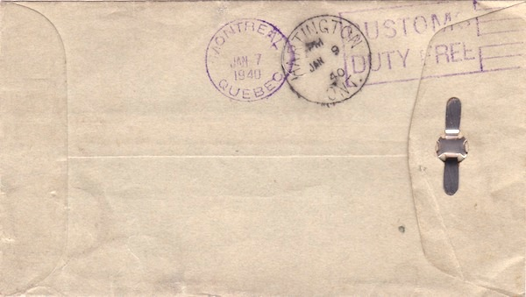
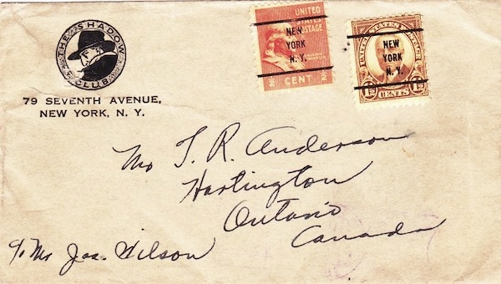
2¢ merchandise rate to Canada: 1940.

Slide 13
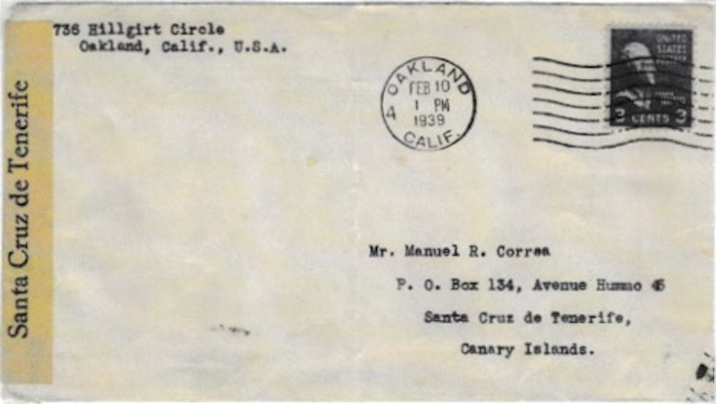
3¢ PUAS letter rate to the Canary Islands, Spanish Civil War Censorship: 1939.

Slide 14
3¢ PUAS letter rate to Brazil,
NY & Buenos Aires Sea Post usage: 1941.

Slide 15
30¢ total postage, part air mail + part surface mail to China via Canada: 1939.

Slide 16
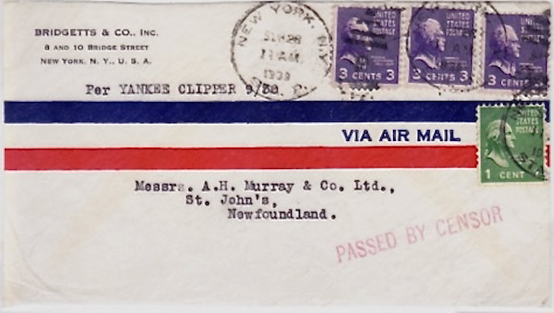
10¢ air mail rate to Newfoundland, flown on last flight before winter suspension of service and rate increase: 1939.

Slide 17
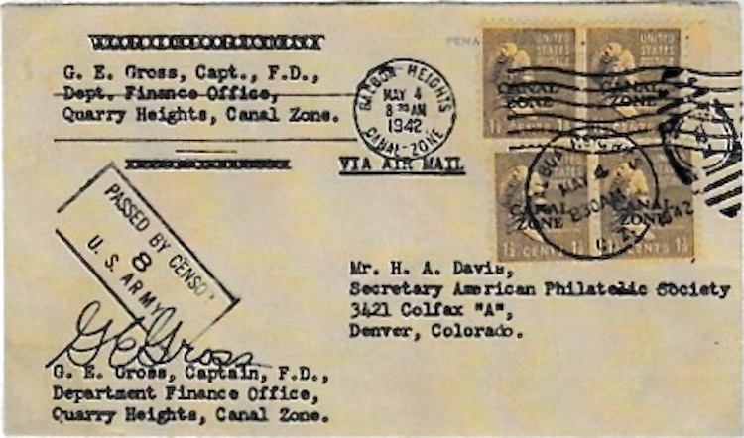
6¢ wartime military air mail rate,
CANAL ZONE overprints: 1942.

Slide 18
42¢ postage = double 21¢ air mail rate,
Canal Zone paquebot use to Iceland, forwarded to Holland: 1954.

Slide 19
16¢ postage = double 8¢ air mail rate, used from Civilian Public Service camp: 1944.

Slide 20
Coil line strip paid 6¢ air mail rate to Mexico,
35c Mexican stamp paid special delivery fee: 1958.

Slide 21
US stamps improperly used in Mexico: 1947.

Slide 22
Underpaid post card from Canada,
US stamps accounted for 4¢ postage due: 1954.

Slide 23
1¢ certificate of mailing fee: 1939.

Slide 24
10¢ fee for changing terms of COD parcel: 1946.

Slide 25
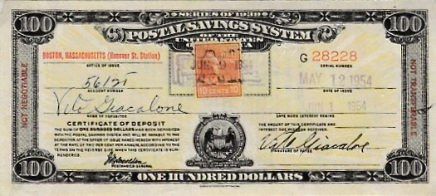
10¢ fee for early redemption of Postal Savings certificate of deposit: 1954.

Slide 26
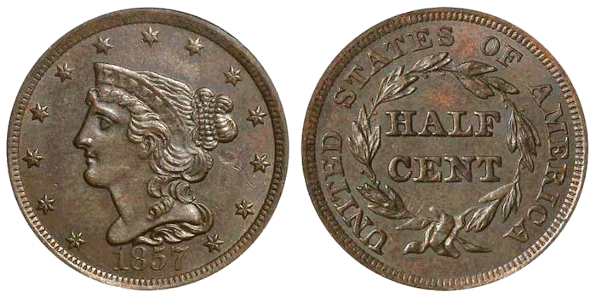
1½¢ postage due, unused ½¢ stamp used as change for 2¢: 1943.

Slide 27
10¢ air mail rate to Cuba, addressed to passenger aboard MS Saint Louis: 1939.

Slide 28
5¢ UPU letter rate to Germany, intercepted by British censor en route: 1940. Released 1946.

Slide 29
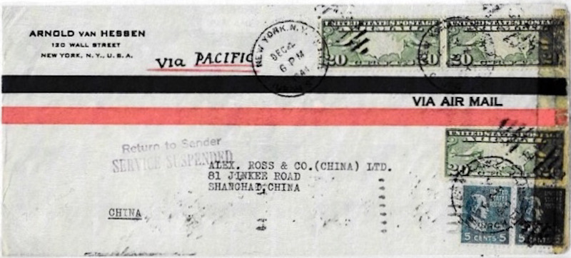
70¢ air mail rate to China, flown on Pan Am Anzac Clipper, diverted Honolulu to Hilo, returned to sender from Hawaii, service west of Hawaii suspended because of war: 1941.

Slide 30
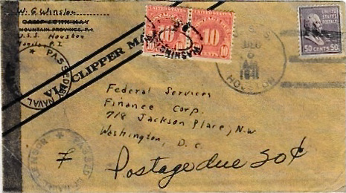
Mailed aboard USS Houston in Philippines, 50¢ air mail rate to USA, flown aboard Pan Am Pacific Clipper westbound from Australia to NYC, 20¢ postage due to pay 70¢ rate: 1941-1942.

Slide 31
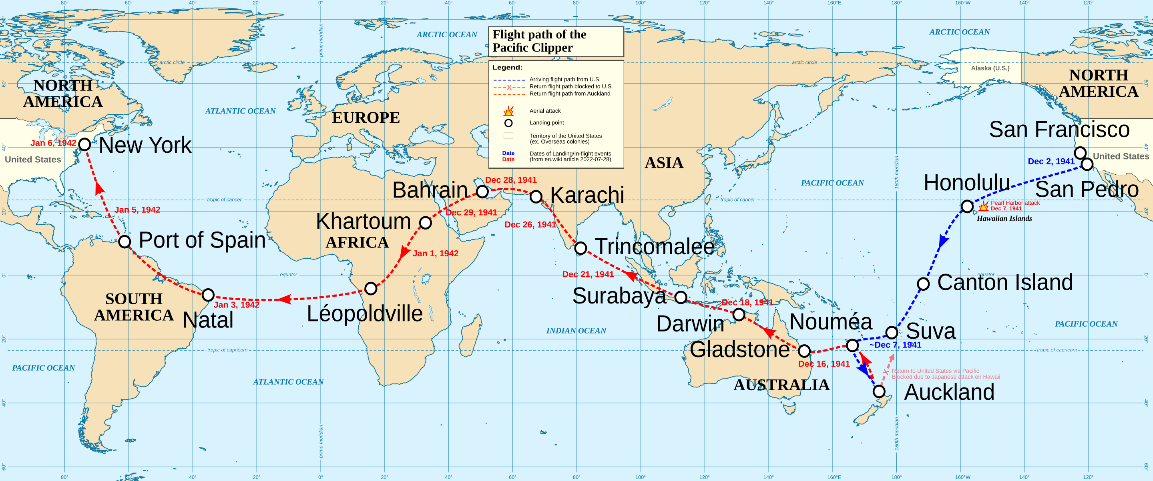
Route of the Pacific Clipper: San Francisco Bay to NYC
Dec. 2, 1941 – Jan. 6, 1942

Slide 32
20¢ postage = double 10¢ air mail rate to Haiti, returned to sender by censor: 1943.

Slide 33
5¢ UPU letter rate to Iran under joint British-Soviet occupation: 1944.

Slide 34
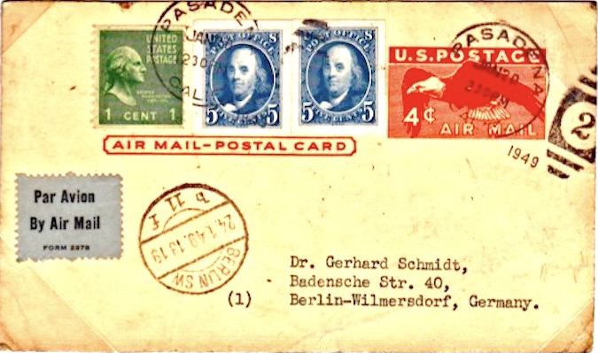
15¢ air mail rate to Germany, flown on Berlin Airlift: 1949.

Slide 35
15¢ air mail rate to Egypt, forwarded from Alexandria to Suez: 1949.

Slide 36
25¢ air mail rate to Israel, flight forced to land in Egypt: 1950.

Slide 37
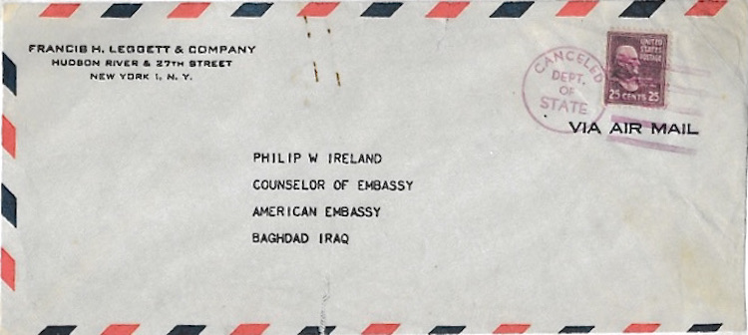
25¢ air mail rate to Iraq, carried in US State Department diplomatic pouch: addressee in Baghdad 1951-1955.

Slide 38
3¢ letter rate, used from APO 317 in Japan to APO 201 in Korea: 1951.

Slide 39
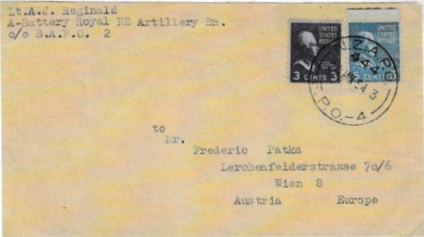
8¢ UPU letter rate to Austria, used from New Zealand APO in Korea: 1954.

Slide 40
First day of 4¢ letter rate: August 1, 1958.

Slide 41
7¢ air mail rate: 1958.

Slide 42
4½¢ 3rd class postage for 3 ounces: rate in effect 1958-1963.

Slide 43
50¢ postage = double 25¢ air mail rate to Pitcairn Island: 1959.

Slide 44
4½¢ 3rd class postage for 3 ounces: 1961.

Slide 45
25¢ air mail rate to Australia: 1970.

