Slide 1
Member Survey 2023
Where do we go from here?

Slide 2
A brief 10 question survey was sent to 64 out of our 73 RPA members with emails on file to get their thoughts on a number of issues dealing with club activities. Twenty seven members responded.
This has been a transition year for the club, returning to a pre-Covid meeting normality, clearing out our storage room at the JCC,
moving to our new meeting facility, and more.

Slide 3
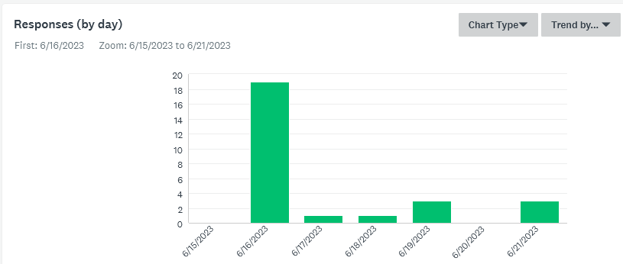
When did members take the survey?
19
3
3
1
1
Q

Slide 4
Question 1: Are you a...
Q

Slide 5
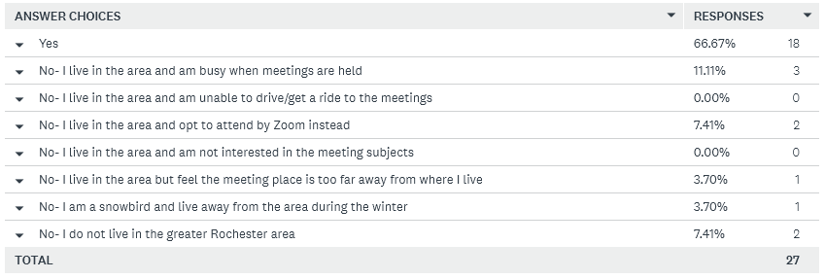
Question 2: Have you been able to attend a RPA meeting in person in the past 6 months?
Q

Slide 6
Question 3: Have you joined any RPA meeting by Zoom in the past 6 months?

Slide 7
Question 4: I prefer RPA meetings be held...
Q

Slide 8
Question 5: In general , how would you rate RPA presentations during our meetings?
Q

Slide 9
Question 6: In general, how would you rate our newsletter, Hinges & Tongs?
Q

Slide 10
Question 7: If a small one day bourse of 6-8 dealers could be sponsored by the RPA on a Saturday in the fall or spring I would...
Q
Ø
I would attend and provide labor on the day, but not to organize.
In favor and would try to time visit to relatives to attend.

Slide 11
Question 8: Do you plan to attend the APS Great American Stamp Show scheduled for August in Cleveland?
Q

Slide 12
Question 9: Do you regularly check out the RPA web site?
Q

Slide 13
Question 10: Would you like to leave a brief comment in the 'Other' box (limited to 100 characters)?
Comments are on the following slides.
Q

Slide 14
Great place to get together and talk what we love.
I just joined recently, so I have not been able to attend any meetings. I am readjust to attend more meetings.
I am rarely able to get to meetings, as I can't drive at night. Would love a daytime meeting sometimes.

Slide 15
Once a month would be OK with me. Would appreciate uncoupling meetings from coin club.
I would like things to stay the same and would also like to see the club regain some of its past strength with better attendance and participation, but my fear is that we are going downhill.

Slide 16
I attend as few public events, including RPA meetings, because of a pre-existing condition with respect to COVID.
I enjoy the meetings. I know it must be difficult, however the President and Tom do a great job. Thank you both.
Thank you for leading the RPA.

Slide 17
Maintain membership out of loyalty to Rochester, stamp collecting and the fact that I know a dozen or so members and like to follow their activities/ services via the newsletter. I mourn the passing of ROPEX.
Is the club considering a ROPEX show May 2024. Would the current meeting location support it?

Slide 18
I'm sorry to see ROPEX go. If we sponsor bourses in the future, I'd like to see (informal) exhibits encouraged.
ROPEX was the most important part of RPA for me. I still try to be active, but it's now much less interesting.

Slide 19
Thanks to everyone who participated and added their comments to the discussion tonight.

