Slide 1



Love for Sale:
The Prostitute Stamps of Rosario, Argentina
By Tom Fortunato
A Presentation for the
Rochester Philatelic Association

Slide 2

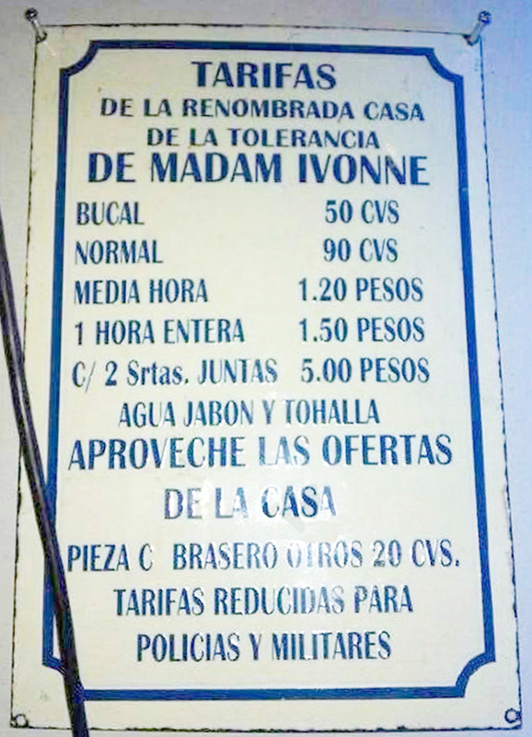
This is the brief story of a philatelic connection to what is claimed to be the oldest profession in the world. In fact, here is proof that almost anything can be taxed, but maybe not in the way you think. And yes, it all boils down to money!
Who?..... Prostitutes
What?.... A preventative “health” tax
Where?.. The city of Rosario, Santa Fe,
Argentina
When?.... 1893-1928
Can you “make out” what’s on the “menu”?

Slide 3
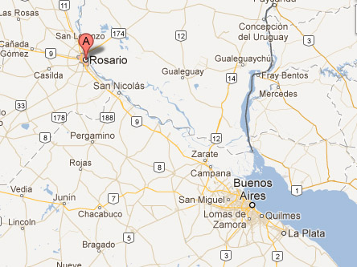
Argentina has had a long history of municipal rather than federal taxation as a way of funding the majority of local needs of all kinds. The city of Rosario, about 175 miles northwest of the capital of Buenos Aires, was the second largest city in the country at the turn of the twentieth century with a population of 112,461 based on 1900 census figures. It more than doubled in size from 15 years earlier when an influx of mostly young male immigrants arrived from Europe. By 1900 native born Italians and Spaniards made upwards of 50% of the residents.

Slide 4
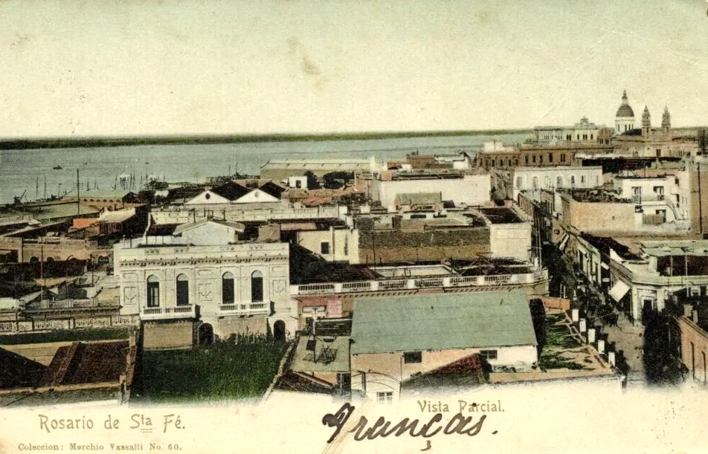
Rosario’s harbor was a Mecca for the import/export trade and many immigrants were hired in related commercial businesses.

Slide 5

With so many young male laborers, and “boys being boys,” it is no wonder that after-work entertainment and expenses mirrored W. C. Fields’ famous quote, “I spent half my money on gambling, alcohol and wild women. The other half I wasted.” That latter vice is what this presentation deals with.

Slide 6

Historically known as consumption, tuberculosis was the primary infectious disease of the era bringing sickness and death. But other plagues of usually lesser severity—blamed on a more pleasurable source—were a bigger problem in Rosario, namely venereal diseases like herpes, syphilis and gonorrhea. Sexually transmitted diseases of all kinds were rampant around the region. Something had to be done.

Slide 7
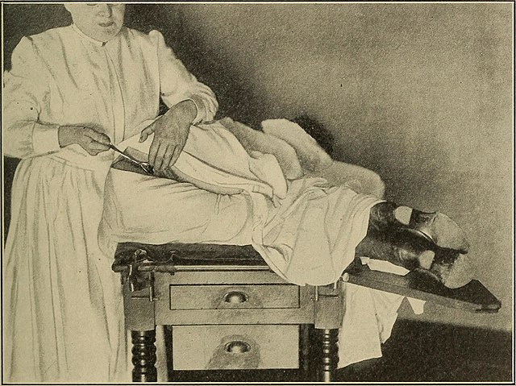
Prostitution was legal in Rosario at the time and “Ladies of the Evening” were licensed professionals. Each had an official identification health book issued by the local Servicio Sanitario (Sanitary Service health department) and by law was required to take a twice-weekly health exam at their own (or a Madam’s) expense.

Slide 8
That’s where these revenue stamps come in. The basic denomination stamp at the time paid the fee for the initial checkup, with higher values available for any follow up procedures or fines. They were stuck to the health book pages, marked accordingly based on the test results and provided proof to clients as to their current condition. Later issues also bore cancellations with the exam date and name of the clinic used.
half page

Slide 9


A test result was noted on the stamp, handwritten or stamped in various ways, using one of five conditions…
SANA or S (healthy)
CON REGLA (menstruating)
ENFERMA (sick)
OBSERVACION (observation/treatment)
REPUESTA (recovered, not shown here)

Slide 10
While stamps were first produced in 1893, new stamps were printed yearly from 1896 onwards, often with changed colors in two or three denominations The more common values were printed in the 15,000-30,000 range, while 1,000 or fewer were made for the higher values up to 4p.
Stamps before 1897 and after 1913 are the least available in dealer stocks. So, too, are the 1902 overprints, the 1903 and 1910 emergency overprints, and high values for most years. The rarer health condition markings of enferma, observacion and repuesta are also most prized.
Let’s look at some of these stamps and marks year by year.

Slide 11
1893 Issue – 1 peso – Manuscript control numbers in red or black. Health conditions written in pen or with cancels per below.
“R” for con regula (menstruating)
stamped SANA (healthy)

Slide 12
1896 Issue – Inspection fee increased from 1 to 2 pesos. Design changed. Large control number at bottom.
1897 and 1898 Issues – Slightly smaller control number at bottom.
1896
1897
1898

Slide 13
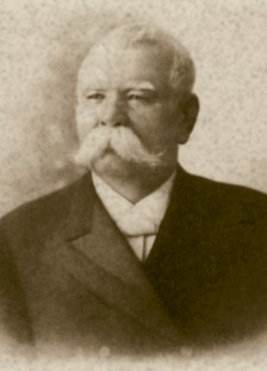
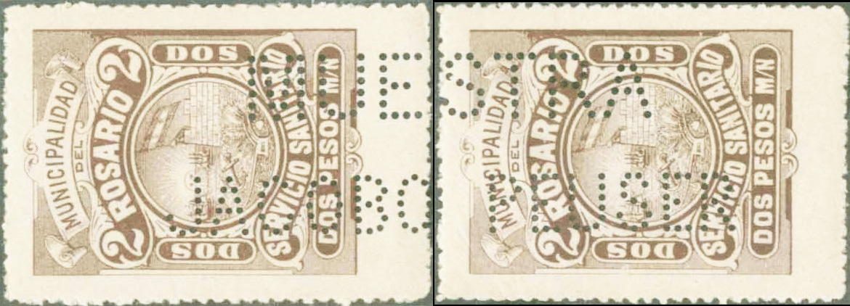
Specimen perfins are known of the1898 issue that span two stamps as shown below. Jacobo Peuser is believed to be the printer of the stamps who founded a chain of stationery/book shops across major cities in Argentina, later publishing tourist guides and post cards.
MUESTRA
JACOBO PEUSER

Slide 14

1899-1901 Issues – Paper quality continues to deteriorate and perfs become more ragged in 1899, improved in 1900. An oval health dispensary condition cancellation was used beginning in 1899.
Sana (healthy)
Enfirma
(sick)
1899
1900
1901

Slide 15
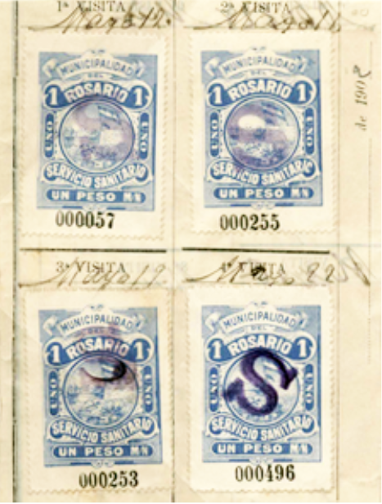

1902 Issue – A new stamp was apparently not issued in early 1902 pending a basic exam rate change. 1901 2p light green stamps were used until the new 1p ultramarine was released between May 10-12 with the change. Here is a sequence from health book pages.
← Front page with exam dates of April 28, May 2, May 5 and May 9 using 2p stamps
→ Back of the same page with exam dates of May 12, May 16, May 19 and May 22 using 1p stamps

Slide 16
1902 Surcharge Issue – Excess 1901 2p stamps were surcharged to 1p to meet the demand in a variety of formats, used with a new date stamp cancel design that can be found through 1905.
UN PESO in blue (top)
UN PESO in red (bottom)
Note the different fonts used.
1 PESO (top)
Un Peso (top)

Slide 17
1903 and 1904 Issues – Basic exam rate was reduced from 2p to 1p between May 9-12. Remainder 1901 2p stamps were surcharged to 1p in several formats with a blue 1p stamp later being issued.
1903 1 peso shades and size variant
1904 1 peso

Slide 18
1904 Issue – All three denominations from 1904 had excessive remainders and were specially cancelled to void them, translated City Accountancy, Rosario de Santa Fe.

Slide 19
1905 Issue – Two different dies were used to produce the basic 1p brown stamp. Remainders are shown here bearing a different accountancy cancellation design than that used in 1904.
Die Type 1 ROSARIO
SA touch
Die Type 2 ROSARIO
SA gap

Slide 20
1906-1908 Issues – As usual, the colors have changed in the basic denominations. A small portion of the 1908 1p was printed with aniline ink, bleeding through the back. The 1906 issues mostly have the health finding stamped on the bottom margins.
1906
1907
1908 with regular and aniline ink

Slide 21
1909-1910 Issues – Nothing special, but…
1909
1910 1p remainder
1910 2p unnumbered remainder
1910 4p unnumbered remainder

Slide 22
1910 Issue (continued) – There was an emergency need to have additional 1p denominated stamps to fill the basic exam rate, so unused 2p stamps were overprinted $1.00 and used.

Slide 23
1911-1913 Issues – Nothing special with the 1911 issue, but after 16 years the design changed in 1912 and continued on in subsequent releases. That’s the first time a year appears!
1911
1912
1913

Slide 24
1914 Issue – Another basic exam rate increase, this time from 1p to 1.50p, necessitated a surcharge on the original blue 1914 issue.
1p
1.50p
4p remainder

Slide 25





Most post-1914 “Servicio Sanitario” items are extremely elusive. Here is a sampling of some of them, thankfully dated…

Slide 26



By the way, Argentine philately is replete with revenue issues of all kinds during this same time period. Compare these stamps below. What did you notice? Be on the lookout for “sanitario” imposters!

Slide 27
That’s right, the same design for the post-1911 “Service Sanitario” stamps was used in the work of City of Rosario veterinary inspectors, with a minor change. Why re-invent the wheel? Collectors and dealers sometime mix them up, too!

Slide 28

In tribute to Ann Triggle, RPA member and the original “Hooker” philatelist who brought the collecting and research of these stamps from obscurity into the limelight. Much of the material here is from her groundbreaking 1998 one-frame exhibit on the subject, then expanded on by collector and exhibitor Ben Termini.
See her exhibit online at: http://www.rpastamps.org/presentations/ladies/index.html.

Slide 29
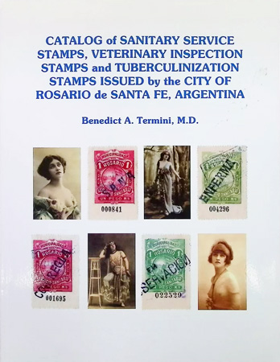
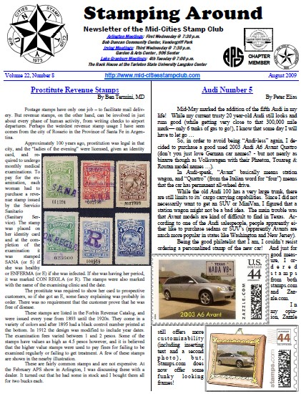
Ben went on to prepare and publish the definitive catalog to date specifically on the revenue issues from Rosario, and has written extensively about them.

Slide 30
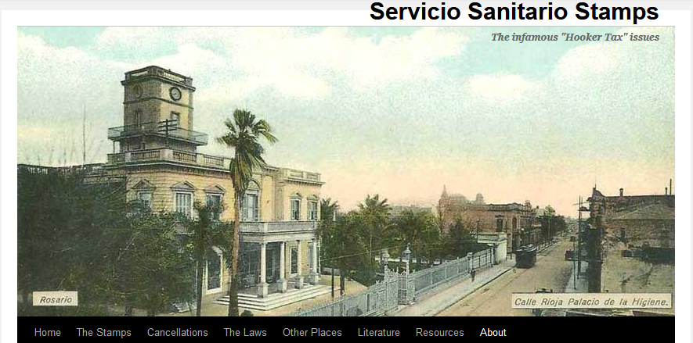
A very complete web site on these issues was active for many years between 2010-2015 run by Steve Olson. It is partially archived here: http://web.archive.org/web/20150421190405/http://sanitariostamps.com/

Slide 31
How about collecting this subject for a different take on
“social” philately?

