Slide 1


1935 King George V
Windsor Castle
Omnibus Issue
by
Tom Fortunato
A Presentation for the Rochester Philatelic Association
Prepared July, 2023

Slide 2
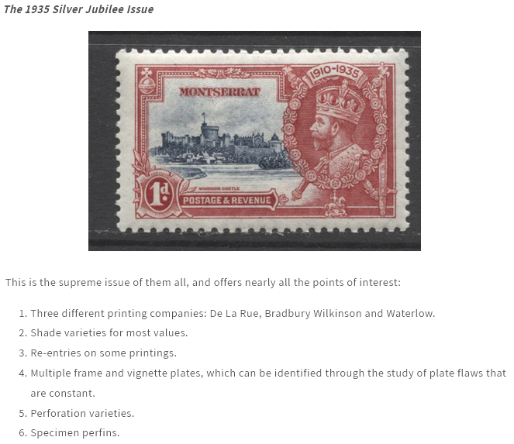
As summarized by the popular web site brixtonchrome.com…

Slide 3
Created to commemorate the Silver Jubilee (25th anniversary) of the reign of King George V, an Omnibus issue of 250 stamps was issued to honor the occasion.
Forty-four crown colonies and dependencies of the British Empire collectively decided to issue a common design to be released in four denominations to fulfill their postal needs for standard letter rates, with the highest denomination equivalent to 1 shilling or its equivalent. These were the wishes of the philatelist King, as the issue was to be “within the pocket of the ordinary man.“ Clearly there was money to be made from collectors.

Slide 4
The Invitation: The British Secretary of State for the Colonies sent the following telegram to each colony on August 24, 1934: "H. M. the King has approved an issue of special postage stamps throughout the Colonial Empire to Commemorate the Silver Jubilee. Single designs with appropriate heading for each territory are now being prepared. Proposed issue should be on sale from, or as soon as possible after, the 10 May 1935 until the end of the year and limited to four denominations. Suggest 1. Shilling or local equivalent. 2. Inland letter rate. 3. Foreign letter rate. 4. One other denomination not exceeding 6d. Please telegraph value to be printed and quantity of each value required excluding those for sale in the UK."

Slide 5
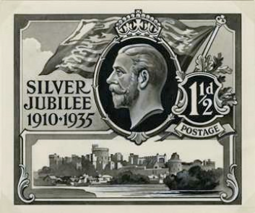
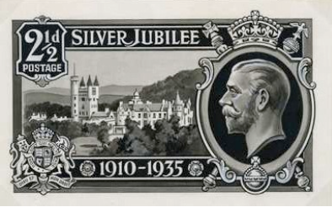
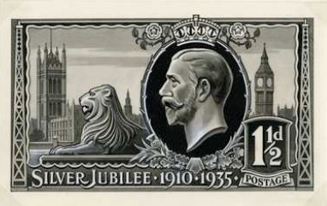
Hugo Fleury, a stamp designer employed by Waterlow and Son, submitted several essays for Britain’s issue on behalf of the firm, which were unaccepted. Here are some of his designs, now in the British Postal Museum & Archive.
The three firms printing the Omnibus issue were invited to submit designs for that issue and 18 were received.

Slide 6
Fleury entered this design featuring Windsor Castle inset in an ornate frame with the King’s image on the right facing left in State Robes encircled by the collar of the Garter. It won the approval of Crown Agents, stamp printers for the colonies and administrative organization in charge of the Omnibus issue.
Hugo Fleury
his earlier essay’s Windsor insert

Slide 7
A follow up to postal administrators, December 5, 1934:
"The series will comprise four denominations only in uniform design as depicted in the accompanying leaflet. The stamps will be printed in two colours in sheets of sixty each. The appropriate heading for each territory will be inserted in place of the word "Specimen" where this appears in the illustration and the duty in the oval panel in the left bottom corner.
‘It is His Majesty's wish that this issue should be placed on sale on the 6 May 1935, and continue in use until 31 December 1935 when the residues whatsoever are to be destroyed. The sale of the corresponding denominations in the permanent series of stamps is to be discontinued during the currency of the Silver Jubilee issue. Arrangements are being made with the Crown Agents for the Colonies for the sale of the stamps to dealers in this country and a public announcement concerning the issue will be made on 1 February 1935 by which date the dispatch should have been received in all the dependencies concerned. I assume that you will also wish to make a public announcement on that date in the territory under your administration".

Slide 8
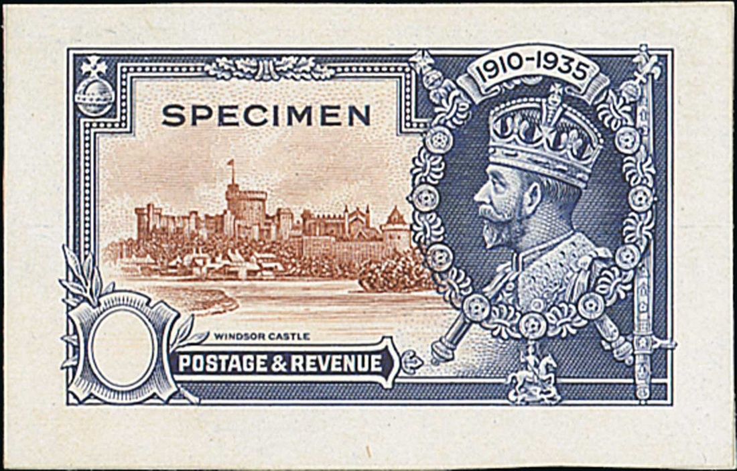
One of 50 Waterlow color specimen proofs believed to have been sent to the colonies as an exemplar of the Omnibus in the December 5 mailing.
from The Brian Brookes Collection of St. Kitts-Nevis, Spink Auction 18013, lot 588

Slide 9
Harrisons was approached to handle the printing, but plans were already underway for their production of Britain’s Jubilee issue, separate from the common design releases. This was in October, 1934, just seven months before the expected May 6, 1935 issue date.
Because of the enormity of the order three alternative British printers were contracted—Bradbury, Wilkinson & Co. Ltd.; Waterlow & Sons, Ltd.; and Thomas De La Rue & Co. Ltd. Both Bradbury and Waterlow were to handle 15 colonies each, with De La Rue given 14, evenly split to ensure compliance with the short deadline.

Slide 10
Here is the listing of each company’s contracted colonies and dependencies.
Q Newfoundland, a late-comer to the plan, opted to have its issues printed in a single color rather than bi-colored to reduce costs and make its issues stand out from the rest. Leeward Islands was the last colony to sign up.
Bradbury Waterlow De La Rue
Bechuanaland Ascension Antigua
British Honduras Barbados Bahamas
Falkland Islands Bermuda Basutoland
Gambia Cyprus British Guiana
Gibraltar Grenada British Solomon Islands
Gilbert & Ellis Island Leeward Islands Cayman Islands
Gold Coast Malaya/Straits Settlements Ceylon
Hong Kong Montserrat Dominica
Jamaica Nigeria Fiji
Malta Nyasaland Kenya, Uganda & Tanganyika
Newfoundland St. Kitts-Nevis Mauritius
Seychelles St. Vincent Northern Rhodesia
Sierra Leone Somaliland St. Helena
Swaziland Turks & Caicos Islands St. Lucia
Trinidad & Tobago Virgin Islands

Slide 11
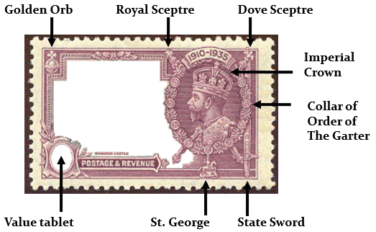
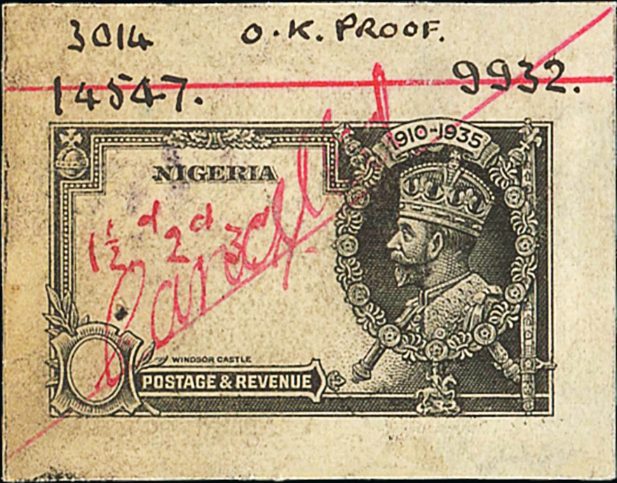
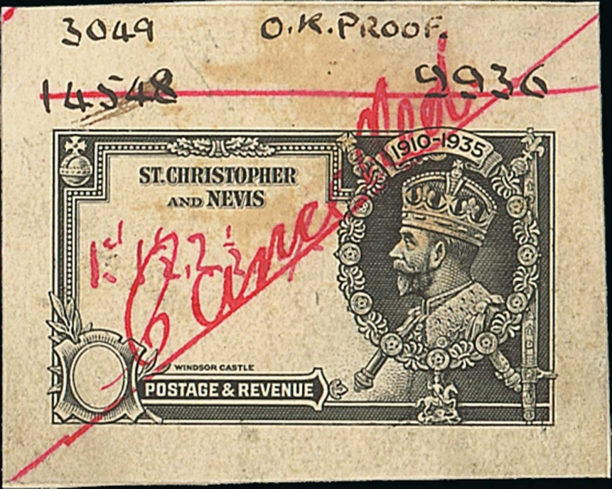
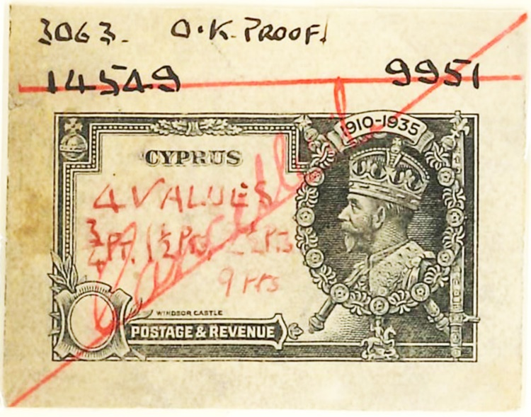
Waterlow completed all frame and vignette engravings and passed them along to their respective printer. Here are final master die frame proofs before the inset of the value tablets, from their archives.

Slide 12
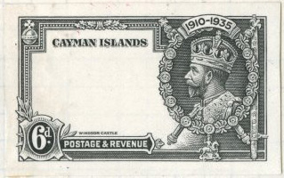
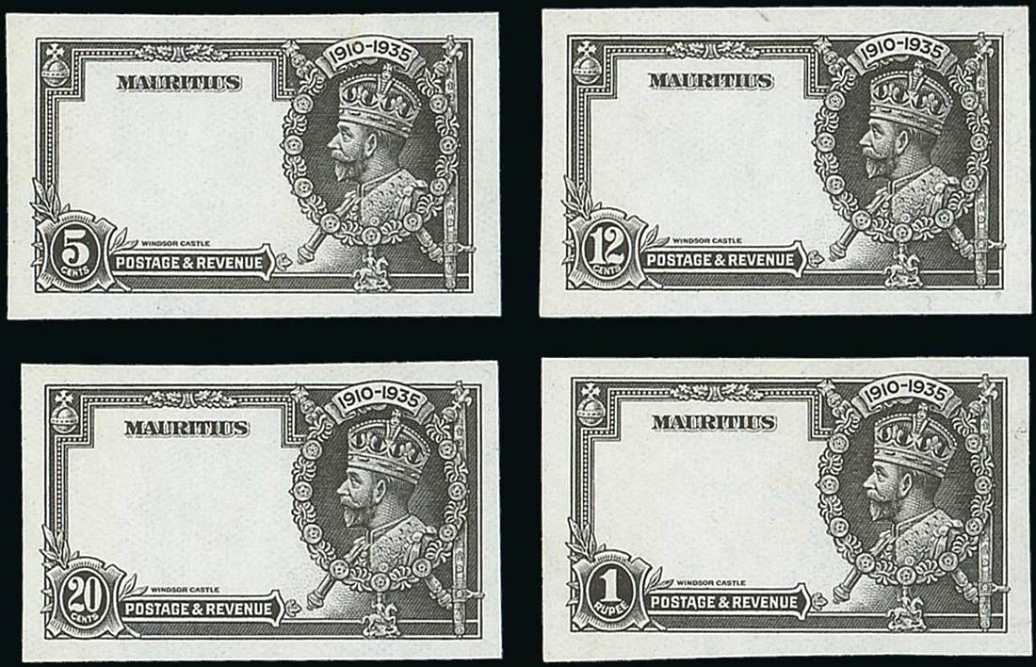
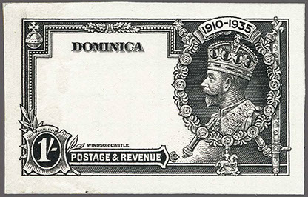
The next step in the process was to make sets of the frame proofs with their denominations. Here is a sample.

Slide 13
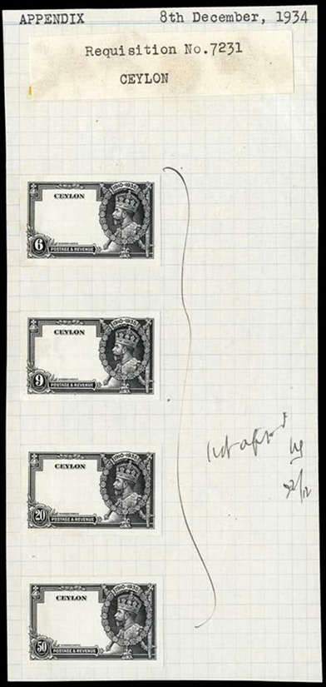
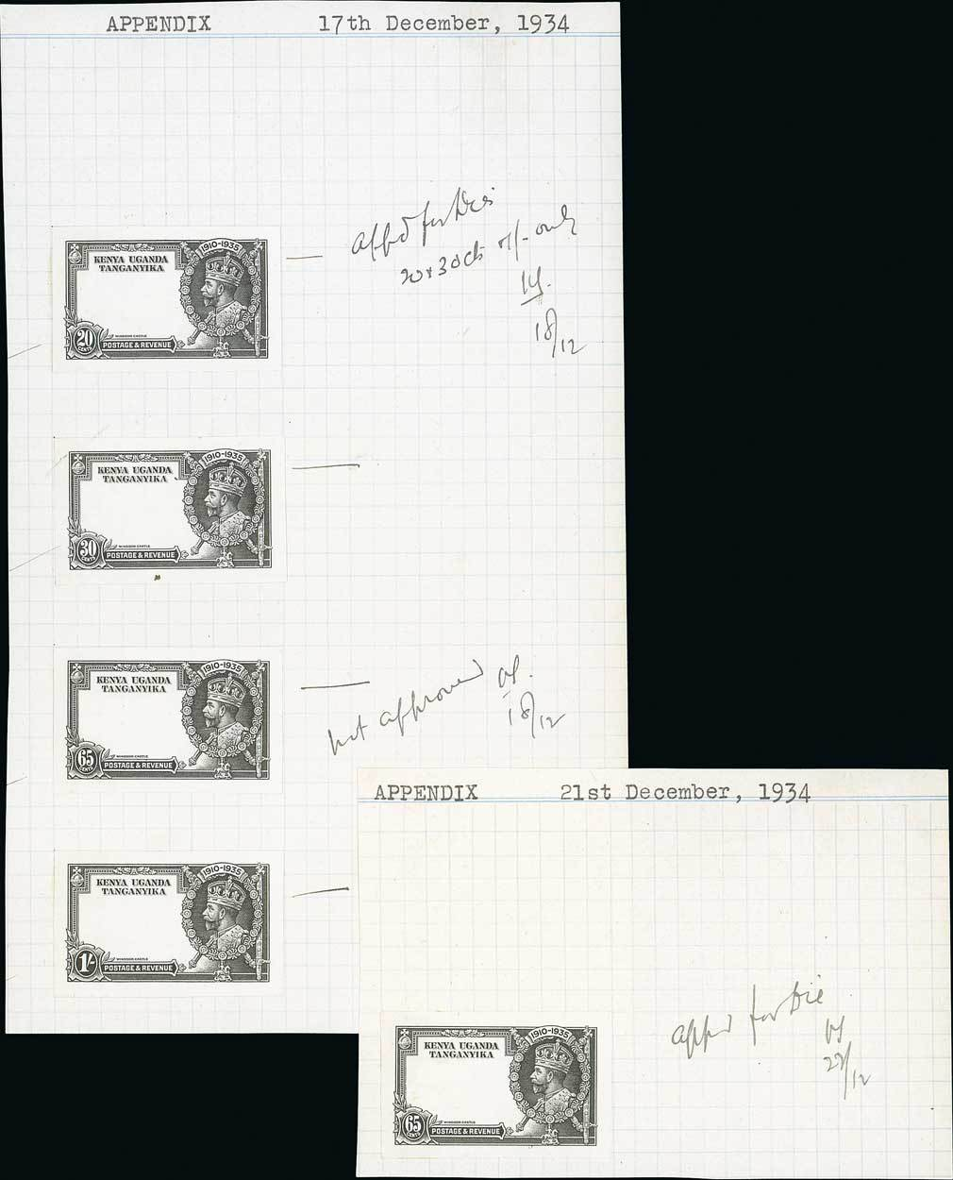
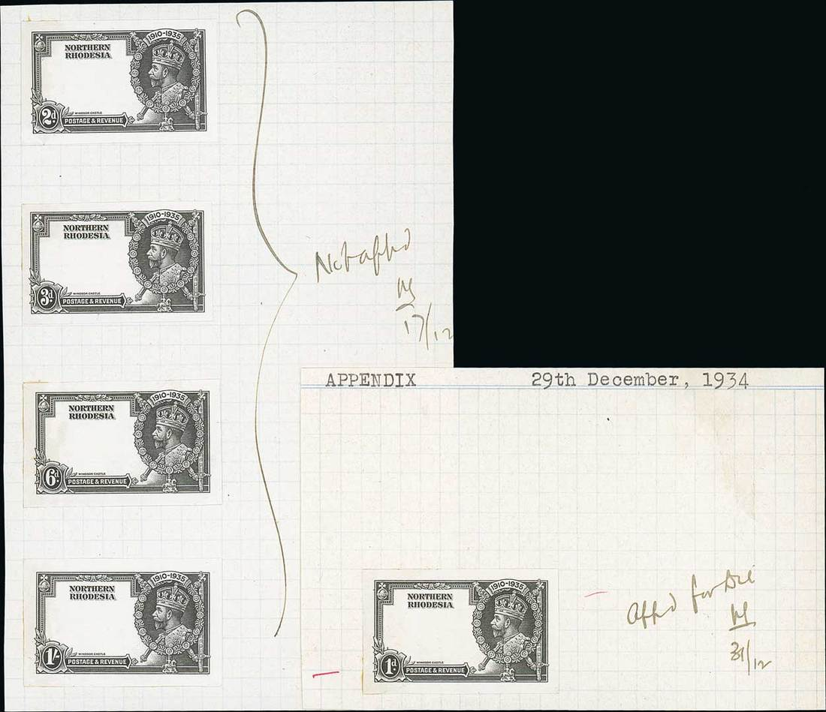
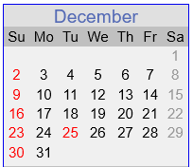
Sets were closely examined, with final proofs individually placed on the equivalent of index cards, December, 1934.
“Appd for die
20+30 cts
1/- only
hS
18/12”
The hS approval initials seen here
are those of Henry Stanfield of Crown Agents’ Stamp and Note Branch.
Ø
“Not Appd
hS
17/12”
“Not Appd
hS
22/12”
“Not Approved
hS
18/12”
Ø
Ø
Ø
(65 cents) “Appd for die
hS
22/12”
(1d) “Appd for die
hS
31/12”
Ø
Ø
Ceylon
Kenya, Uganda and Tanganyika
Northern Rhodesia

Slide 14
The following information is reported in the Stanley Gibbons catalogue:
De La Rue reportedly used 6 different center vignette plates identified as 2A, 2B, (2A), (2B), 4 and 4/ which can often be found on sheet selvage. Examples will be shown later.
Bradbury used either 11 or 12 center plates, probably used in permanent pairings. No plate identification numbers or marks were printed on sheet selvage.
Waterlow printings also do not show any type of plate identification markings. Ten vignette plates are known, also used in pairs.

Slide 15
The vignette sheets were printed first, with the frames printed on top of them.
Imperforate color trials of the final completed designs on watermarked paper were made and presented to Crown Agents for approval in the following color combinations:
Grey Black & Deep Green Blue & Green Green & Mauve
Black & Mauve Blue & Grey Green & Indigo
Red & Purple Indigo & Red Vermillion & Green
Mauve & Green Mauve & Brown Red Brown & Black
Green & Vermillion Green & Sepia Brown & Deep Blue
These now reside in the Royal Collection.

Slide 16
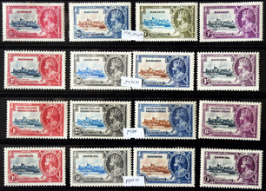
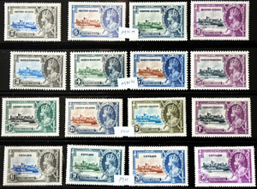
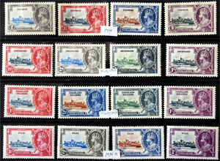
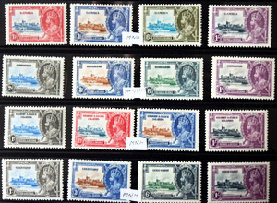
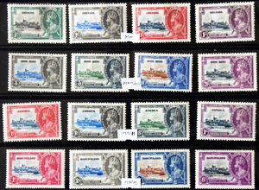
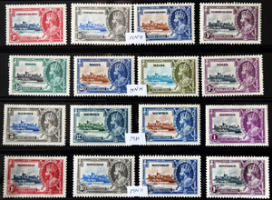
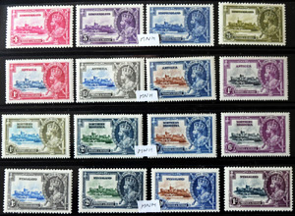
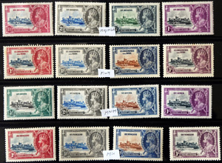
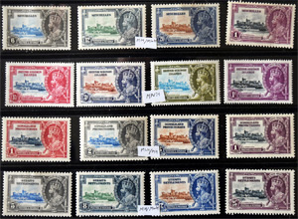
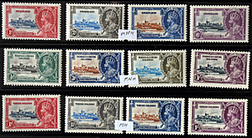
Little is written about the color selection process, here shown in alphabetical set order, low to high value.

Slide 17
Research found that a total of seven color combinations were posed to postal administrators (vignette/border):
Black/Green Indigo/Red Brown/Blue
Myrtle Green/Indigo Light Blue/Bronze Green
Deep Ultramarine/Slate Blue Slate Blue/Purple
The slate blue/purple combo was used on the highest denomination of all colonies except one, Newfoundland, which used bronze green for its 24 cent issue.

Slide 18
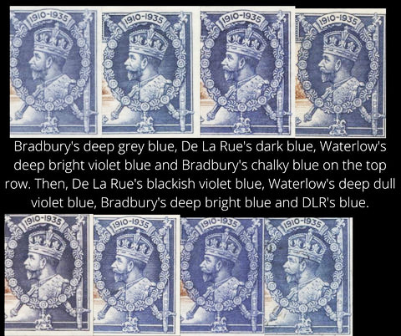
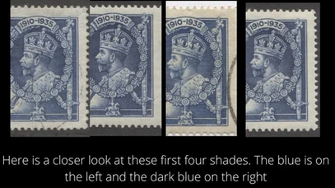
Shade varieties exist, within each printer and among all three. Here are samples in blue.
De La Rue printings: same ink formulas?
blue, deep blue, lighter blue, dark blue shades

Slide 19
How many shades do you see here, of both colors?

Slide 20

The 1½d stamps from Fiji (De La Rue) and Gambia (Bradbury) were printed in aniline red ink that contains a brightening agent, unlike the red inks used in the other stamps of the series. It can smear on the surface, seep through paper and appear on the stamp’s underside.

Slide 21
Frame centering was also quite good overall, with just slight shiftings seen. No mis-perfs are know.

Slide 22
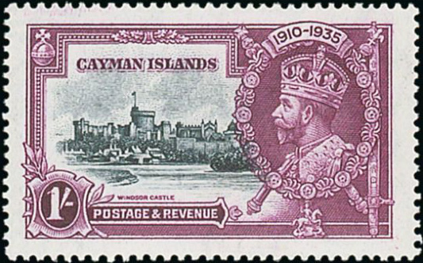
Vignette centering in general was very good. Only slight shifts left, up, down and right per the examples below.

Slide 23
A full printing plate, making two 10x6 panes. When identifying specific stamp locations, Row #/Column # is used. R2/3 would refer to a stamp on the second row down, third stamp from the left.
A sample sheet layout (disregard the perfs!)

Slide 24
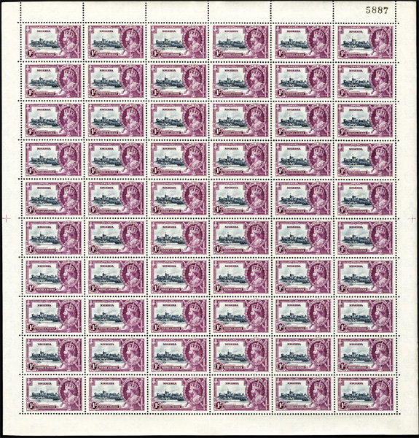
Here is an example of a printed and perforated pane as sent to the postal administrations, one of two from a full printing plate.
This is a 1 shilling pane from Nigeria by Waterlow perf 11 x 12. Note the perforation guide crosses, which are 18 millimeters from the edge of the nearest stamp.
Ø
Ø

Slide 25
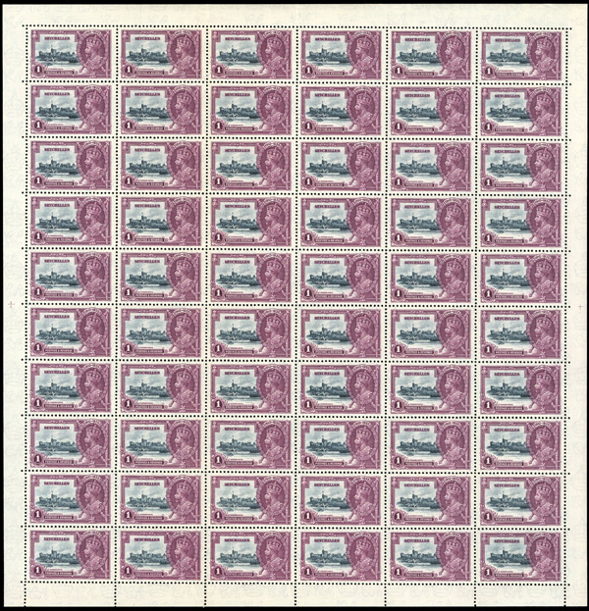
This is a 1 shilling pane from Seychelles by Bradbury Wilkinson perf 11 x 12. Note the perforation guide crosses, which are 9½ millimeters from the edge of the nearest stamp.
Bradbury stamps were more deeply engraved than Waterlow, leaving a slightly sharper impression.
Ø
Ø

Slide 26
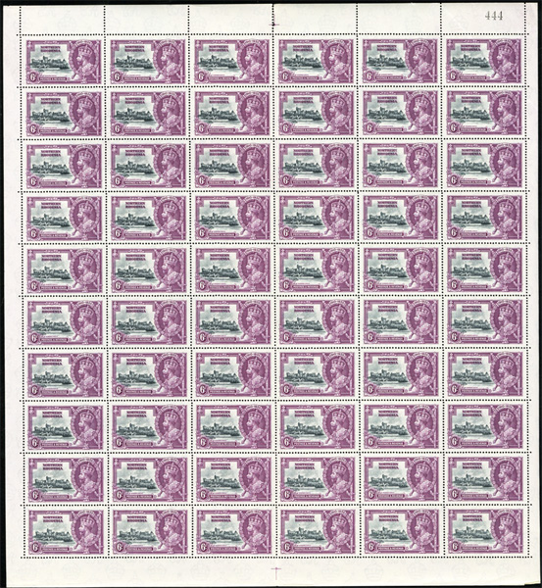
This is a 1 shilling pane from Northern Rhodesia by De La Rue perf 13½ x 14. Note the perforation guide crosses that are in a different orientation from that of the other two printers and shaped more like a T than a +.
Ø
Ø

Slide 27
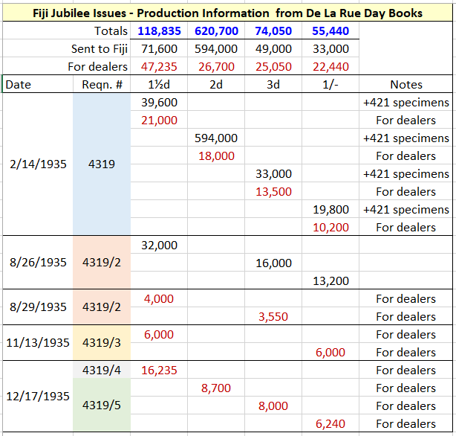
Multiple rounds of printings were needed for most colony’s denominations. Here is De La Rue’s production data for Fiji’s issue.
Each colony was responsible for its own printing costs.
In the end, more than 94 million stamps were printed from all three printers.

Slide 28
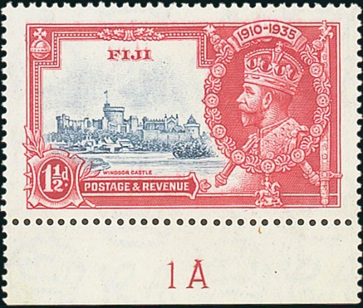
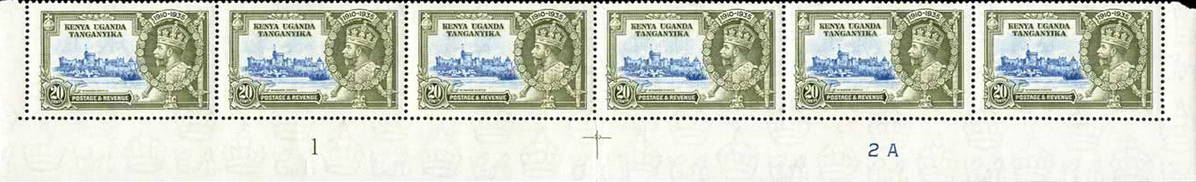
De La Rue is the only one of the three firms that display marginal plate numbers. Plates 1 and 1A (under the 2nd stamp) refer to the frame plates and plates 2, 2A, 2B and 4 (under the 5th stamp) deal with the vignette plates used.
1
Ø
Ø
Ø
Ø
Ø
Ø
frame plate number
vignette plate number
notice the font type and size differences of frame and vignette plate numbers used

Slide 29
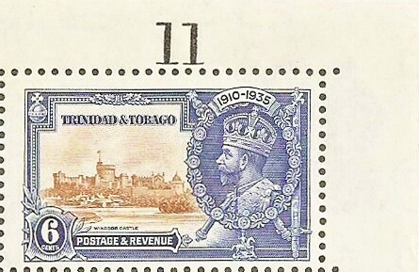
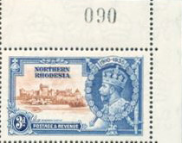
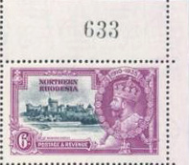
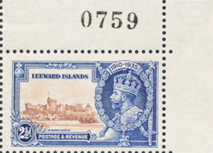
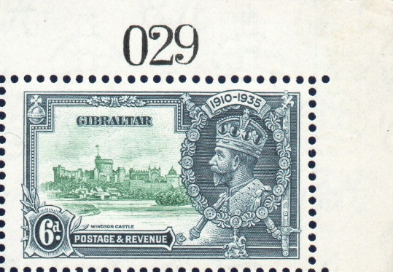
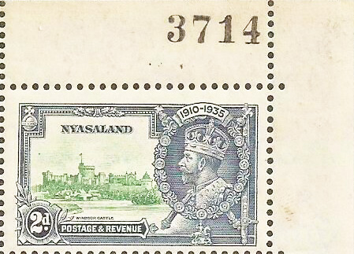
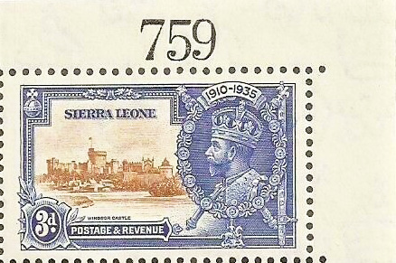
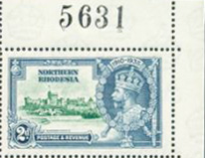
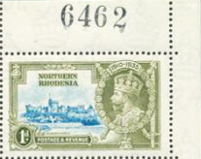
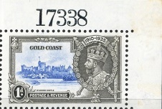
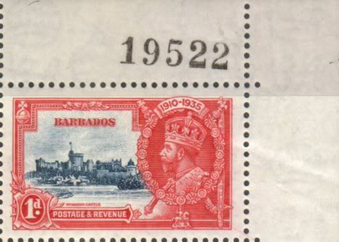
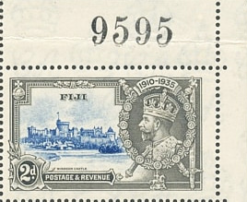
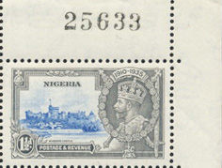
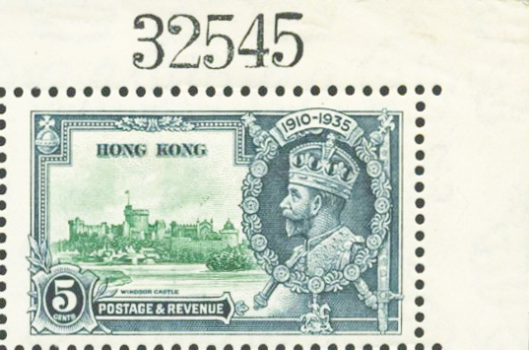
All three printers put sequential numbers in the upper right corners of some sheets (not panes) supposedly as a counting mechanism for auditing.
Bradbury De La Rue Waterlow
De La Rue apparently switched number fonts between its first and subsequent printings.

Slide 30
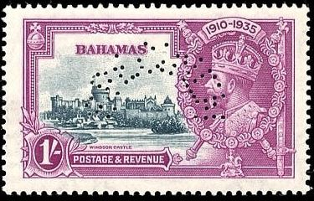

Each of the three printers created 421 specimen sets of 4 in their usual fashion:
Bradbury - horseshoe
De La Rue - semicircle
Waterlow – diagonal
67 holes 65 holes 70 holes
counterfeit specimens are known

Slide 31


Here’s where the fun begins! Varieties and flaws developed when plated and during production, creating “fly specks” in both the frame and castle vignette portion of certain stamps. These are eagerly sought by collectors with some commanding hefty prices. Stanley Gibbons details these throughout the “Commonwealth & British Empire Stamps 1840-1970 Catalogue.” Examples are found on the next few slides. Research continues by devotees documenting constant varieties and one-off flaws of the 176 stamps in this series.

Slide 32



The vignette of Windsor Castle with buildings identified.
color insert/guide from www.philatel2.com/jubilee/

Slide 33

Here is where to look when checking for flyspeck varieties.

Slide 34













Stanley Gibbons’ identified type a-m constant varieties.
Ø
Ø
Ø
Ø
Ø
Ø
Ø
Ø
Ø
Ø
Ø
Ø
Ø
Ø

Slide 35


Stanley Gibbons type “a” extra flagstaff
Bradbury Wilkinson

Slide 36



Stanley Gibbons type “b” short extra flagstaff
Bradbury Wilkinson

Slide 37


Stanley Gibbons type “c” lightning conductor
Bradbury Wilkinson

Slide 38



Stanley Gibbons type “d” flagstaff on right hand turret
Bradbury Wilkinson

Slide 39


Stanley Gibbons type “e” double flagstaff
Bradbury Wilkinson

Slide 40

Stanley Gibbons type “f” diagonal line by turret
De La Rue

Slide 41


Stanley Gibbons type “g” dot to left of chapel
De La Rue

Slide 42



Stanley Gibbons type “h” dot by flagstaff
De La Rue

Slide 43


Stanley Gibbons type “i” dash by turret
De La Rue

Slide 44


Stanley Gibbons type “j” damaged turret
Waterlow

Slide 45



Stanley Gibbons type “k” kite and vertical log
Waterlow

Slide 46


Stanley Gibbons type “l” kite and horizontal log
Waterlow

Slide 47


Stanley Gibbons type “m” bird by turret
Waterlow

Slide 48

The most famous constant frame variety comes from Kenya, Uganda and Tanganyika- the “line through 0,” De La Rue plate position R4/2 found on every sheet. The three colonies combined to form one unified postal administration, releasing their first definitive set on May 1, 1935, 4 days before their Jubilee issue.
Ø
Ø

Slide 49


The Falkland Islands value tablet re-entry, Bradbury pane position R8/1, is another sought frame variety. Notice the thickness difference of the top/bottom rays (center image).
Ø
Ø
Ø
Ø
lower stamp shows the variety

Slide 50


De La Rue printings sometime show the “frame printed double, one albino” variety, caused when a vignette sheet passed through the frame plate that was dry of ink, needing to be passed through a second time, displaying a slight design shift from issues of Antigua, British Solomon Islands, Fiji, Northern Rhodesia, St Helena, and St Lucia.

Slide 51

Summarizing recognized varieties from Bradbury:

Slide 52

Summarizing recognized varieties from De La Rue:

Slide 53

Summarizing recognized varieties from Waterlow:

Slide 54




Ceylon locally created booklets made up of 30 6 cents (domestic/India) or 9 cents (UK/Empire) rate stamps.

Slide 55







Most interesting is that the production date of each is on the booklet cover: Job #̶quantity made (month/year)

Slide 56



Jamaica’s booklet cost 2/ and had 24 1d stamps (4 panes of 6) paying the basic domestic letter rate.

Slide 57

Unlisted varieties abound. Most turn out to be one-off flaws, but specialists in these stamps continue their search in finding similar looking specks and lines. When they do the next step is to determine which plate it came from and its plate position.
The ultimate goal is to get the variety listed in the Stanley Gibbons catalogue.
Antigua page from the Caerynn Collection

Slide 58




A potential contender: St Christopher dot over tower.
found on Waterlow vignette plate 1 position R3/1
Ø
Ø

Slide 59






And a few more, one offs?…
Ø
Ø
Ø
Ø
ink dot?
detached flag
Ø
Ø
Ø
Ø
Ø
flying saucer
ducks in the water

Slide 60

Can you see the many doctor blade lines? Look close!

Slide 61

Doctor blade lines exposed. A “one off” interesting flaw.

Slide 62

An finally, here’s a design knock-off duplicating this iconic design.
I hope you enjoyed this presentation and encourage you to check your Omnibus stamps for varieties—or start your own collection of this fascinating and challenging issue!

Slide 63
Online Resources…
Neil Donen and his former site: www.philatel2.com/jubilee, now accessible at:
https://web.archive.org/web/20110827040144fw_/http://www.philatel2.com/jubilee/index.htm
Spink & Son’s Caerynn Collection of 1935 Silver Jubilee Issues and Covers
https://www.the-saleroom.com/en-gb/auction-catalogues/spink/catalogue-id-srspi10153
StampCircuit
https://www.stampcircuit.com/CircuitSearch?circuit_search_term=1935+silver+jubilee+omnibus&search_api_views_fulltext_op=AND

