Slide 1
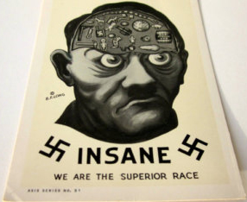
ADOLF HITLER:
Clues to the Diagnosis of his Madness
Taken from Postage Stamps and Postcards 1933-1945
Dr. Anthony Labrum

Slide 2
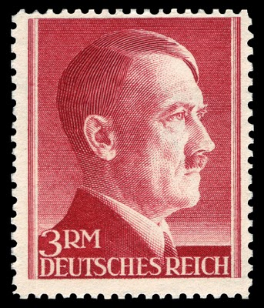
The Second World War began August 31, 1939 with the German invasion of Poland, knowing that this would automatically trigger a declaration of war by Britain and France. One estimate of the number of deaths through 1945 was:
Armed Services
Allied Forces 1,500,000
Germany/Italy 1,500,000
Russia 11,000,000
Total 14,000,000
Paciﬁc Zone
USA and Allies 300,000
Japan 1,300,000
Total 1,600,000
Civilian Deaths
USSR 7,000,000
Poland 5,675,000
Yugoslavia 1,200,000
Germany 780,000
Great Britain 92,000
Total 16,000,000
Total Loss of Life 31,000,000
The Encyclopedia Britannica 2003 estimates the total dead even higher at 35 to 60 million. It is impossible to even estimate the total number injured.
The decision to invade Poland was made by one man--Adolf Hitler.

Slide 3
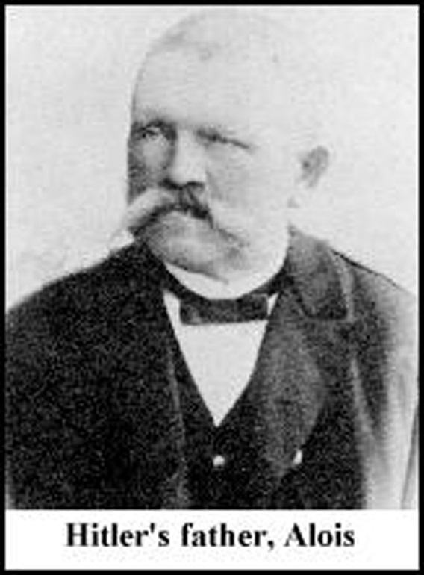
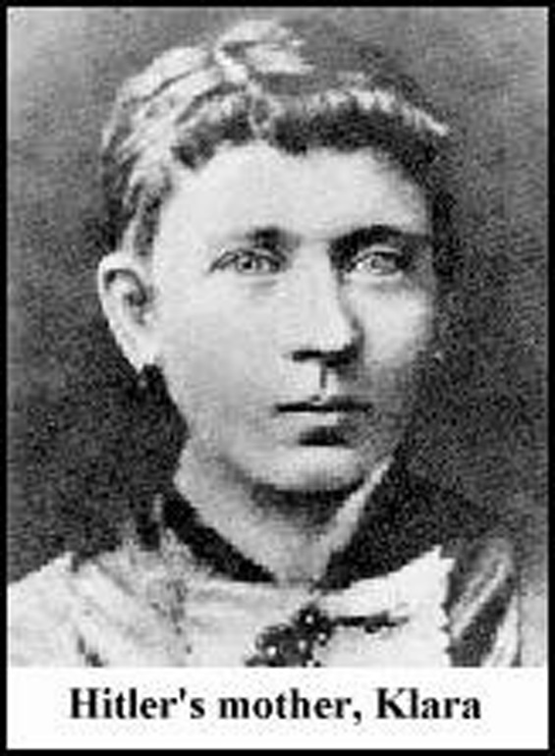
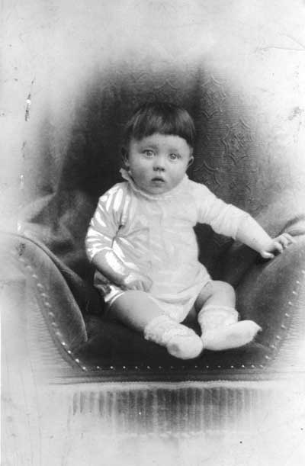
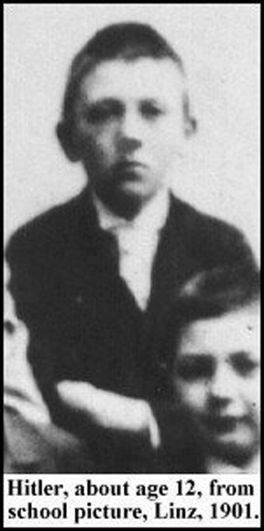
Adolf Hitler was born in 1889. His father frequently physically abused him, probably not uncommon for the time. After his father’s death in 1903, when Adolf was 14, he took his mother’s name, Schikelgrueber, but later changed it back to Hitler. He lived with his mother, aunt and younger sister in a carefree “cosseted” existence. Hitler attended Catholic Church and became an altar boy. Elements of the Catholic Church experience greatly inﬂuenced him--the “mysterious twilight in Catholic churches, the burning lamps and smell of incense and the dogmatic inﬂexibility of the priests.”

Slide 4
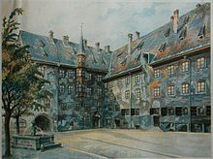
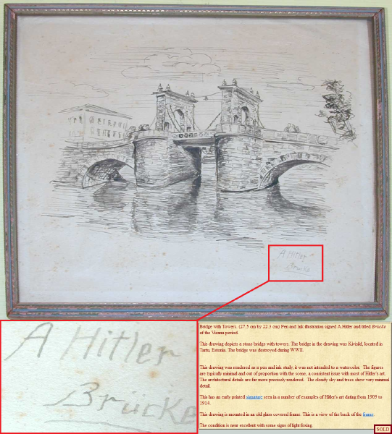
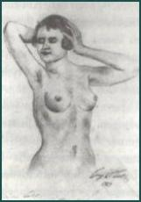
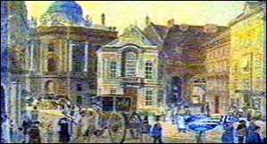
In 1907 Hitler’s mother died of cancer and he moved to Vienna. An orphan at age 18 he had delusions of artistic greatness and wanted to study at the Academy of Fine Arts but was rejected for two consecutive years.

Slide 5
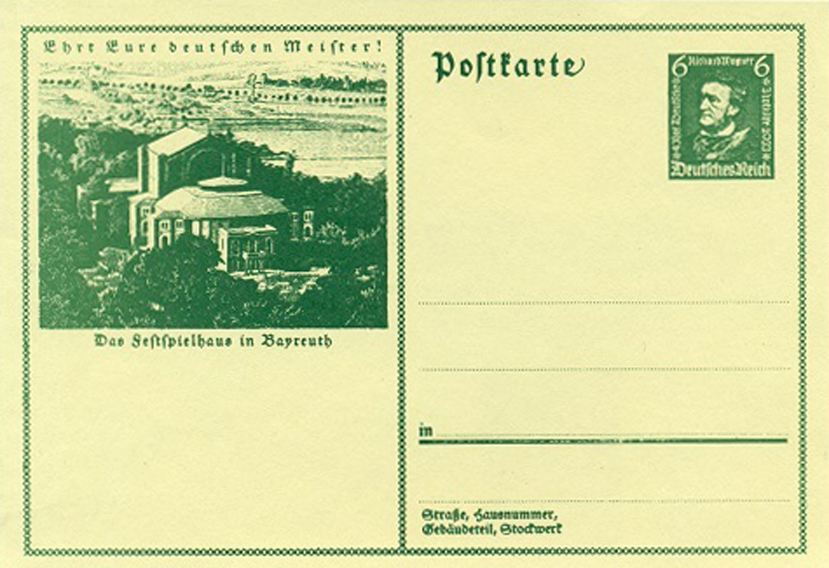
During the ages 18-20, which are peak years for the development of psychosis, both schizophrenia and manic depressive or bipolar illness. Hitler developed an obsessive interest in Wagner’s operas. These operas are full of heroic fantasy, love and death, power contest, and ideas of world domination.
Wagner and the Bayreuth Festspielhaus (Festival Opera House of Bayreuth)
Hitler became so obsessed with these operas that he spent the small inheritance from his father on his visits to the opera house. He went through all his money and ended up in a men’s charitable hostel funded by the Rothchilds. He did not smoke or drink. (Had he discovered both made him feel worse?) He had no girlfriends and no sexual activities because he was terriﬁed of getting venereal disease (paranoia). He regarded his self-imposed isolation and his apparent ostracism as an indication of his greater insight and originality.

Slide 6
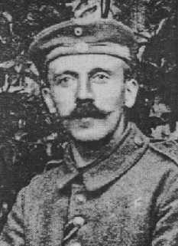
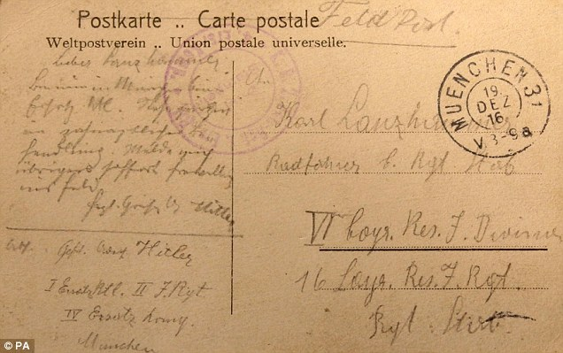
I believe his psychosis continued and when he enlisted in the Bavarian Army in 1916 he behaved with no evidence of fear. This resulted in the award of the Iron Cross twice for conspicuous bravery under ﬁre. It is of interest that one of his expectations of the Hitler youth was the total absence of fear.
“Dear Lanzhammer, I am now in Munich at the Ersatz Btl (battalion). Currently I am under dental treatment. By the way I will report voluntarily for the field immediately.
Kind regards, A. Hitler”
Recently discovered Fieldpost card written by Hitler addressed to a member of his regimental headquarters.

Slide 7
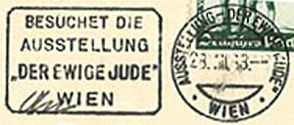
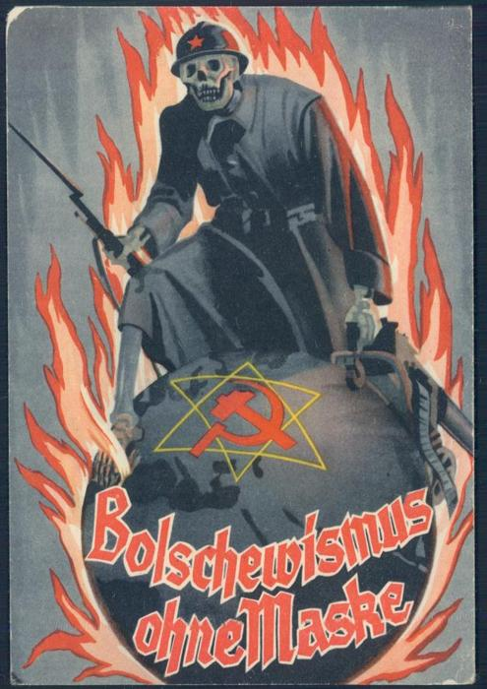
After the First World War ended Hitler was in the hospital, possibly because of severe depression, ostensibly because he had been gassed. Over the next few years Hitler focused on the elimination of all Jews and expression of his hatred for Communism, homosexuality, and the gypsy population.
“Der Ewige Jude” (The Eternal Jew)
(Bolshevism without a Mask)

Slide 8
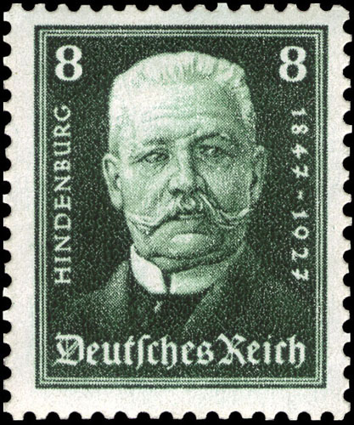
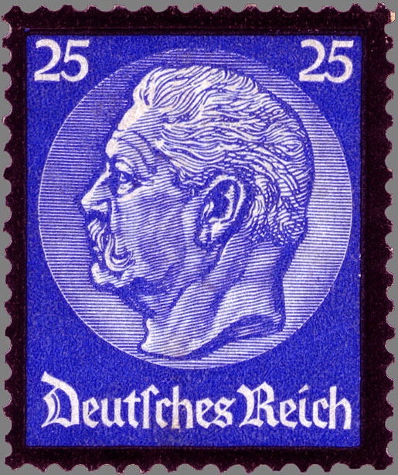
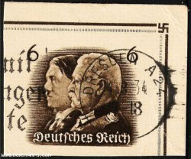
Hitler reached the highest position of power in Germany in a number of ways:
The election for the Presidency following the death of Paul von Hindenburg was run by the Nazi Party. There was rampant voter fraud and the ballots were collected and the counting supervised by members of the Party. Hitler was declared Chancellor with a vote of 90.3% and then assumed the position of President by ﬁat.

Slide 9
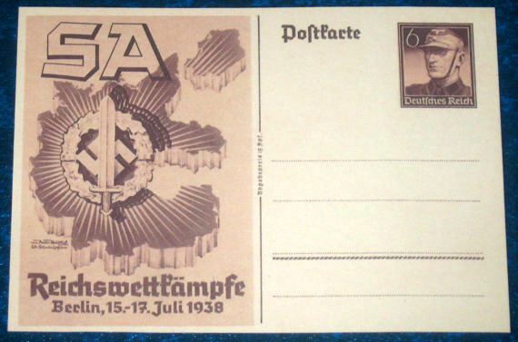
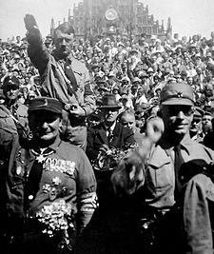
Establishing a following of men who would carry out his wishes, even if these included brutal intimidation of those opposing him and often the murder of individuals or whole groups of friends and their associates who once supported him but had become “too powerful”. The Sturmabteilung (SA) Brown Shirts are one example.

Slide 10
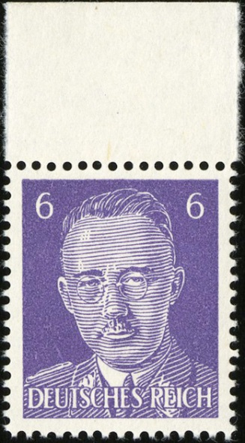
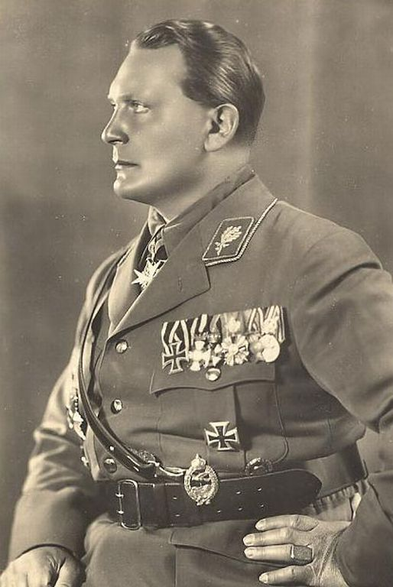
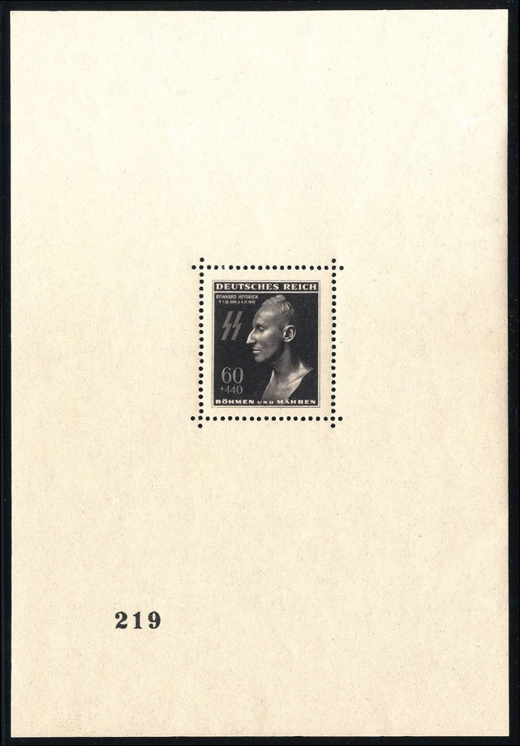
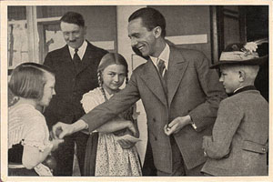
Attracting brutal extremists like Adolf Eichmann, Joseph Goebbels, Hermann Goering, Reinhard Heydrich, Heinrich Himmler and Gregor Strasser.
Herman Goering
Joseph Goebbels
Himmler Allied propaganda fantasy
Heydrich “Death Mask” numbered sheet, print run of 1000 issued, estimated 100 surviving examples

Slide 11
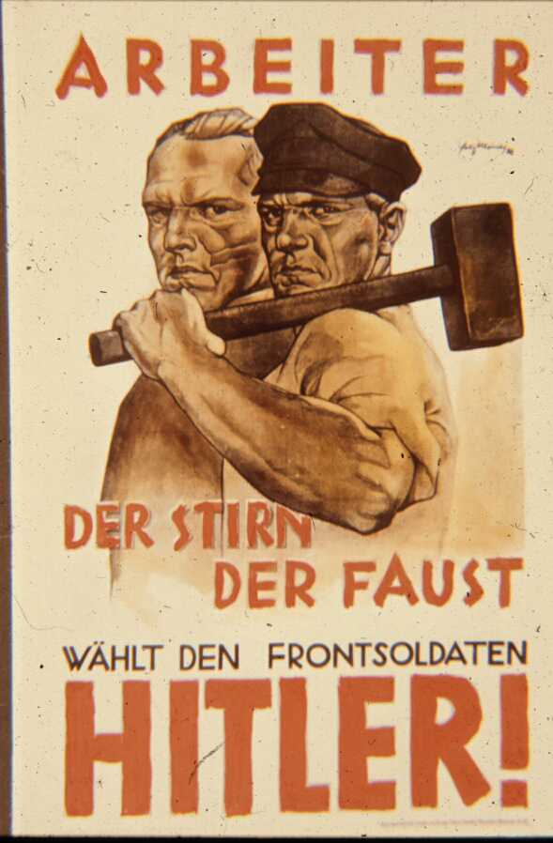
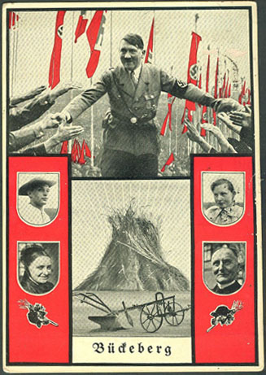
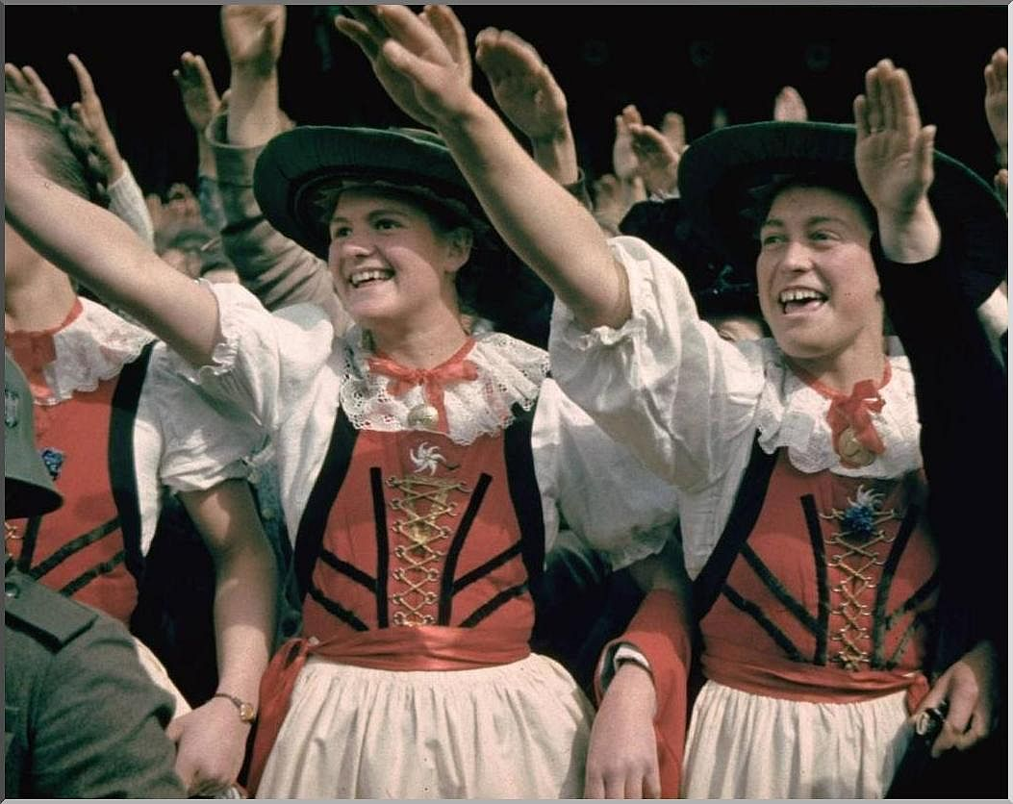
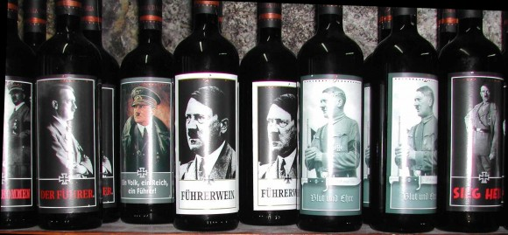
Improving the quality of life for millions of Aryian Germans by reducing poverty, unemployment, and deﬂecting the national acceptance of shame for WWI onto the Jews and the wealthy industrialists.
Providing paid vacations under the Health and Welfare Act.

Slide 12
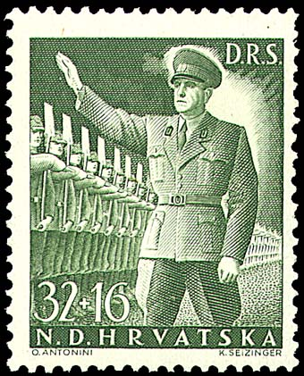
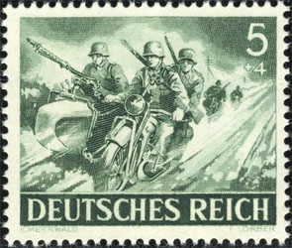
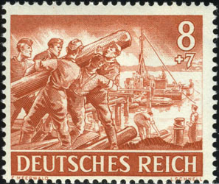
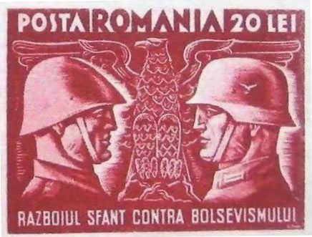
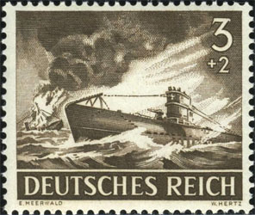
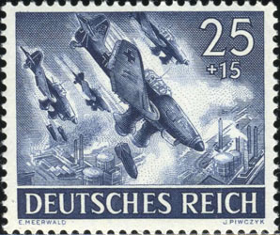
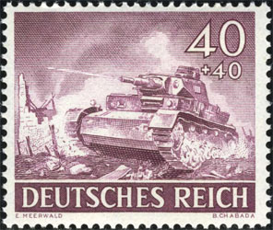
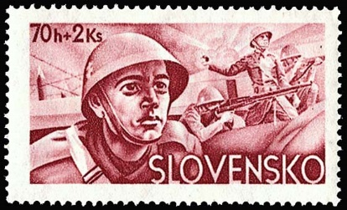
By creating the largest army ever seen in Europe, producing powerful weapons, tanks, aircraft and a large navy, especially the submarine ﬂeet, making Germany once again the strongest power in Europe.
By declaring war on Communism, the subject of fear by many European and British governments following the brutal Russian Revolution of 1917.

Slide 13
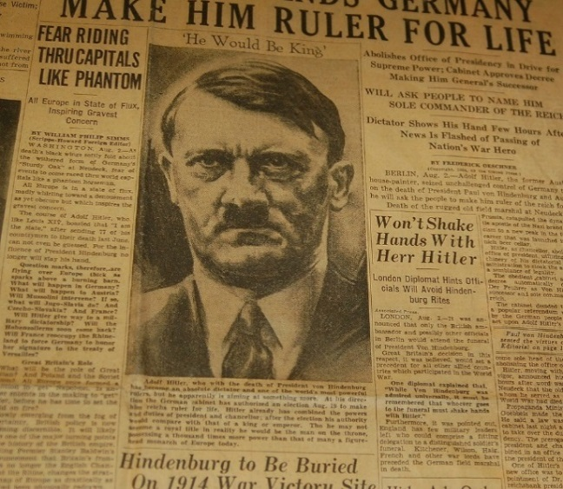
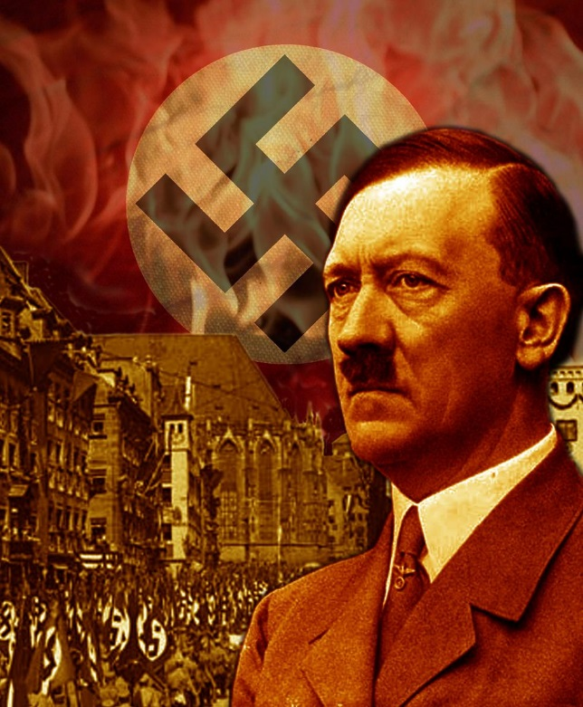
The verdict of most people who had studied Hitler is that he was “mad”. That is a very vague term, but there are very few clues as to what his “madness” really was. Are we talking about Schizophrenia, some similar psychotic disorder, a major personality disorder such as Anti-Social Personality Disorder or something else? There is no consensus.
Going through my German stamp collection I became aware of a number of stamps which together strongly supported a diagnosis of Manic Depressive Psychosis or Bipolar illness. I would like you to look at these stamps, then I will provide a brief explanation of bipolar disorder. Finally, by looking at the Wagner set of operatic stamps, I will suggest how this all began.
In my medical experience, including fourteen years on staff at the Rochester Psychiatric Center, the belief that “One is God” is a hallmark of psychosis. Schizophrenics are most of the time obviously psychotic, people with Manic Depressive Psychosis can appear normal much of the time.

Slide 14
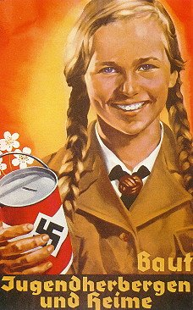
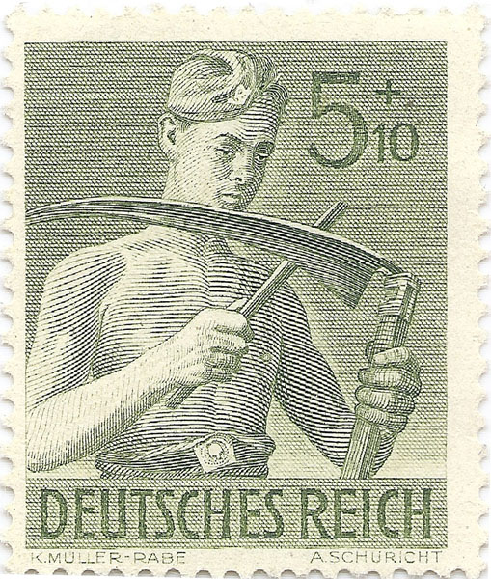
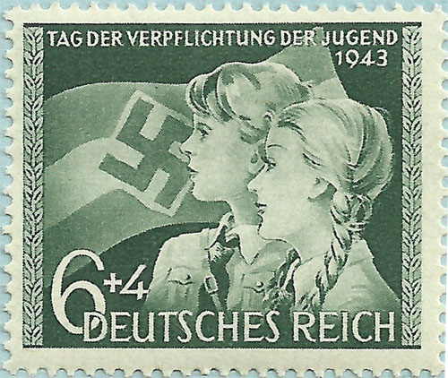
In 1937 Hitler established two organizations, the Hitler Youth (Hitler Jugend) and the League of German Girls (Bund Deutcher Maedel). At first, membership was voluntary; later it was compulsory.
Hitler said of the Hitler Jugend, “I want violently active, dominating, brutal youth, indifferent to pain. I will have no intellectual training, knowledge is ruinous to young men.” Their motto was, “Loyalty Unto Death.”

Slide 15
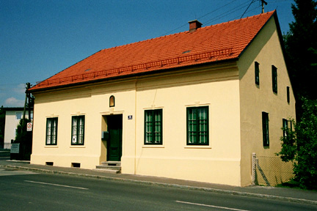
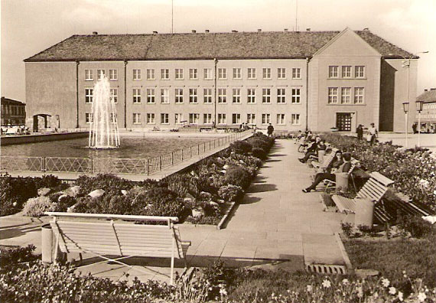
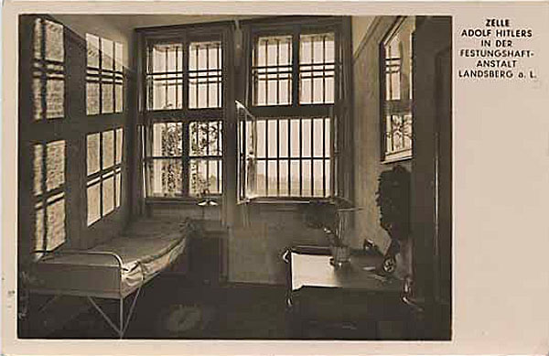
Several places associated with Hitler came to have semi-religious attraction--shrine sites for Hitler worshippers:
His birthplace in Brainau, especially the room where he was born.
The site of the ﬁeld hospital in Pasewalk where Hitler was treated in WWI.
Landsberg Prison, where he was incarcerated in cell #7 for nine months after the attempted government takeover (The Munich Putsch) in 1923. It was here that he wrote “Mein Kampf.”

Slide 16
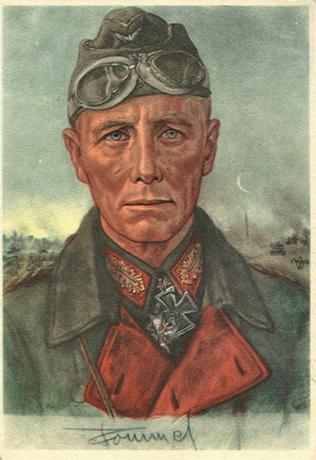
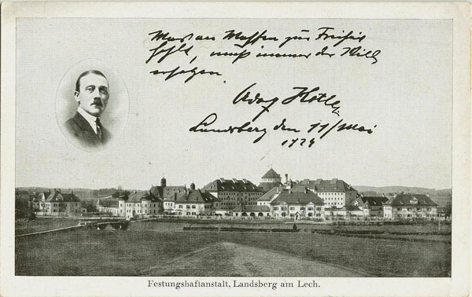
During a march of Hitler youth to see Landsberg Castle (and Prison) Hitler required all of them to swear allegiance to him: “Treu auf bis dem todt”--Loyalty unto Death. This picks up the theme of Paranoia, the expectation of absolute obedience. The Oath of Obedience was also required of every member of the armed forces and all public ofﬁcials. One German general talking about the signiﬁcance of the oath said, “A German ofﬁcer does not break an oath sworn before God.”

Slide 17
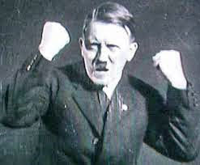
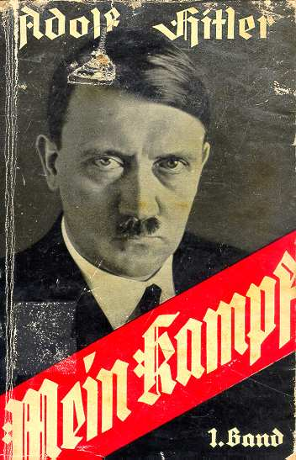
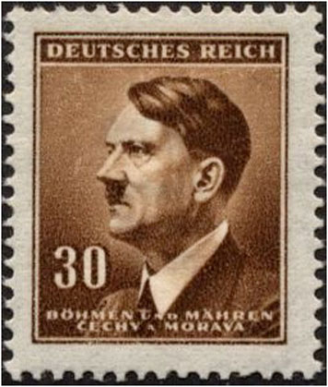
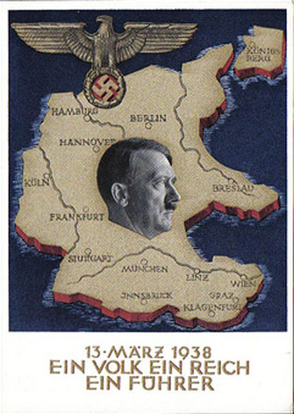
George Orwell, who wrote a brilliant review of “Mein Kampf.” said, “In photographs, Hitler often has a pathetic, doglike face, a man suffering under intolerable wrongs. It reproduces the expression on the face of Christ cruciﬁed and there is little doubt that that is how Hitler sees himself.”

Slide 18
In a quote from the book “Hitler’s Charisma” (2012), Lawrence Rees says, “The hordes of Germans who traveled--almost as pilgrims--to pay homage to Hitler at his home above Berchtesgaden; the pseudo-religious iconography of the Nuremberg rallies, the fact that German children were taught that Hitler was “sent from God” and was their faith and light; not as a normal politician but more a prophet touched by the Divine.”

Slide 19
So now we come to what, in my opinion, are the most extraordinary stamps of the Third Reich (1933-1945), the Wagner set of stamps based on his operas.
Postal announcement of the 1933 Wagner stamp release.

Slide 20
Themes of Wagner operas:
Glorifying the ancient splendor
of Germany and its Teutonic Gods.
Renunciation of Christianity.
Glorifying the rebirth of an Aryan
Master Race.
The Ring of the Nibelung (A Gold
Ring). Whoever wears it will have to
renounce love but will rule the world.
Liebestod (Love-Death)- Lovers dying together.
Fighting and death, murder,
separation and loss.
Intermingling of Gods and mortals.
The operas were huge productions with dramatic sets. Hitler was so obsessed
with the “heroic” nature of Wagner’s
work that he saw Lohengrin at least ten
times and spent all of his small inheritance attending performances of Wagner operas.

Slide 21
BIPOLAR DISORDER
Bipolar Disorder is a disorder in which moods swing from depression through normal to mania, which is a special kind of high feeling. Symptoms during episodes of mania or depression can be mild, moderate or severe and can last for hours, days or weeks. The diagnosis of mania requires at least four out of a list of twelve symptoms. I have selected those I think apply to Hitler:
Increased energy and activity. During his manic episodes Hitler experienced increased energy and activity. He needed only a few hours of sleep, yet was very active the next day.
Racing thoughts and very fast-talking. Schroeder, Hitler’s associate, recalls a meeting, “Hitler was talking the whole time and dictating to two secretaries. He was behaving like an absolute maniac.”

Slide 22
Having an inﬂated feeling of power, greatness, or importance, or an unrealistic sense of his abilities. Hitler clearly regarded himself as God, with total power over anyone he came in contact with.

Slide 23
Difﬁculty getting to sleep. This was so bad Hitler received an injection of sleeping medication every night and then an injection of an amphetamine like drug to awaken him.
Aggressive behavior. Frequently Hitler had someone murdered, usually because he felt that person had too much power or was perceived to have disobeyed Hitler.
Abuse of drugs. Sleeping medications or amphetamine-like drugs.
Unusual sexual behavior. There are many assertions that Hitler had engaged in unusual sexual behaviors.

Slide 24
Spending sprees. Hitler borrowed millions of marks and began a huge building program, including construction of the Autobahn, upgrading the rail system and stockpiling huge quantities of armaments. He knew he could not repay the loans unless Germany went to war, steal money and steal saleable objects. He also planned to use people from occupied countries, especially in Eastern Europe, as slave laborers.
Extreme Irritability. Hitler had planned to speak at the launch of the Battleship Tirpitz but heard that Great Britain and France had announced they would declare war if Hitler invaded Poland. Hitler was in such a rage he had to cancel his speech. There are many other stories of Hitler losing control.

Slide 25
Depression, includes feeling sad, hopeless, helpless, empty, fatigued, unable to do things or lack of interest in doing things previously enjoyed. Sometime after the end of WWI Hitler spent some time in a hospital. No record I’ve found stated why but, given the secrecy, could have been depression. After the suicide of his niece, with whom Hitler was in love, he was deeply depressed for several months.
Triggers are events that may precipitate an episode of mania or depression.
Sleep deprivation.
Use of alcohol. Hitler gave up all forms of alcohol.
Smoking can trigger mania. Hitler never smoked.
Death of someone close to you. His mother?
Diet can have a strong impact on susceptibility to a manic episode. Protein snacks in the evening can increase insomnia. Hitler became a vegetarian and was helped to find mood stabilizers--oil-rich fruit, vegetables, whole grains, B vitamins and Vitamin C.

Slide 26
SUMMARY
Hitler’s total lack of pity for those killed was very obvious and extended to German troops, for example, those freezing to death on the outskirts of Stalingrad. His last public action was to ﬂood the Berlin underground system to slow the Russian advance, despite the fact that thousands of Germans had taken refuge there.
In addition to Bipolar Disorder, Hitler may have suffered from:
Antisocial Personality Disorder (ASPD)--Deceitfulness, impulsivity, aggressiveness, lack of remorse. Evaluation of people with ASPD often shows a charming manner, yet lack of concern about life style. Hitler lied constantly, which he said was often reversed a day later.
Paranoid Disorder--Suspicion of others, preoccupation with doubts about the trustworthiness of others, tendency to feeling attacked, bearing grudges and irrational sexual jealousy. This certainly applies to his relationship with his niece Geli, who committed suicide, blaming Hitler’s oppressive control and jealousy.

Slide 27
Hitler hated his father, loved his mother (he changed his name to hers), and, I believe, had the onset of Manic-Depressive Disorder at age 18-20, the typical time for onset, soon after his mother’s death.
He became infatuated with Wagner and his operas. Wagner was anti-Semitic, pro-Aryan, and a fanatic believer in a pure Aryan race. Hitler found the operas spellbinding, particularly the themes of world domination, Aryan supremacy and racial purity.
Final Diagnosis:
Manic-Depressive Psychosis (Bipolar Disorder)
Antisocial Personality Disorder
Paranoid Disorder
I also believe that Hitler, especially in the 1930s, was in an altered state and was transposing his opera-induced emotions onto his everyday life. Hitler did collect stamps, strangely those of Great Britain, and I suspect was involved in the design of German stamps. His mass gatherings were very “Wagnerian” and the design of a number of stamps also demonstrates this.

Slide 28
The End
Image Selection and Design Layout Tom Fortunato

