Slide 1
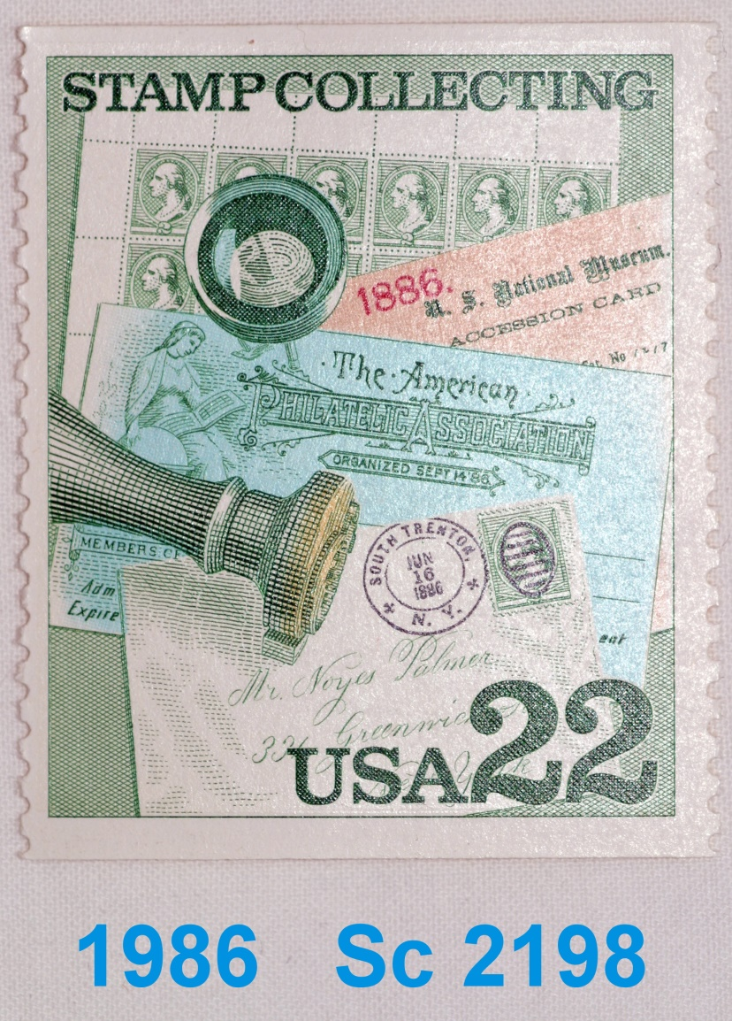
Hand Cancel Dies
Notes:
1986 Post office issue
With postal hand stamp killer

Slide 2
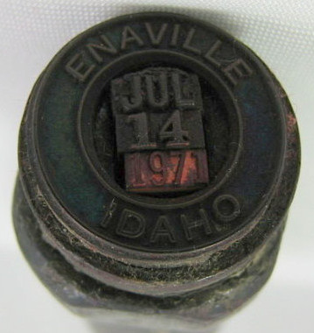
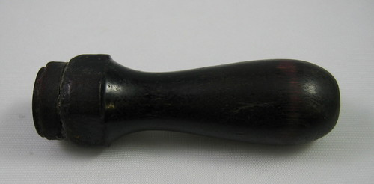
Enaville, Idaho
CDS

Slide 3
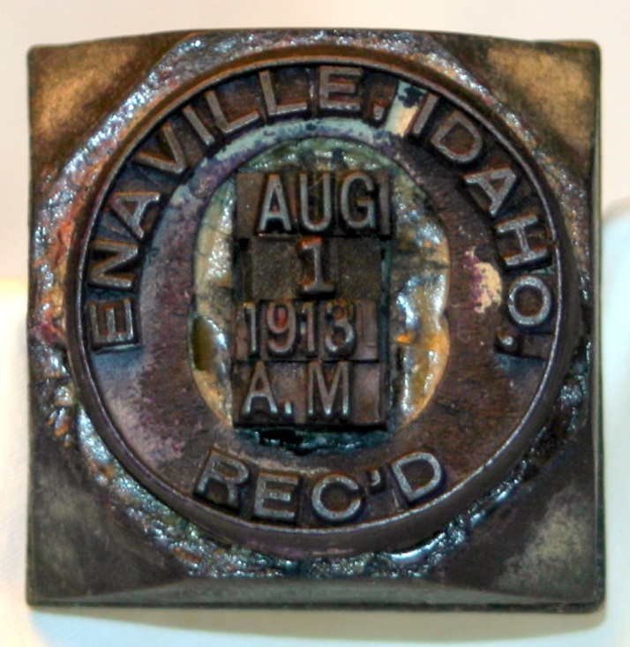
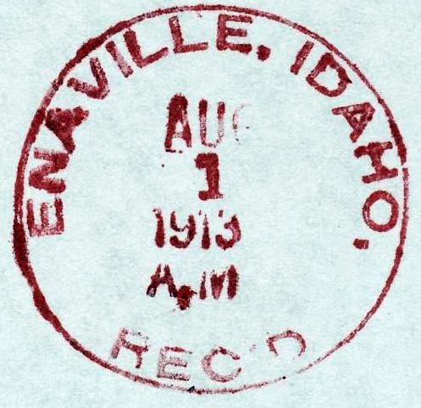
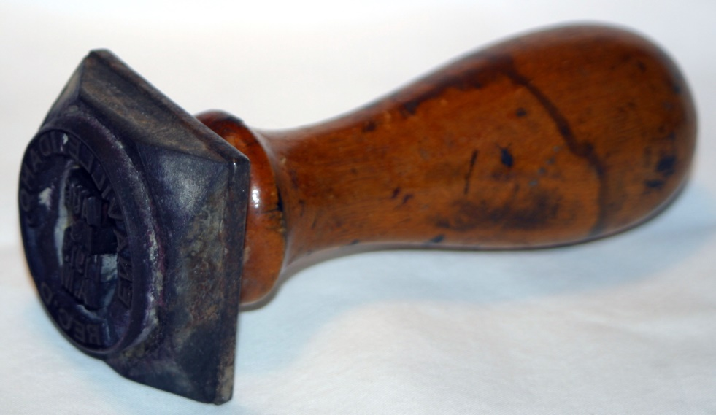
Enaville, Idaho
CDS Rec.

Slide 4
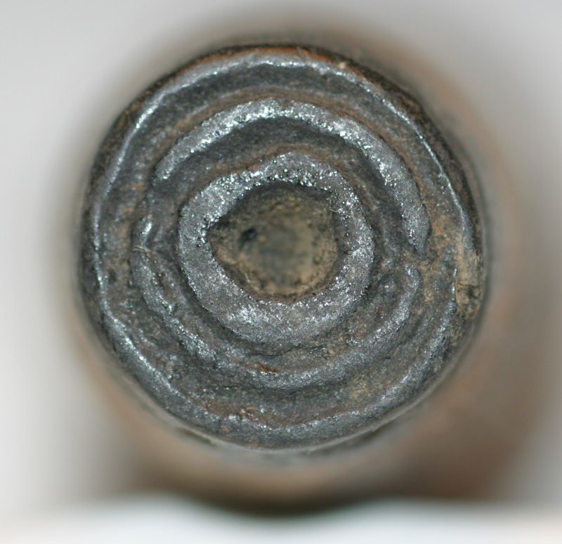
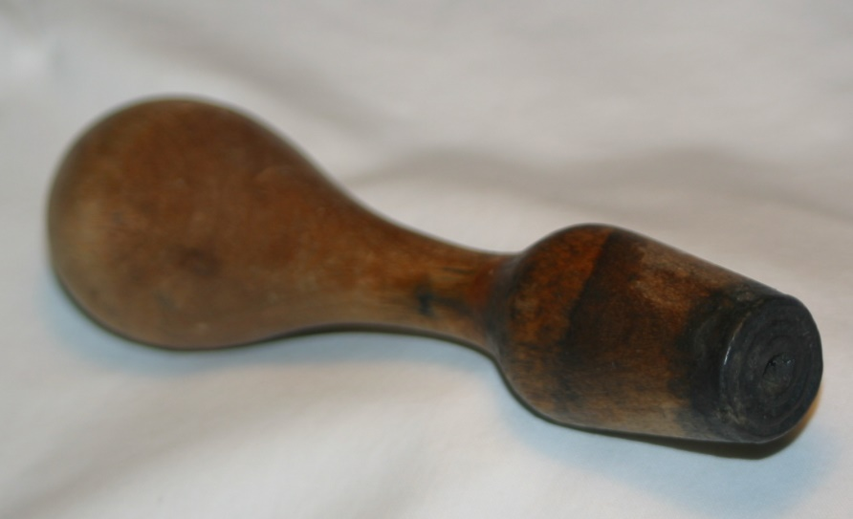
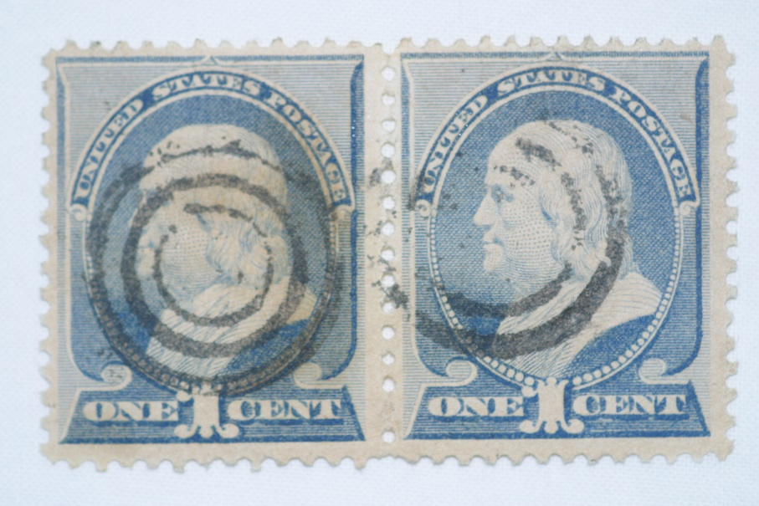
Obliterator
7/23/1860 PM General
Joseph Holt
Forbid the use of CDSs
Circular Date stamps
to cancel stamps.
Notes:
earliest die I own
Post master issue an order forbidding circular date stamps to obliterate the stamp

Slide 5
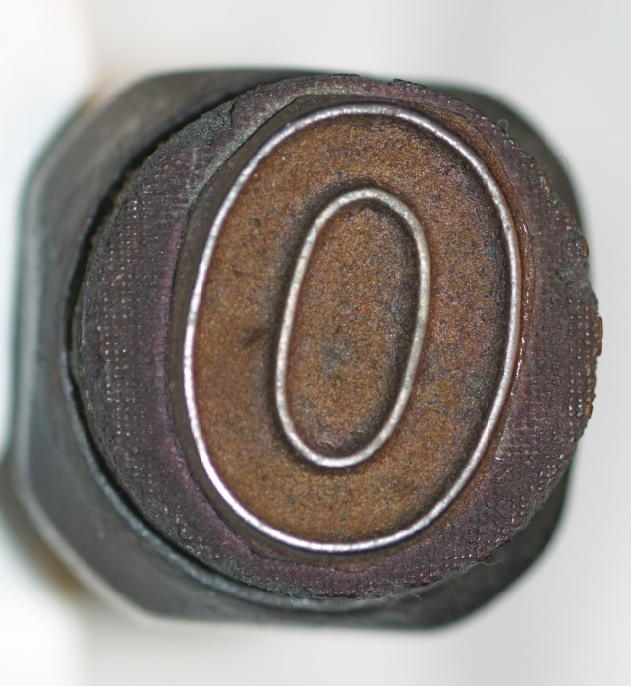
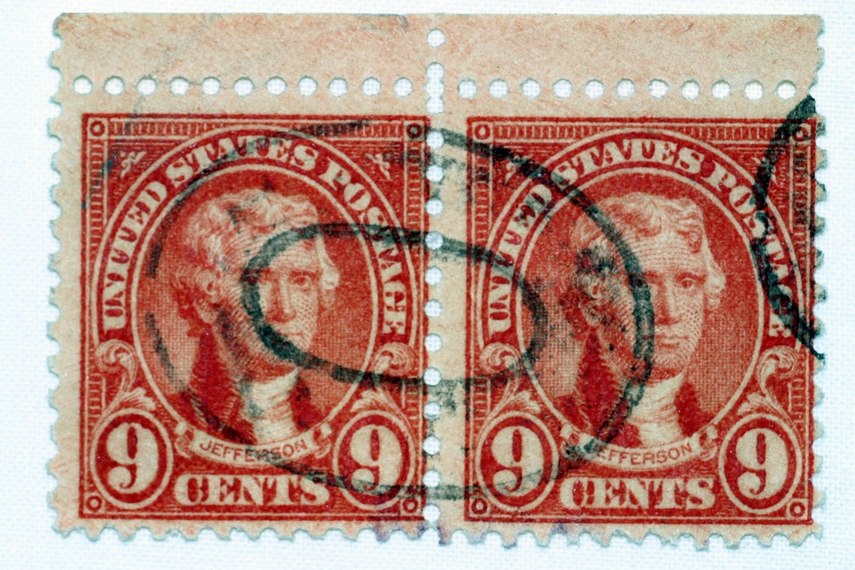
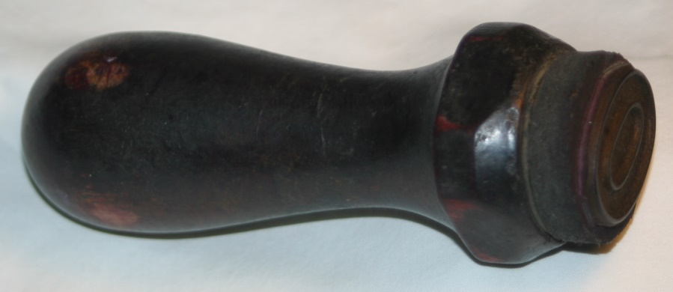
Oval
Obliterator
Notes:
More recent obliterator started in the 20’s

Slide 6
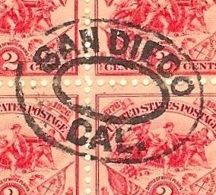
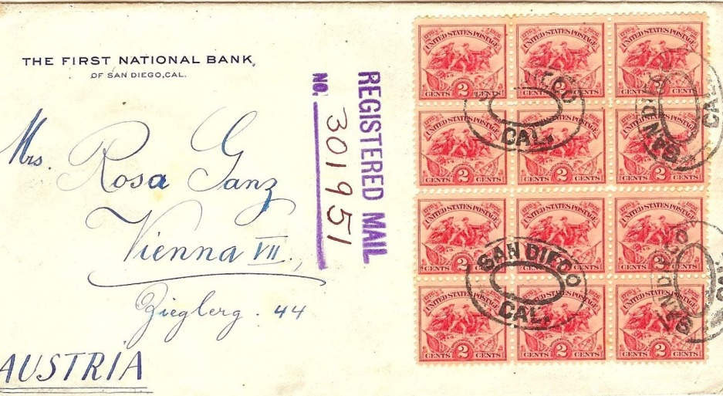
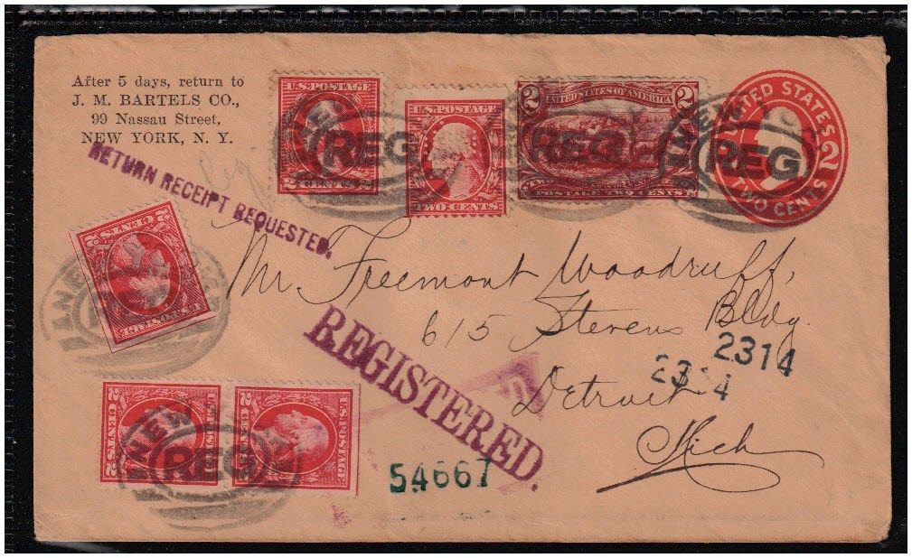
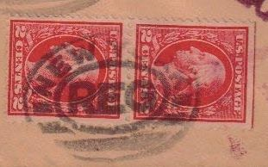
Registered Cancels

Slide 7
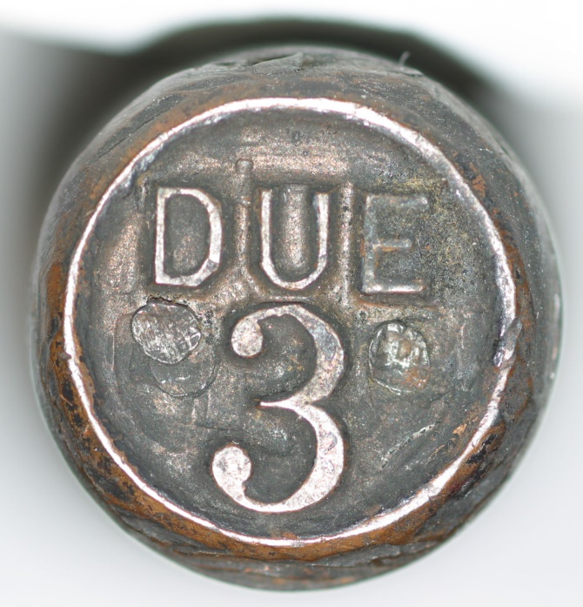
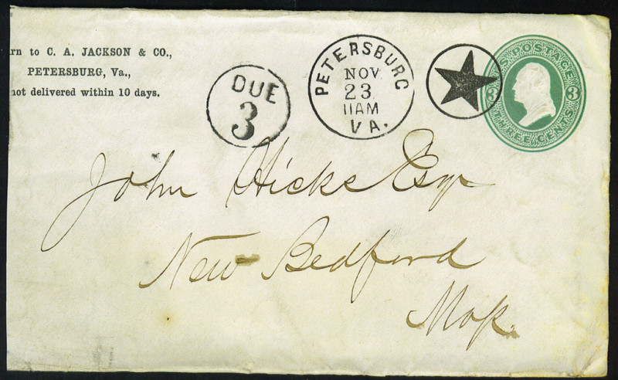
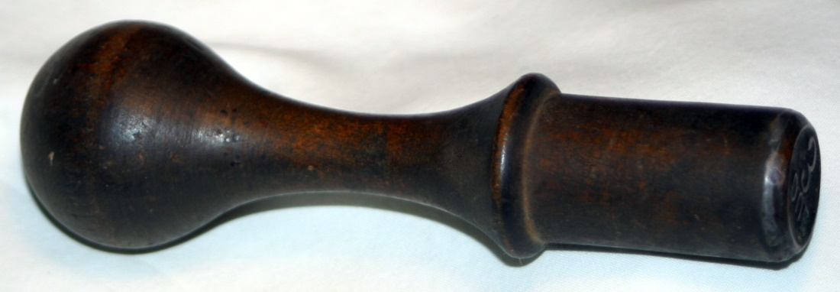
Postage Due
& Obliterator
& Circular Date Stamp(cds)
Notes:
Here is postage due
Interesting cover with 3 slug cds
Star oblitorator
Three cent Postage due

Slide 8
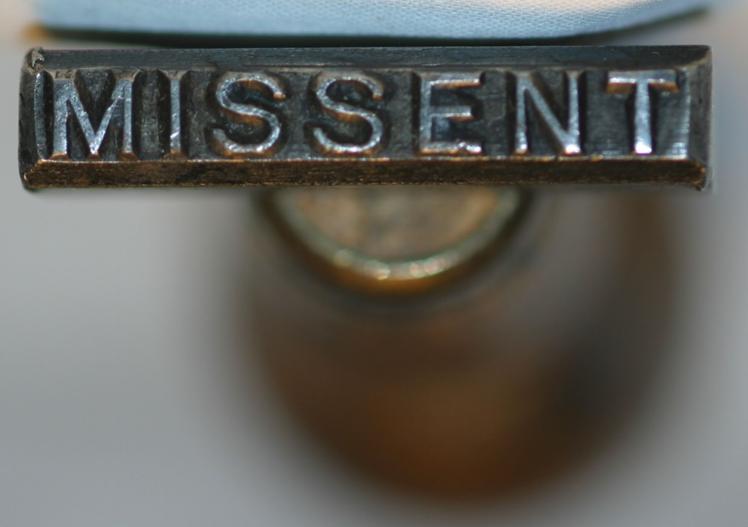
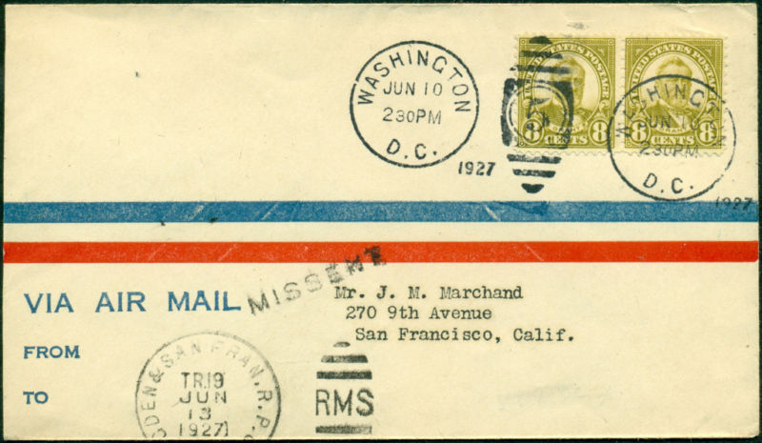
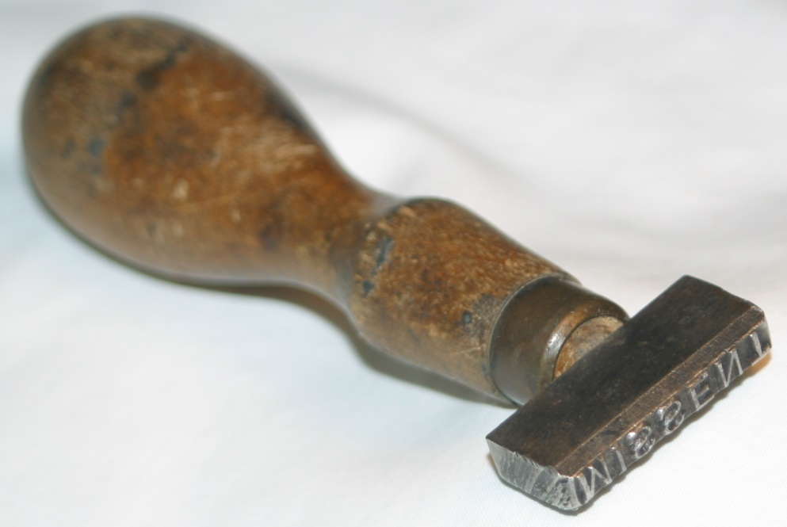
Missent
Notes:
Another interesting cover
triplex die with number 5 year outside
Duplex railway(RPO) die
And Missent

Slide 9
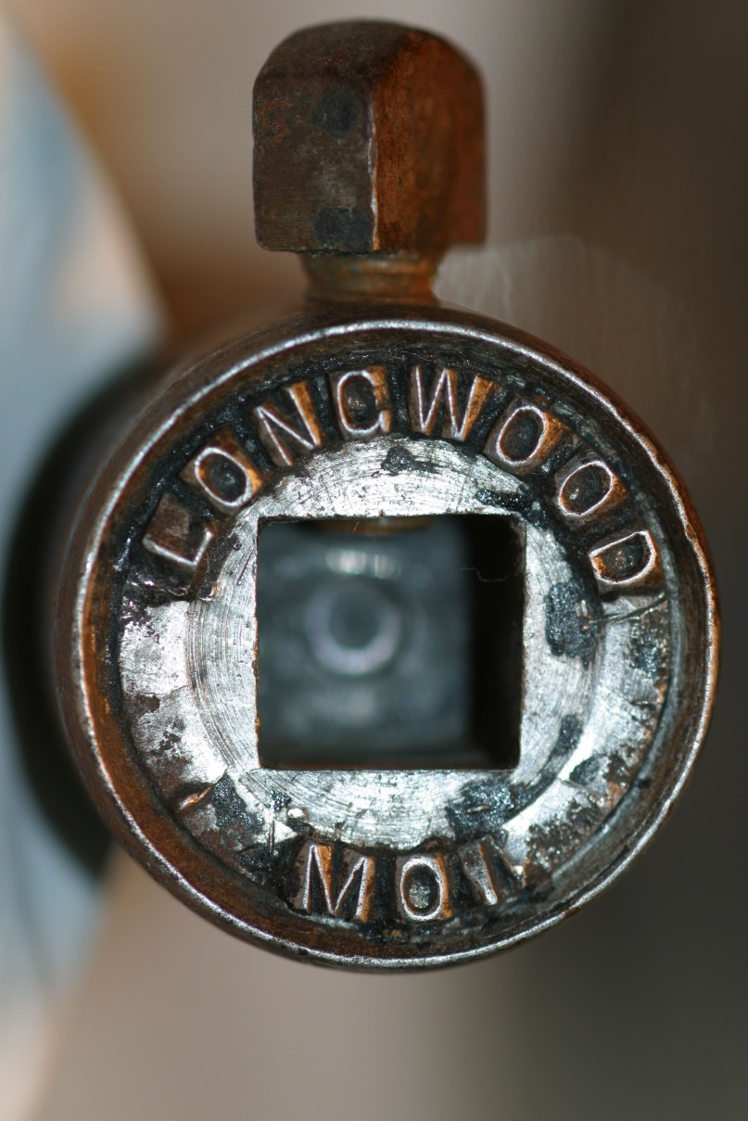
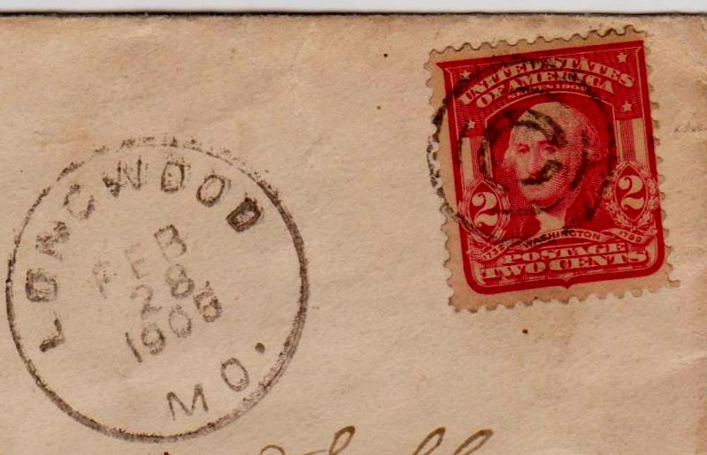
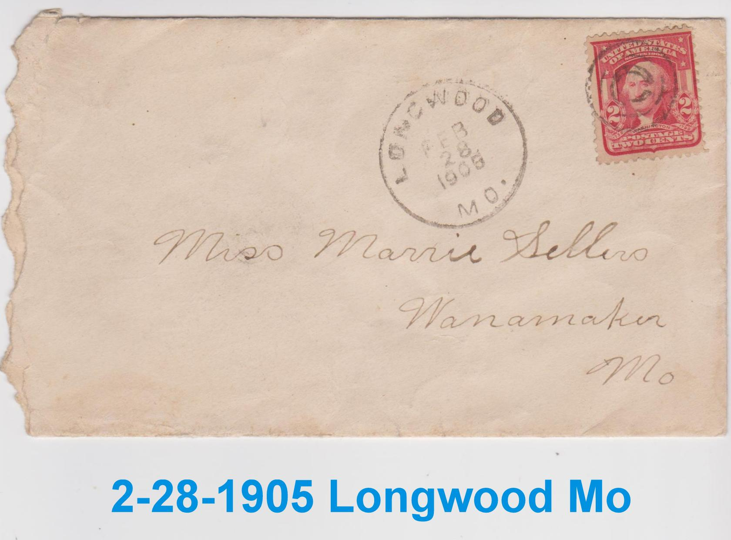
Longwood Mo
CDS
Notes:
Three slug CDS
Month
Day
Year
Cover with the die

Slide 10
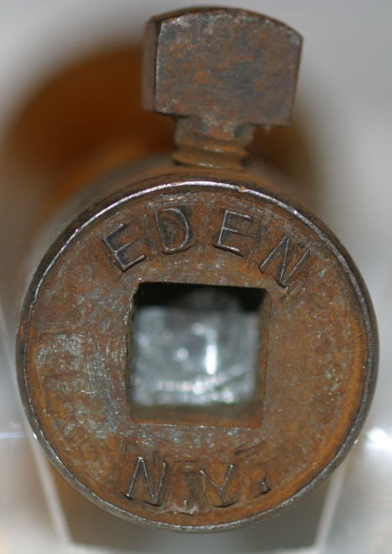
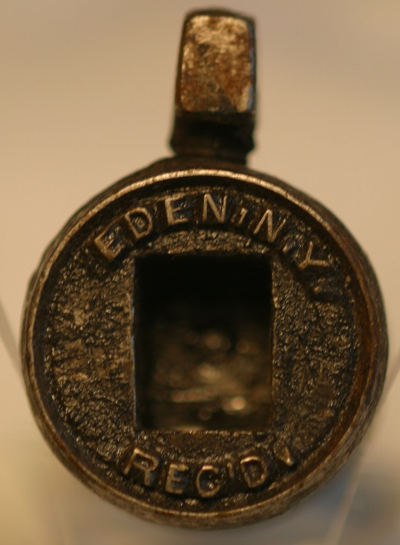
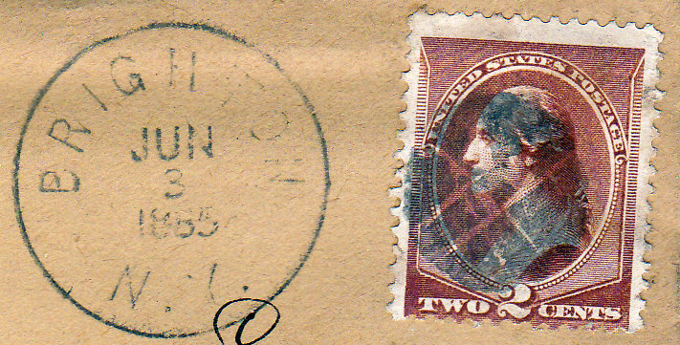
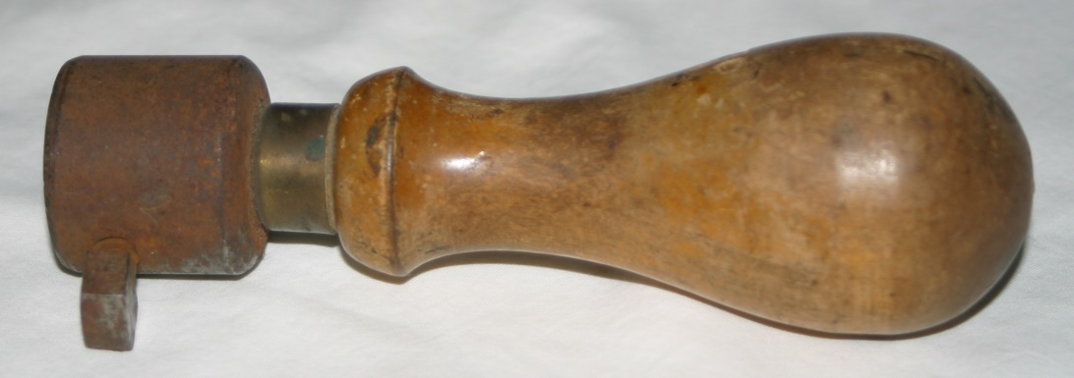
Eden N.Y.
CDS
Notes:
Seldom do I find covers to match stamp die
Both a 3 slug CDS
And 4 slug Receive CDS

Slide 11
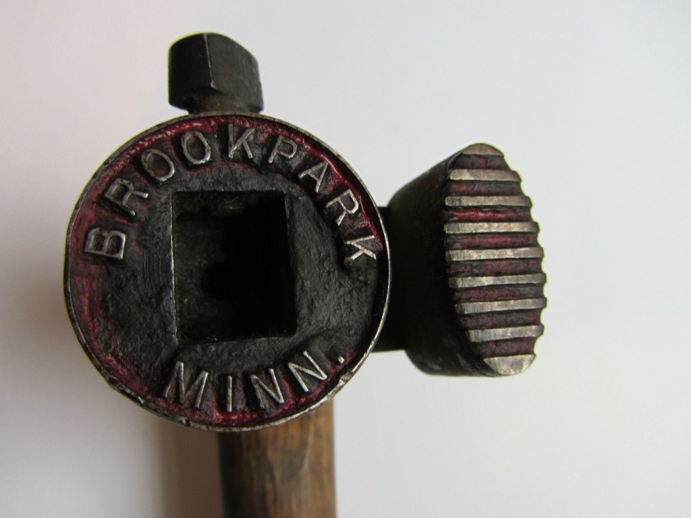
Duplex with Killer
Obliterator

Slide 12
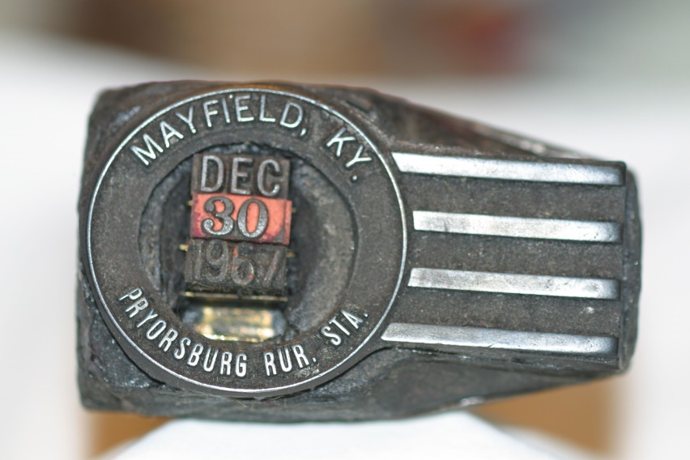
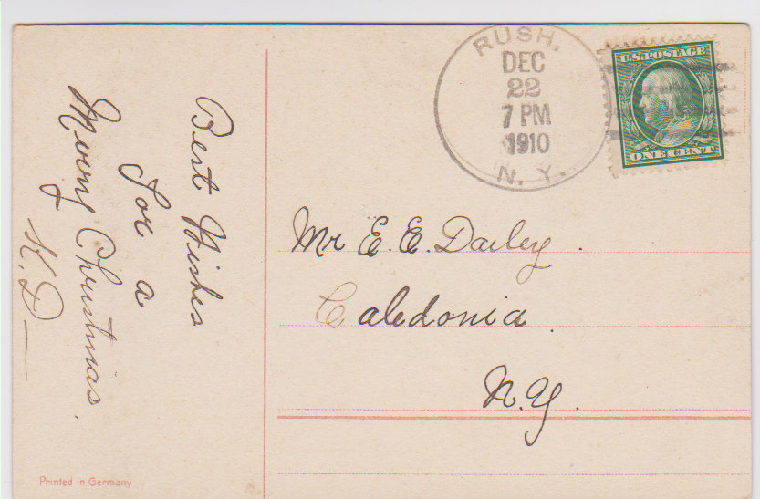
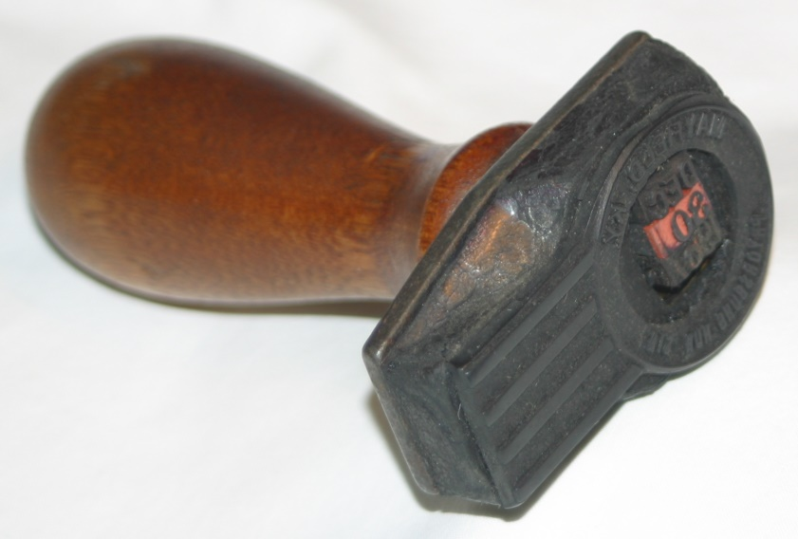
Duplex with obli.
Mayfield Ky
Pryorsburg Rur. Sta.
Notes:
About 1907
4 bar duplex Just after Doans

Slide 13
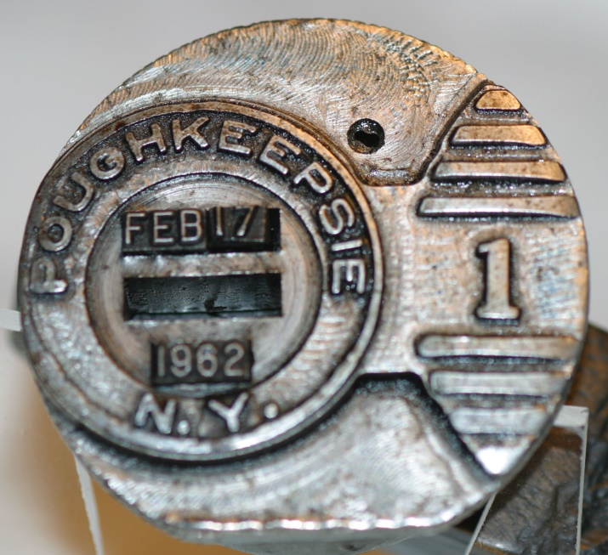
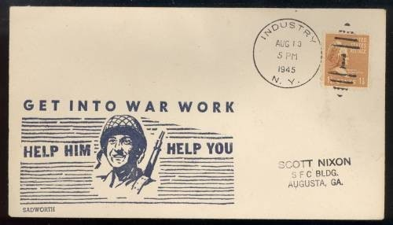
Duplex stamp die
Poughkeepsie N.Y.

Slide 14
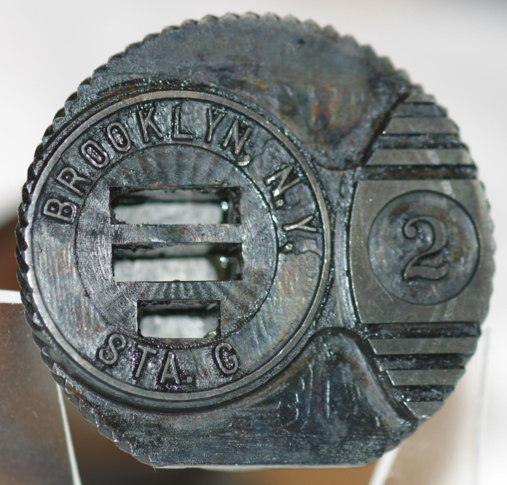
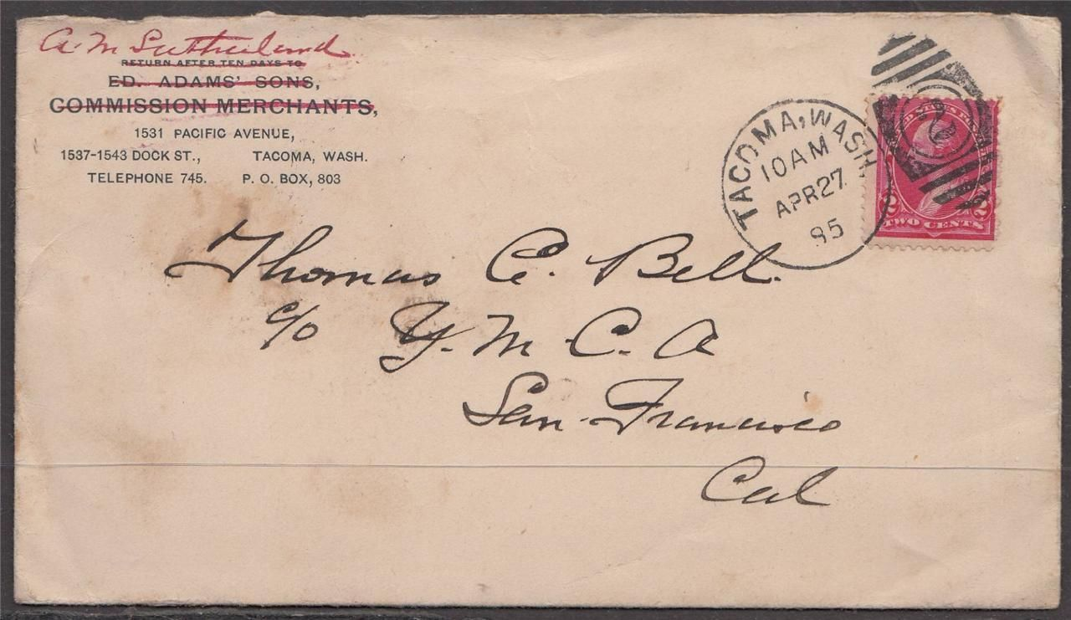
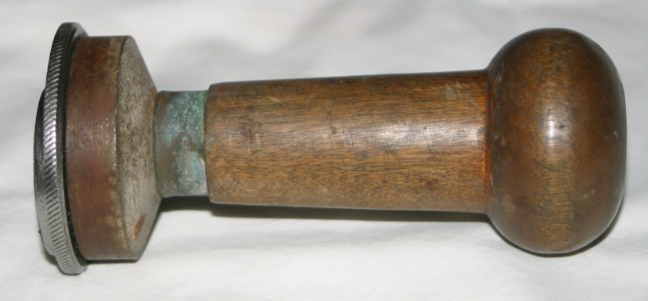
Brooklyn, N.Y.
Sta. G

Slide 15
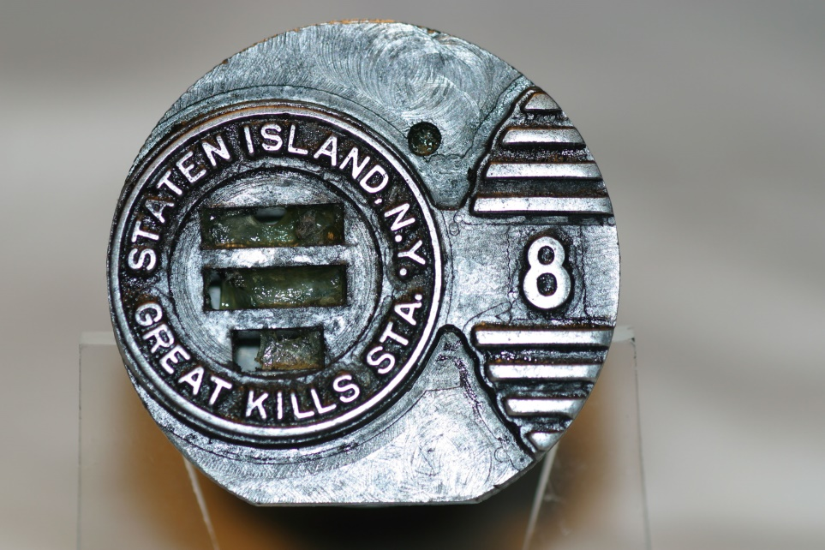
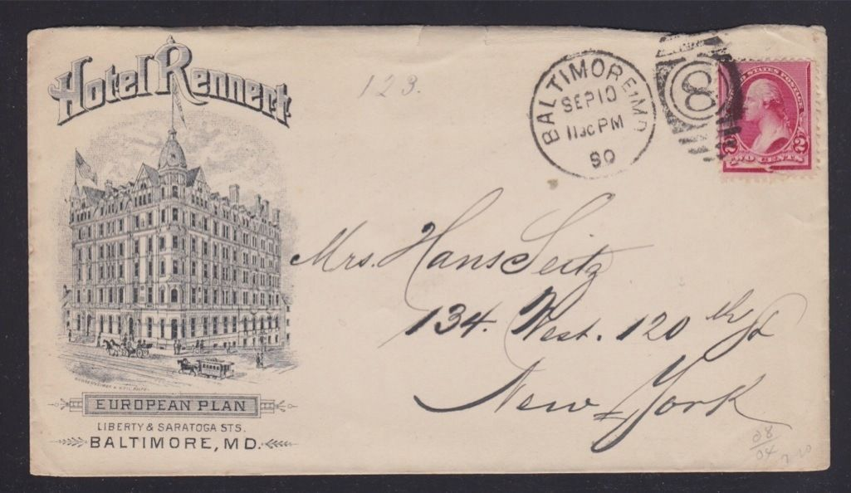
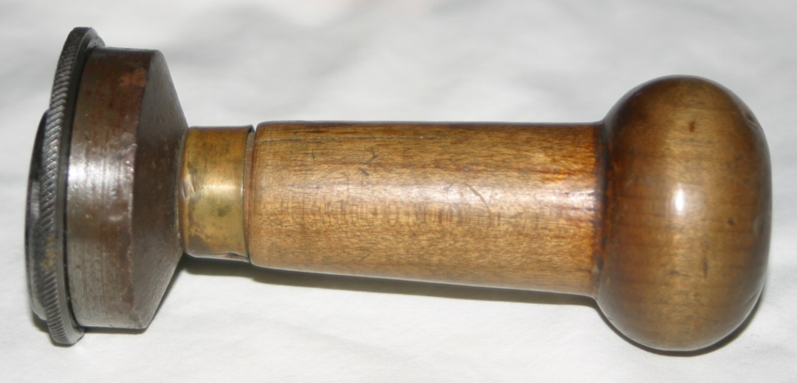
Staten Island, N.Y.
Great Kills Sta.

Slide 16
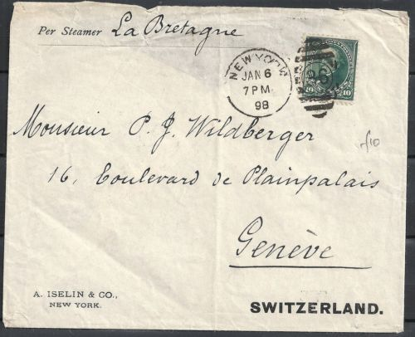
Highest Die Number 36

Slide 17
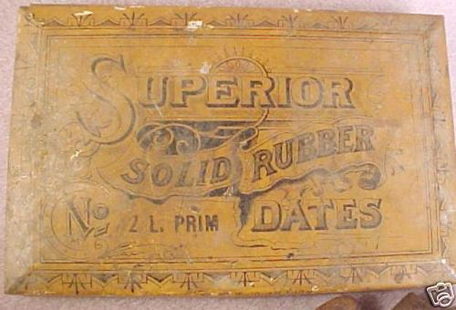
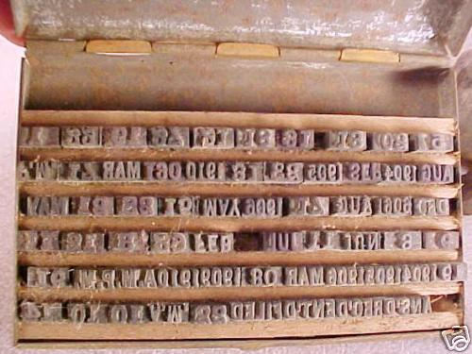
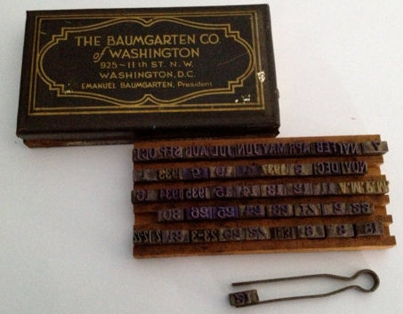
1904-1910
Date Slugs
1931-1937

Slide 18
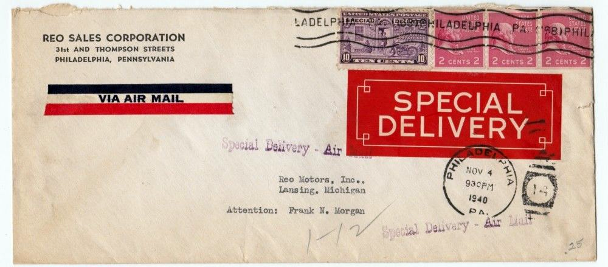
Pryorsburg Ky
Pre-ink roller

Slide 19
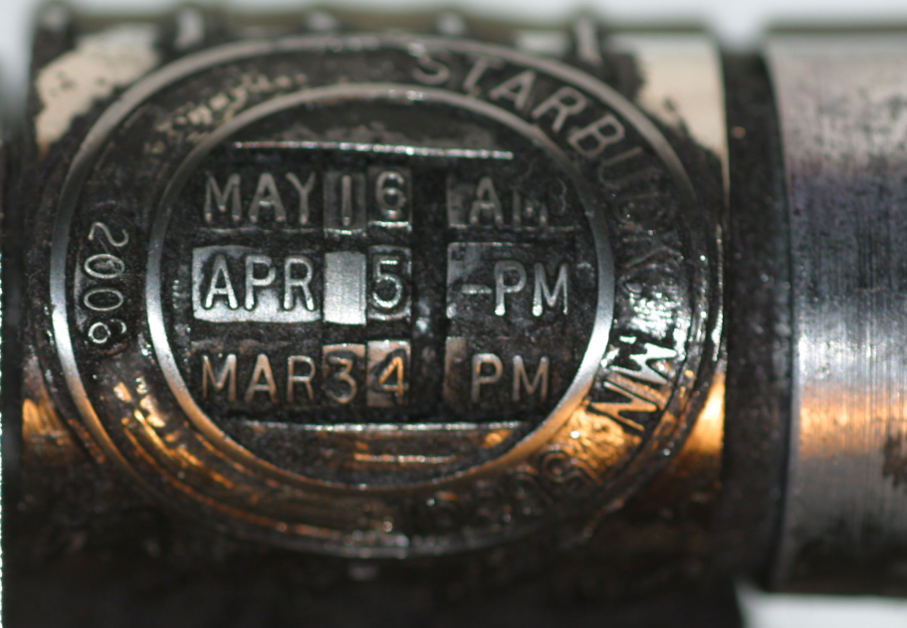
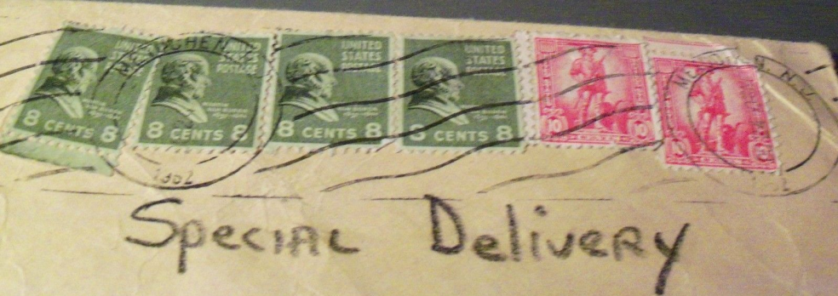
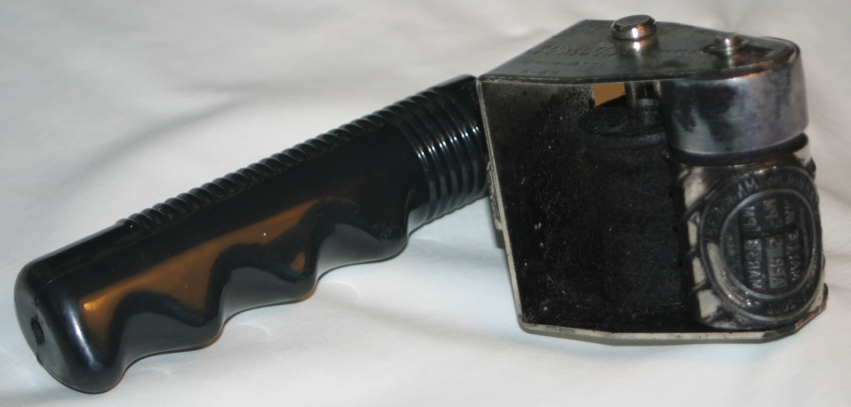
Starbuck Minn.
Pre-ink roller
Internal date/time

Slide 20
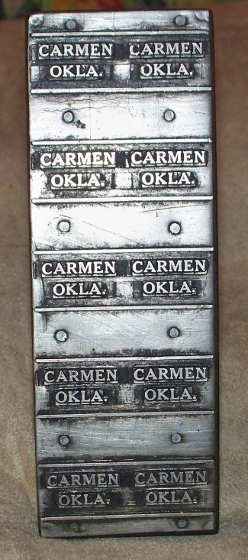
Carmen Okla
precancel
2x5

Slide 21
Greenville ILL.
precancel
5x5

Slide 22
Other Precancel Devices
Point Loma
Calif
5x5
Camden
Del
2x5

Slide 23
Other Precancel Devices
Bement
ILL
5x5
Englewood
Ohio
5x5
Orland
Calif
5x5

Slide 24
National Air Mail Week
(NAMW)
May 15-21,1938
New York, N.Y.

Slide 25
Canal St. Sta.
New York N.Y.

Slide 26
Church Street Sta.
New York. N.Y.

Slide 27
Colonial Park Sta.
New York. N.Y.

Slide 28
Peter Stuyvesant Sta.
New York. N.Y.

