Slide 1

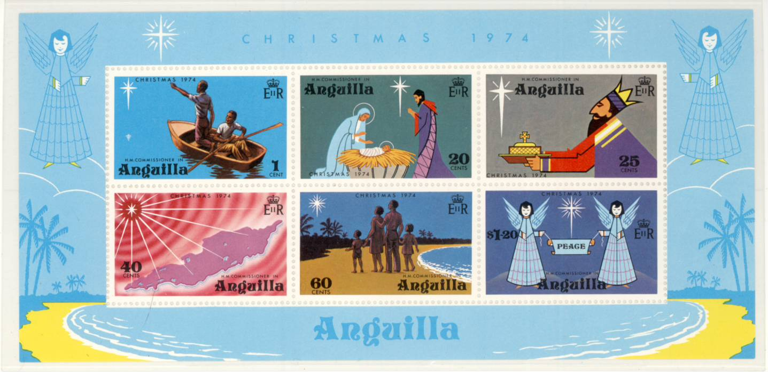
Christmas in Philately 2026
The beginnings of Christmas imagery and the Christmas Story through worldwide postage stamps
By Tom Fortunato, adapted from Florence Wright’s 2016 presentation

Slide 2
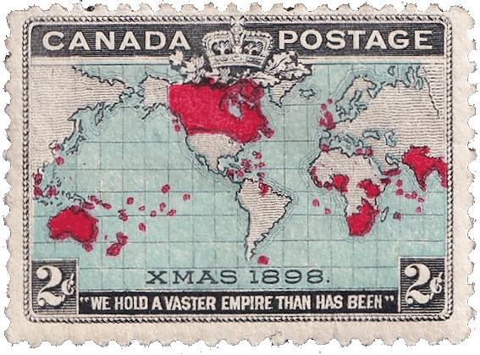
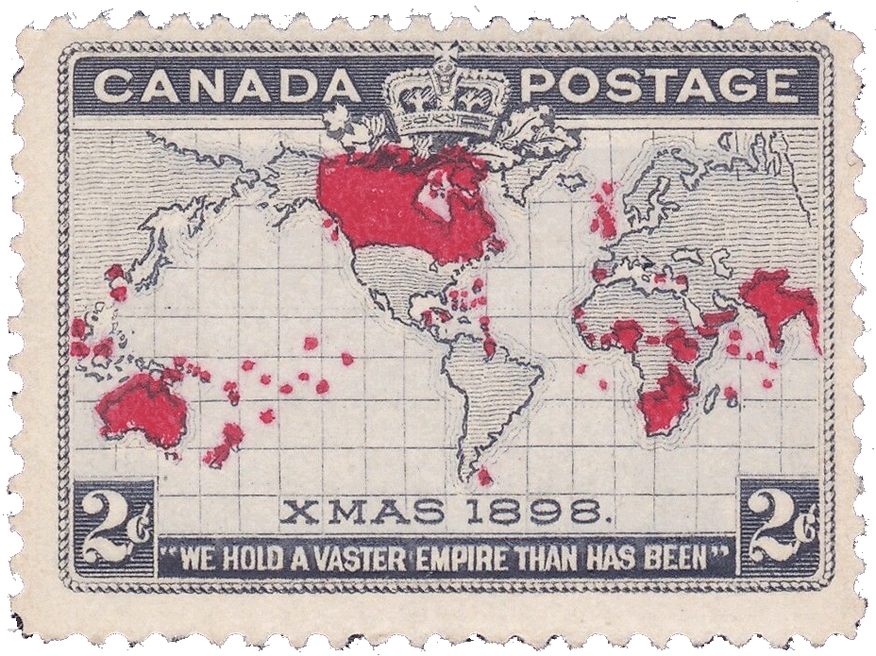
Considered the world’s first Christmas stamp, inscribed “XMAS 1898,” Canada’s December 7 issue of that year actually ushered in a postage rate reduction plan throughout the British Empire that began on Christmas day, December 25. The map design displays member countries and territories outlined in red. Several “sea” color varieties exist, including light blue and lavender.

Slide 3

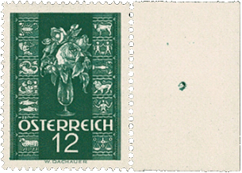
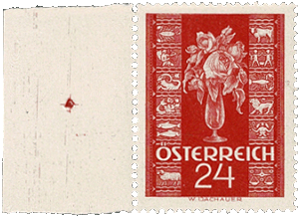
Christmas stamps have portrayed both classical religious themes and secular holiday related images, like trees, stars, candles, gifts, Santa Claus, winter scenes, music and even Disney characters. Austria’s commemorations started with a pair of greeting stamps in 1937. Professor Wilhelm Dachauer’s original design of the Christ-child floating in a star was rejected as being too religious and was replaced with a vase of roses framed by Zodiac signs.
rated for inland postcards and letters, valid until Oct. 31, 1938

Slide 4
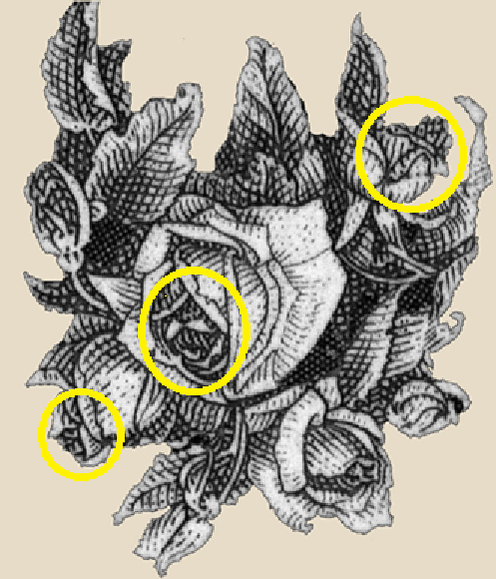
Interesting to note:
Reported by the designer’s friends years later after the impending Nazi Anschluss takeover of Austria, caricature faces of three politicians can be found among the rose petals when the stamp is turned upside down as shown here--Hitler (upper right), Mussolini (center) and the 1937 Japanese premier Hayashi Senjuro (lower left).

Slide 5
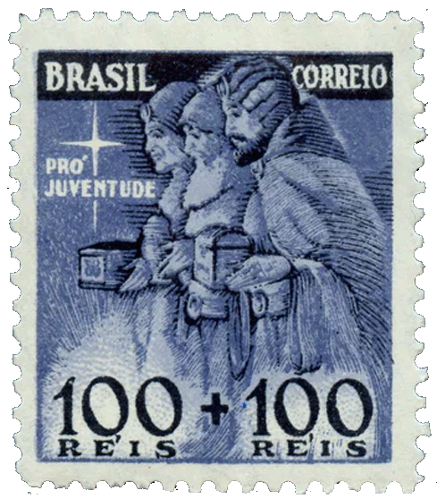
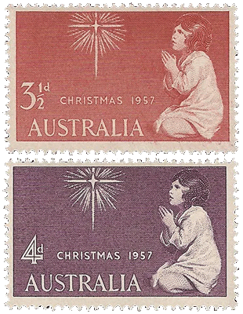
One of Brazil’s 1939 semi-postal designs two years later depicts the Three Wise Men. Australia’s first Christmas issue came out in 1957 in two denominations as a one-year experiment that became an annually release.
additional charge went to fund projects for children
Sir Joshua Reynolds, The Infant Samuel at Prayer, 1776. Musée Fabre, Montpellier, France

Slide 6
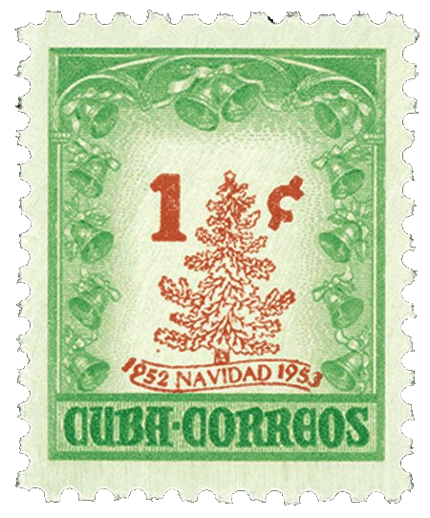
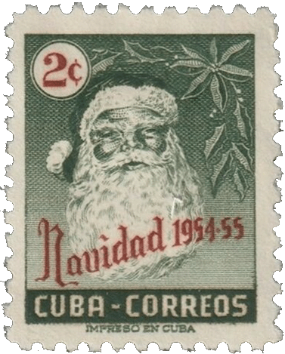
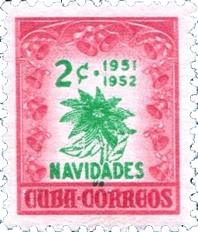
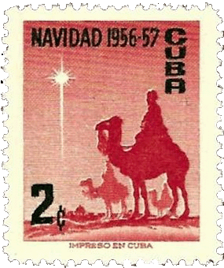
Beginning in 1951, Cuba was the first country to annually release Christmas postage stamps. They depicted mostly holiday imagery before the Cuban Revolution in 1959.

Slide 7

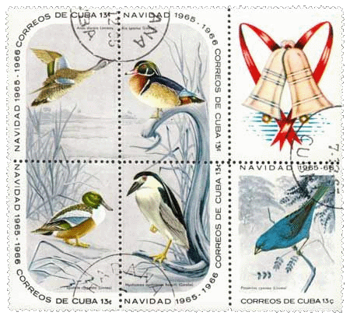
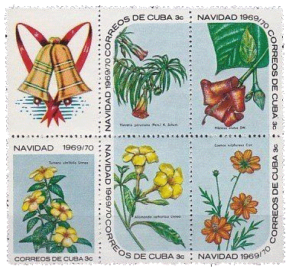

Afterwards they took on a decidedly non-holiday tone.

Slide 8
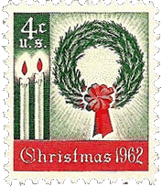
The U.S. joined the Christmas club on November 1, 1962 by issuing the 4-cent wreath and candles stamp, Scott #1205, in Pittsburgh, Pennsylvania.

Slide 9
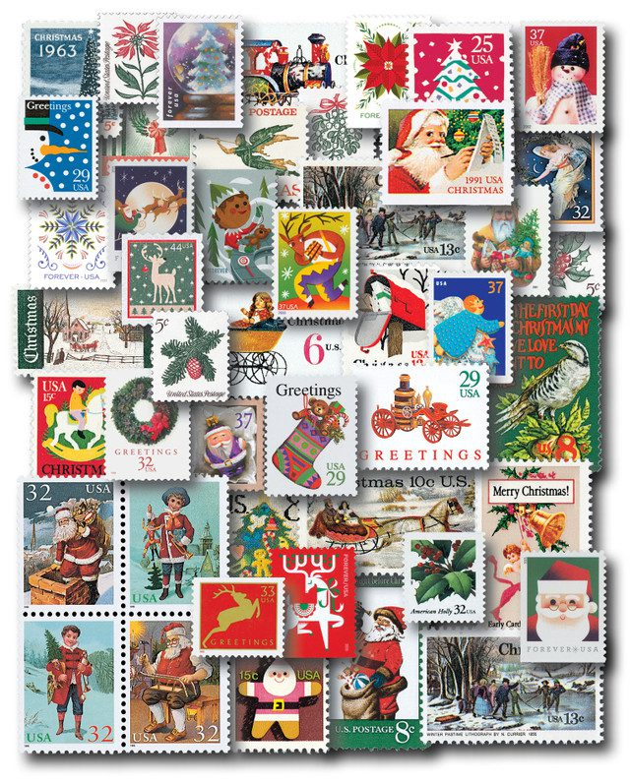
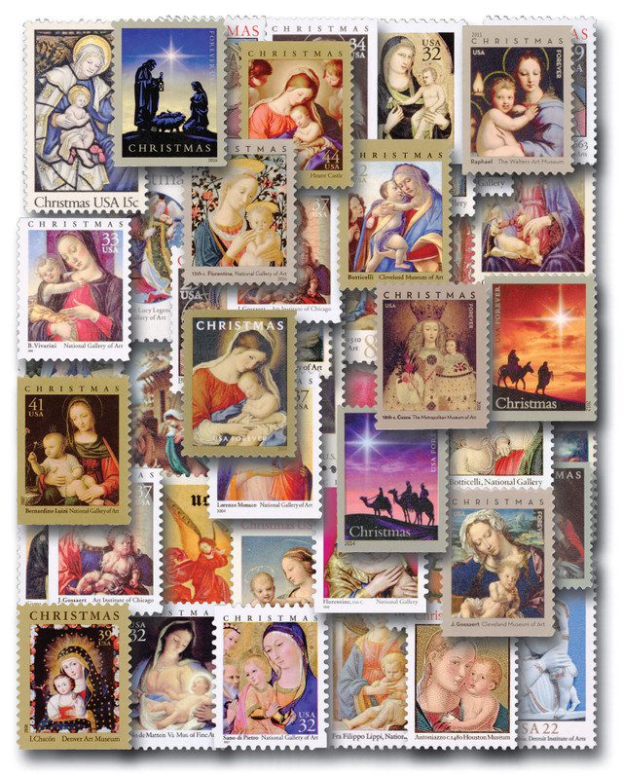
Between 1962 and 2024 the United States has issued no fewer than 275 contemporary and 53 religious Christmas stamps per sales advertising by Mystic Stamp.

Slide 10
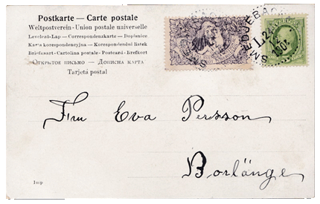


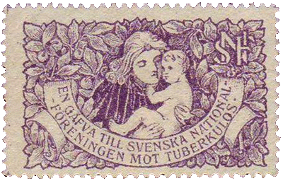
Of course, Christmas has been represented in philately in various ways other than postage stamps. The first “Christmas seal” was released in Denmark in 1904, with Sweden and Iceland following with theirs that same year. Their sale raised money in support of children sick with tuberculosis.
Denmark Sweden’s first seal tied on cover Iceland

Slide 11
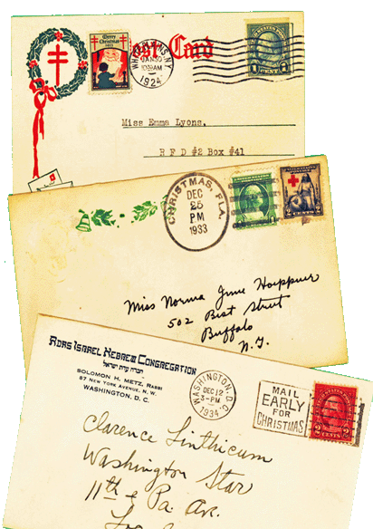
U.S. seals have been around since 1907.
Christmas, Florida is a real place; an unincorporated area in Orange County, originally named Fort Christmas in 1837 for the time of year the fort was built. “Fort" was dropped by the time the first post office opened in 1892.
Slogan postmarks relating to the holiday abound.

Slide 12
USPS has always tried to find unique first day locations for their contemporary and traditional (religious) Christmas releases related to the stamp’s design or the holiday.

Slide 13
The Colnect.com web site lists 383 countries, territories and organizations that have issued 49,206 thematic stamps and Cinderella labels commemorating the many aspects of Christmas.
Presenting them all here would be impossible! It’s easier to use an assortment of worldwide stamps thematically to recount the Biblical story of the birth of the Christ child using stamps depicting paintings and artwork.
The nativity of Jesus is described in the gospels of Luke and Matthew, both written around 75-85 AD. Believed to have been written independently, major details match, but some events are found in either one or the other.
Bible verses presented are from the King James edition

Slide 14
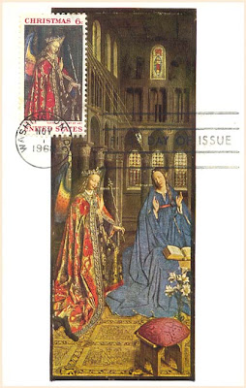
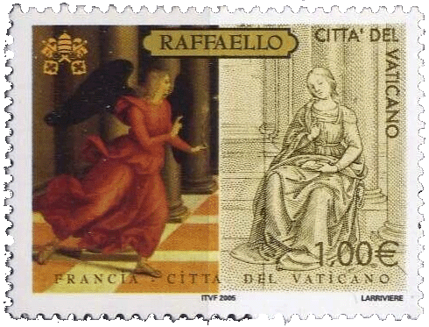
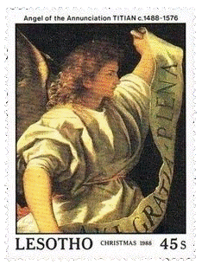
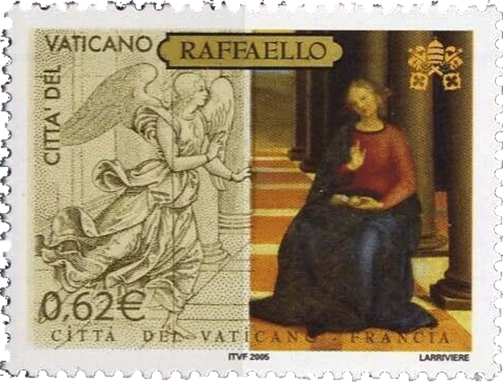
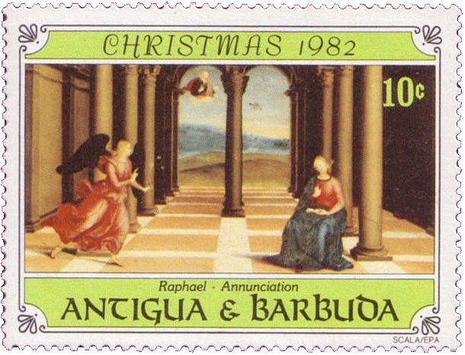
The Annunciation: The announcement by the angel Gabriel appearing to the Virgin Mary in Nazareth that she would divinely conceive a son. summary of Luke 1:26-38

Slide 15
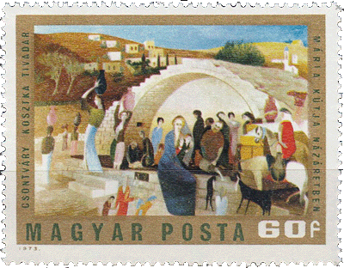
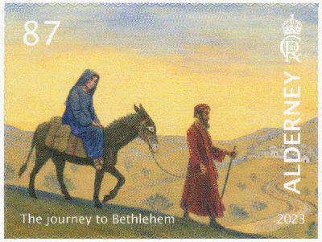
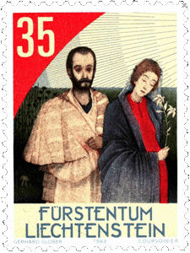
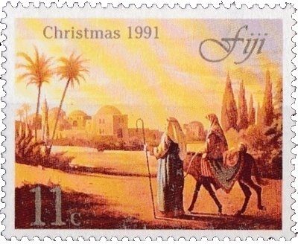
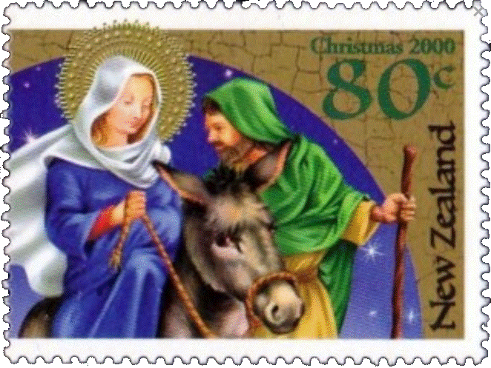
Luke 2:3-4 And all went to be taxed, every one into his own city. And Joseph also went up from Galilee, out of the city of Nazareth, into Judaea, unto the city of David, which is called Bethlehem; because he was of the house and lineage of David.

Slide 16
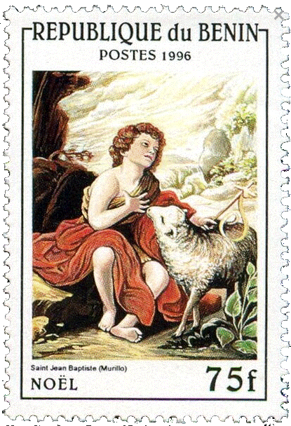
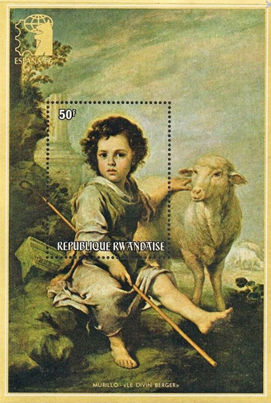
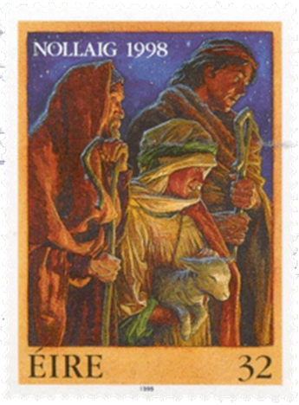
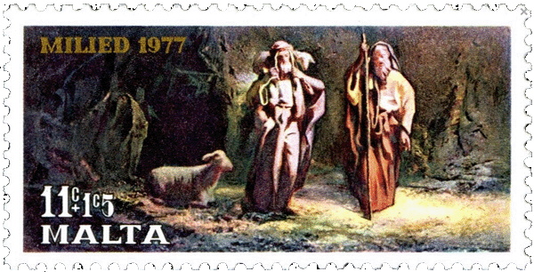
Luke 2:8 And there were in the same country shepherds abiding in the field, keeping watch over their flock by night.

Slide 17
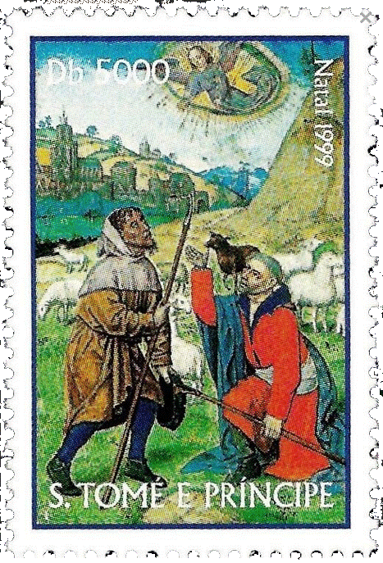

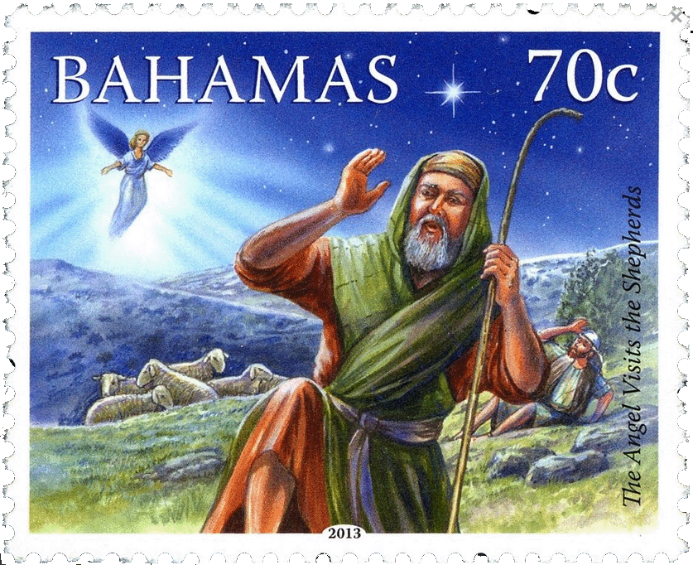
Luke 2:9 And, lo, the angel of the Lord came upon them, and the glory of the Lord shone round about them: and they were so afraid.

Slide 18
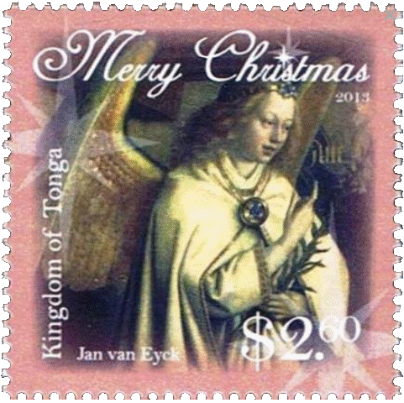
Luke 2:10-12 And the angel said unto them, Fear not: for, behold, I bring you good tidings of great joy, which shall be to all people. For unto you is born this day in the city of David a Saviour, which is Christ the Lord. And this shall be a sign unto you; Ye shall find the babe wrapped in swaddling clothes, lying in a manger.

Slide 19
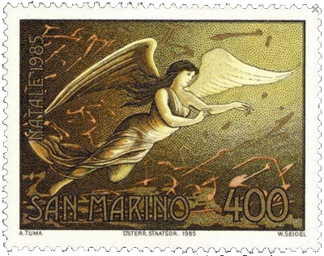
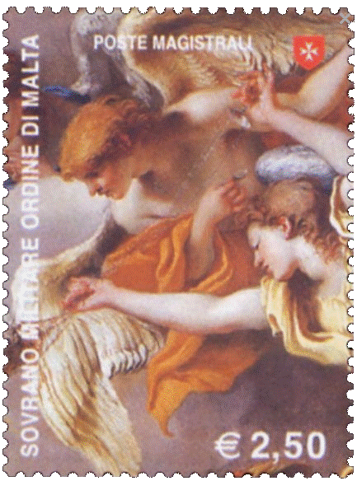
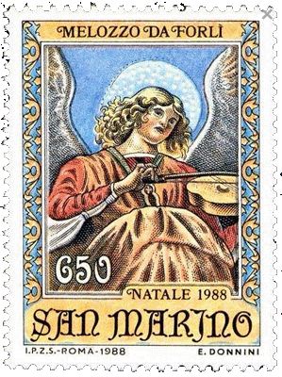
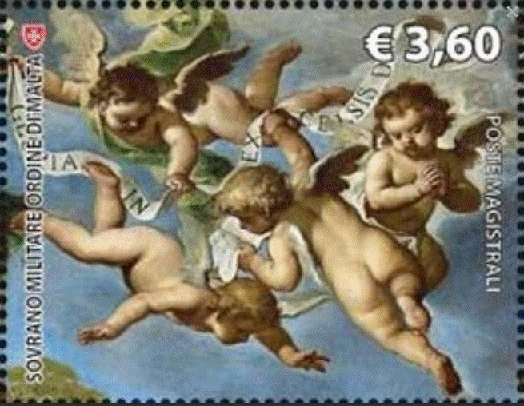
Luke 2:13-14 And suddenly there was with the angel a multitude of the heavenly host praising God, and saying, Glory to God in the highest, and on earth peace, good will toward men.

Slide 20
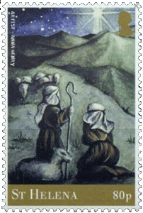
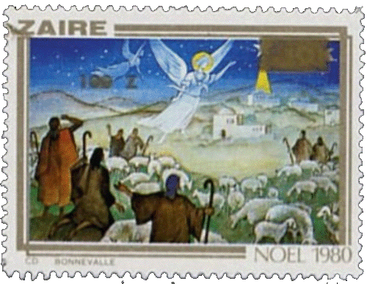
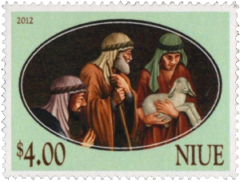
Luke 2:15 And it came to pass, as the angels were gone away from them into heaven, the shepherds said one to another, Let us now go even unto Bethlehem, and see this thing which is come to pass, which the Lord hath made known unto us.

Slide 21
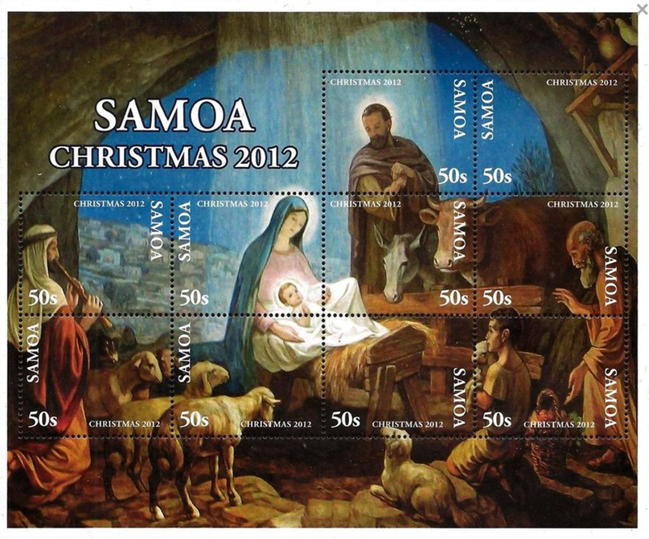
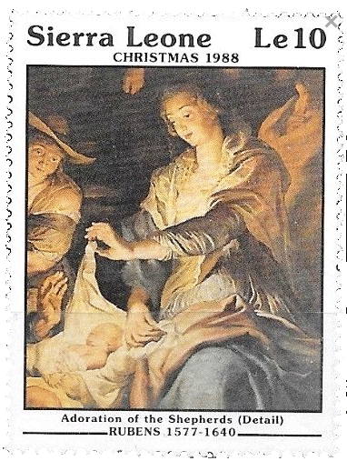
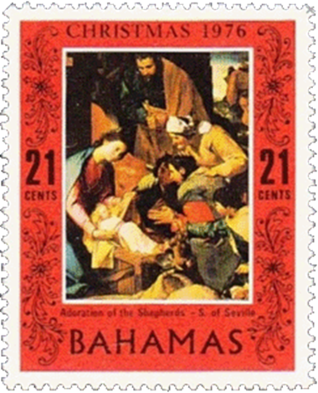
Luke 2:17 And they came with haste, and found Mary, and Joseph, and the babe lying in a manger. And when they had seen it, they made known abroad the saying which was told them concerning this child.

Slide 22

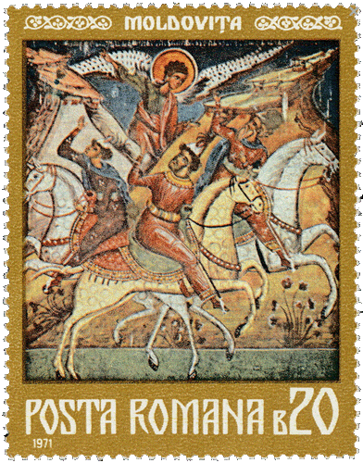
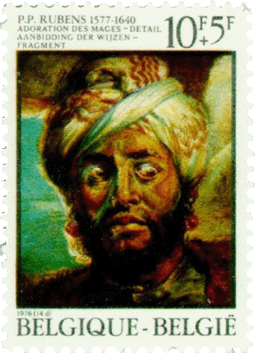
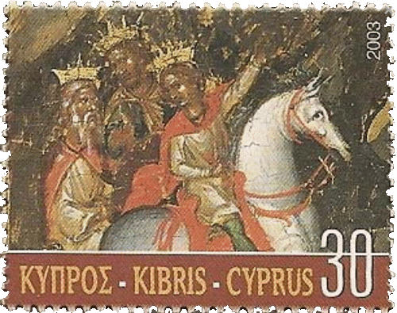
Matthew 2:1-2 Now when Jesus was born in Bethlehem of Judaea in the days of Herod the king, behold, there came wise men from the east to Jerusalem, Saying, Where is he that is born King of the Jews? For we have seen his star in the east, and are come to worship him.

Slide 23


Matthew 2:7-8 When Herod the king had heard these things, he was troubled, and all Jerusalem with him. Then Herod, when he had privily called the wise men, enquired of them diligently what time the star appeared. And he sent them to Bethlehem, and said, Go and search diligently for the young child; and when ye have found him, bring me word again, that I may come and worship him also.

Slide 24




Matthew 2:9-10 When they had heard the king, they departed; and, lo, the star, which they saw in the east, went before them, till it came and stood over where the young child was. When they saw the star, they rejoiced with exceeding great joy.

Slide 25



Matthew 2:11-12 And when they were come into the house, they saw the young child with Mary his mother, and fell down, and worshipped him: and when they had opened their treasures, they presented unto him gifts; gold, and frankincense and myrrh. And being warned of God in a dream that they should not return to Herod, they departed into their own country another way.

Slide 26

Matthew 2:13 And when they were departed, behold, the angel of the Lord appeareth to Joseph in a dream, saying, Arise, and take the young child and his mother, and flee into Egypt, and be thou there until I bring thee word: for Herod will seek the young child to destroy him.

Slide 27


And the rest, as they say, is history!
Thanks for watching.

